Slide 1
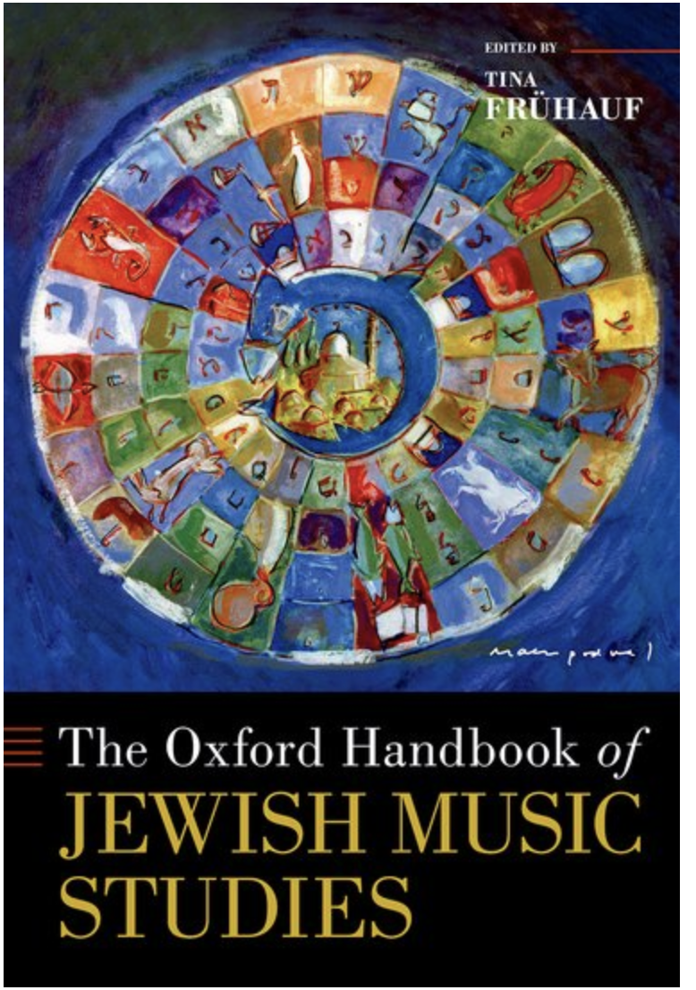
Jewish Music
Sound Recording Collections in the US
J
Jewish Music Sound Recordings
Accessing Collections
History & Challenges
Judith S. Pinnolis
October 18, 2024
For
NEMLA
Based on “Jewish Music Sound Recording Collections in the United States” in The Oxford Handbook of Jewish Music Studies

Slide 2
Is “Jewish music” an academic orphan?
Where does Jewish Music belong?
Jews are often viewed as pan-national. A co-territorial Western cultural group – yet Jewish music most often not included in Western art music history, sacred music, or folk culture classes.
“Exotic”: Mizrahi or Sephardic heritages not often a study group in ethnomusicology courses.
American-based Ashkenazi/Sephardi folk cultures ignored in curriculums (except the occasionally “Klezmer revival music”)

Slide 3
Some
Jewish Cultural Subgroups
Ashkenazi/Sephardi/Mizrahi
Linguistic: Yiddish/Ladino/Judeo-Arabic/Hebrew/European Languages
(4 Major Dialects of Yiddish)
Ashkenazi Subgroups: Western and Eastern
Indian Subgroups: Bene Israel/Malabari-Cochini/Baghdadi
Yemeni

Slide 4
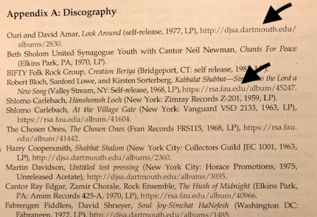
Discography Largely From Online Collections
Dartmouth and FAU
For those doing research….

Slide 5
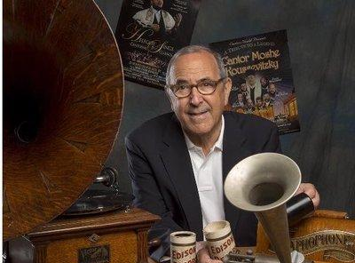
Origin
Stories

Slide 6
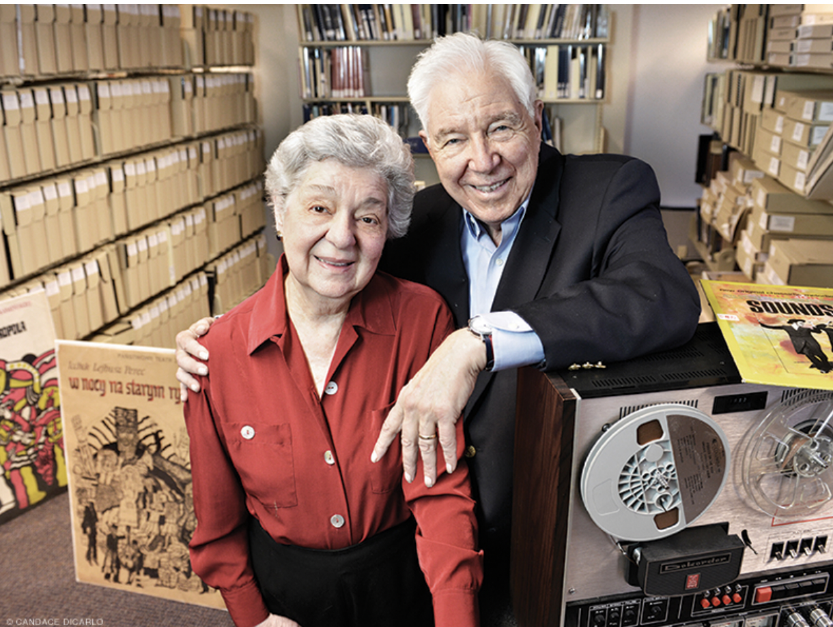
Origin
Stories
Bob and Molly Freedman
https://www.library.upenn.edu/collections/notable/freedman/explore

Slide 7

Joel Bresler’s Sephardic Music
View CD Anthologies from
Jewish Music Research Center,
Hebrew University for samples
from this collection.

Slide 8
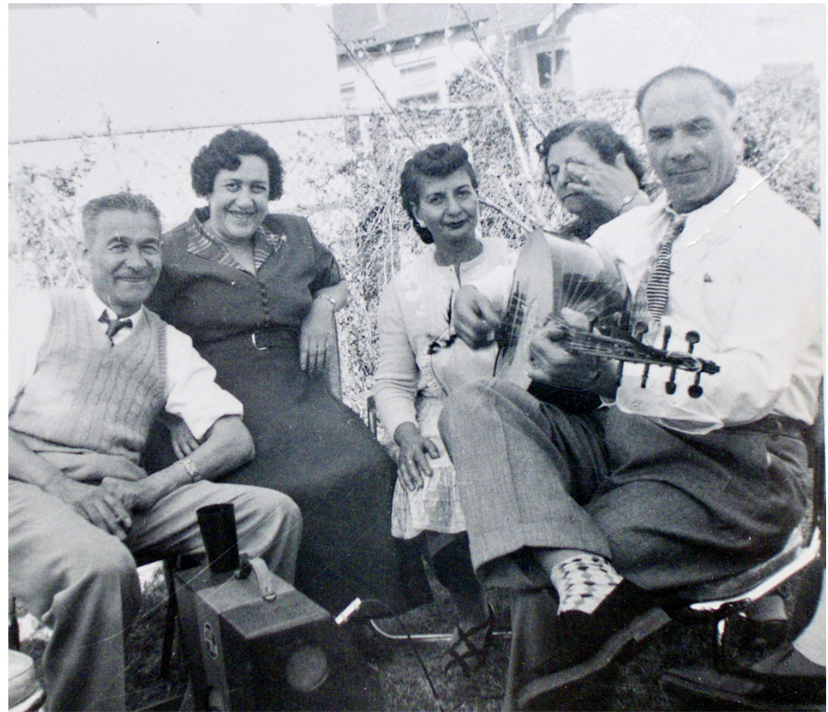
Emily and Isaac Sene
Emily Sene,
Second from left
Isaac Sene on Oud
https://sephardiclosangeles.org/portfolios/emily-senes-sephardic-mixtape/

Slide 9
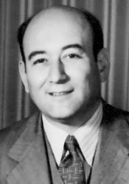
Benedict Stambler (1903-1967)

Slide 10
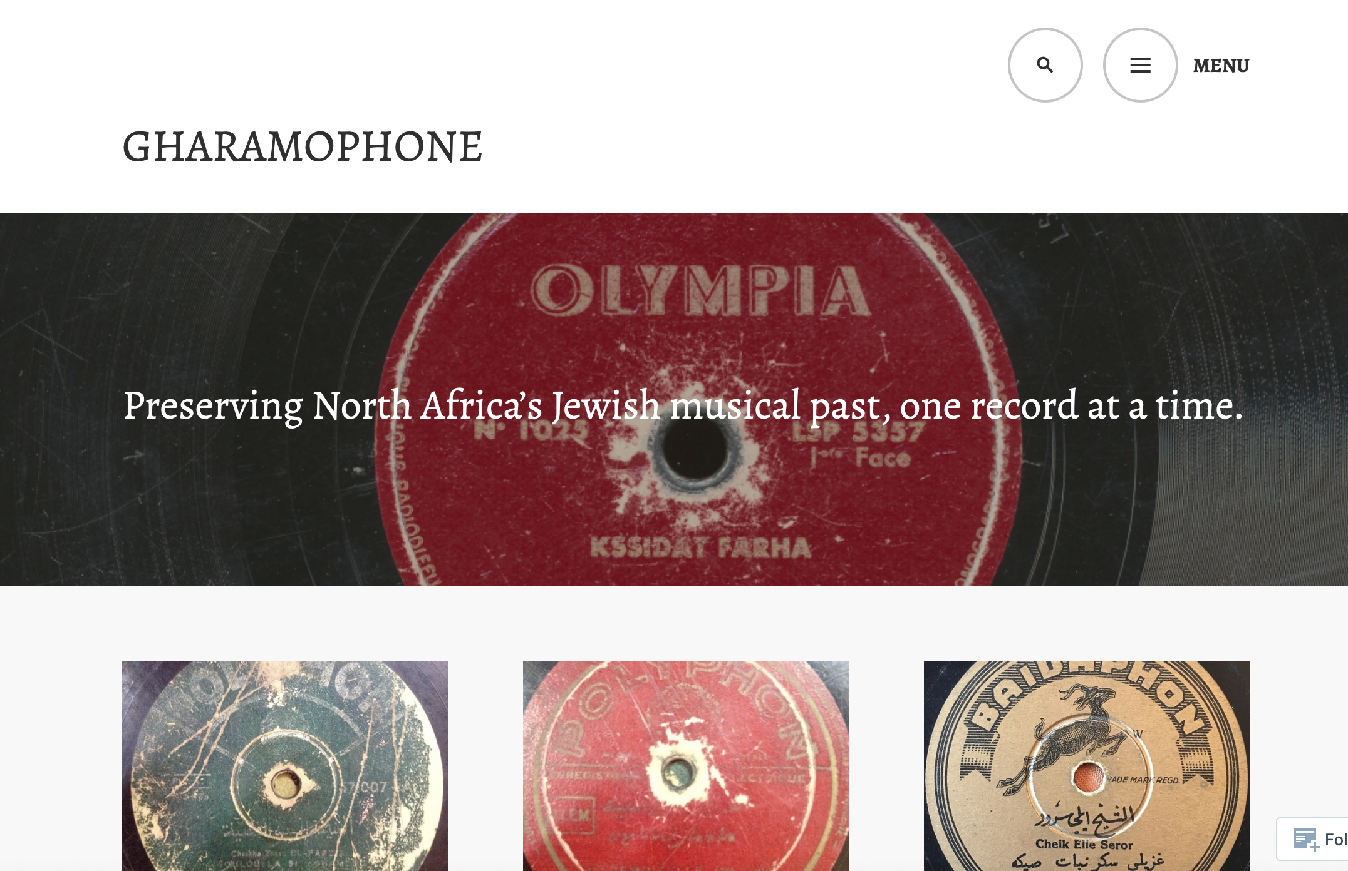
Gharamophone.com
Zohra El Fassia
https://gharamophone.com/2024/02/05/zohra-el-fassia-aita-akki-atta-and-aita-moulay-brahim-pathe-1951/

Slide 11
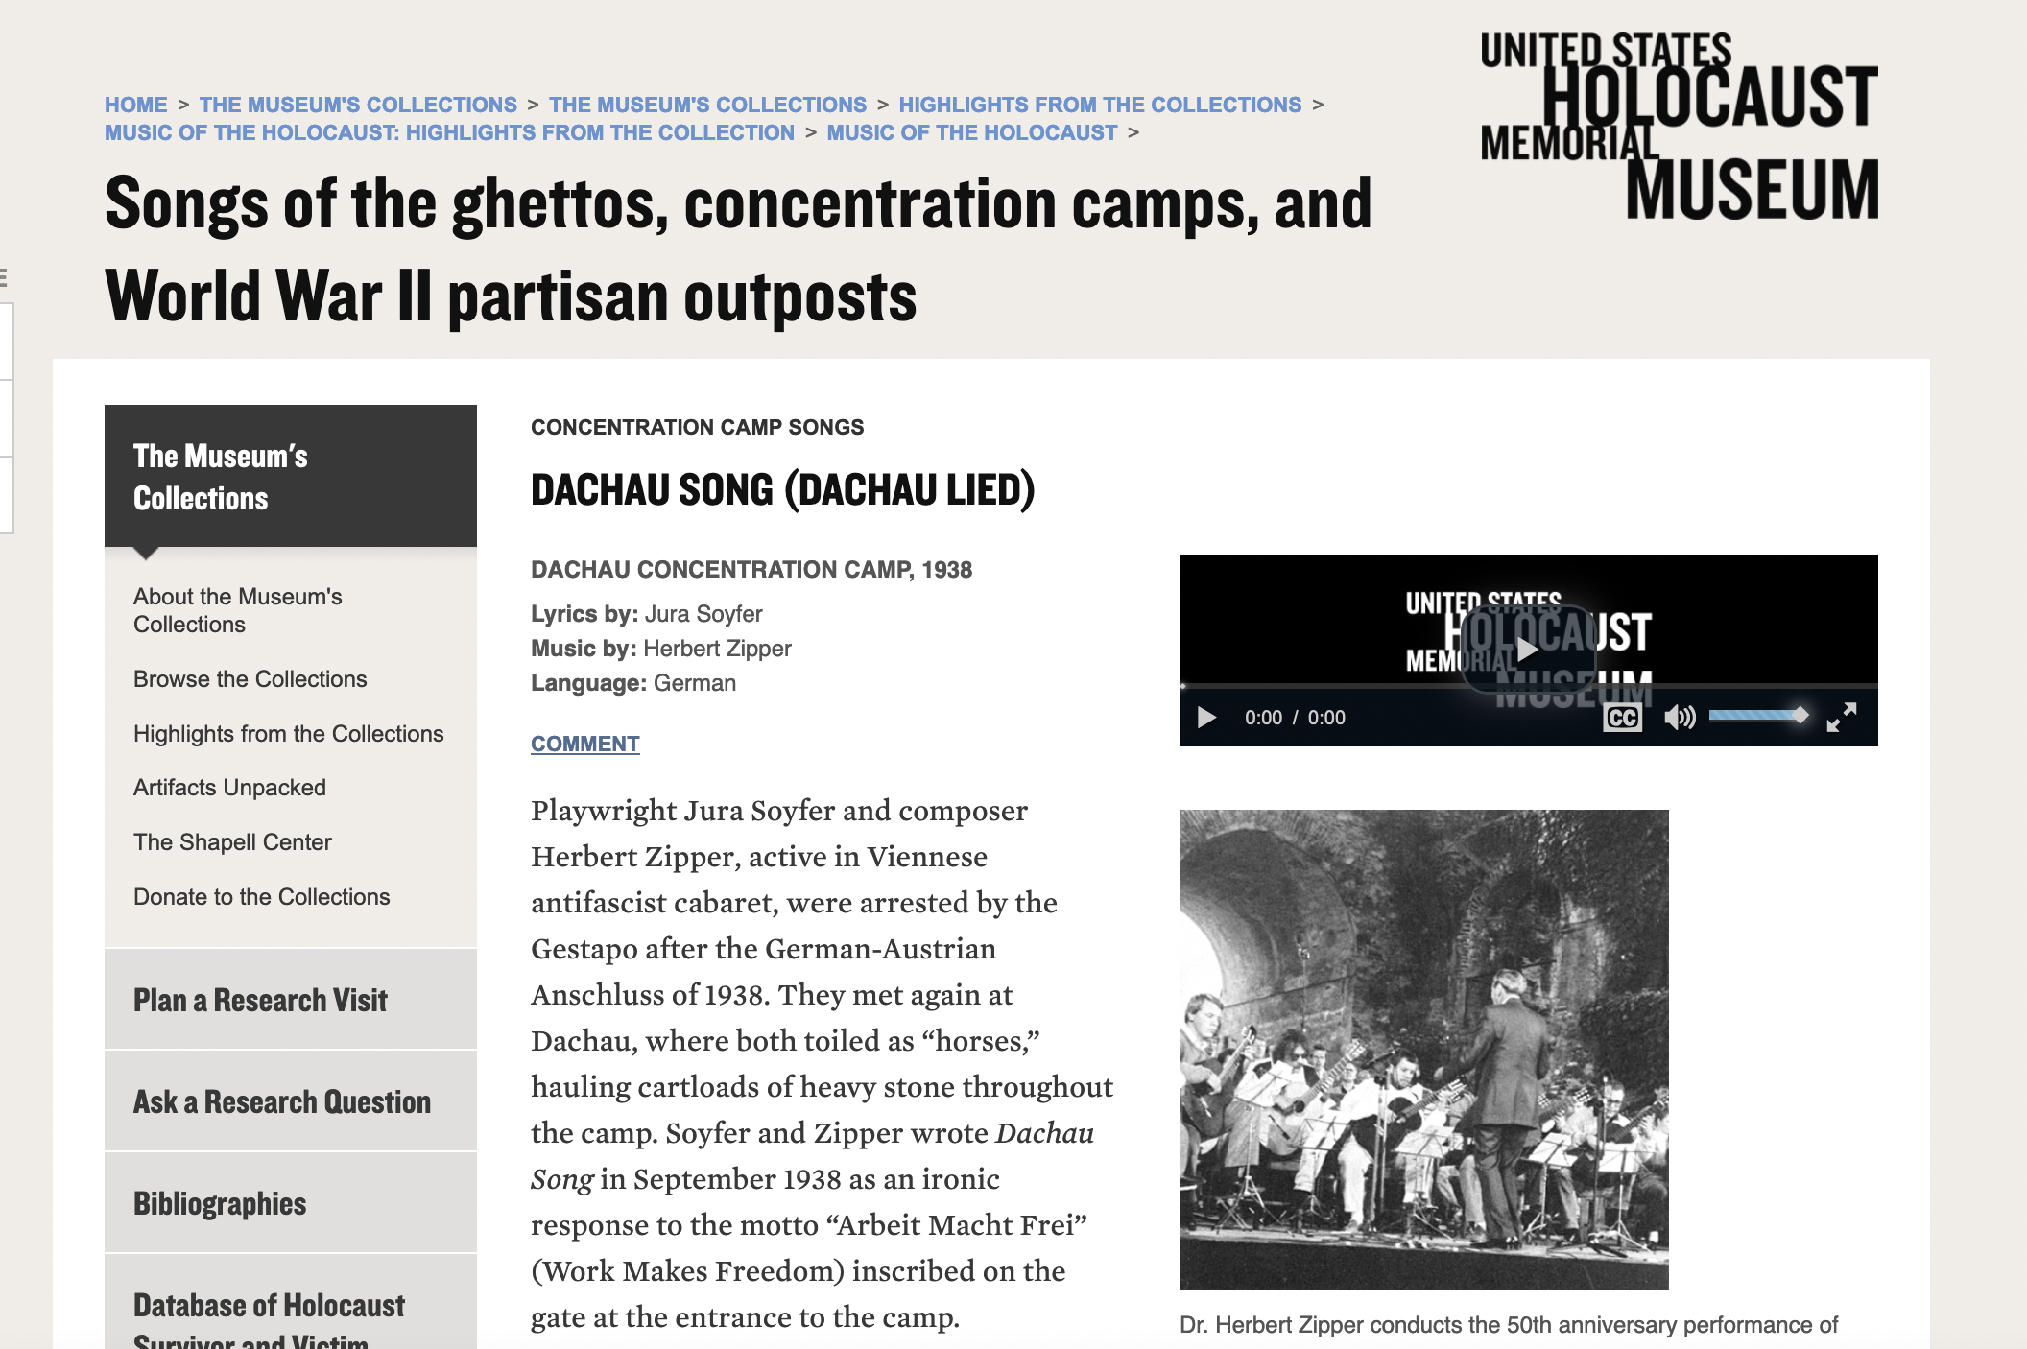
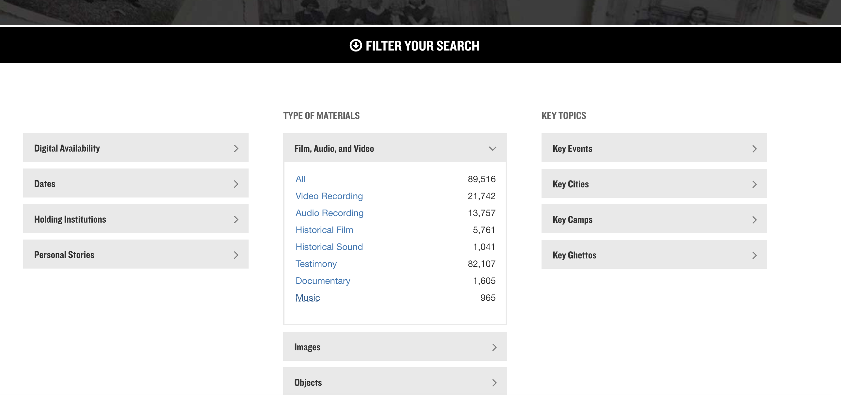
US Holocaust Museum
https://collections.ushmm.org/search/
https://collections.ushmm.org/search/?utf8=%E2%9C%93&q=music&search_field=Subjects+and+Keywords

Slide 12
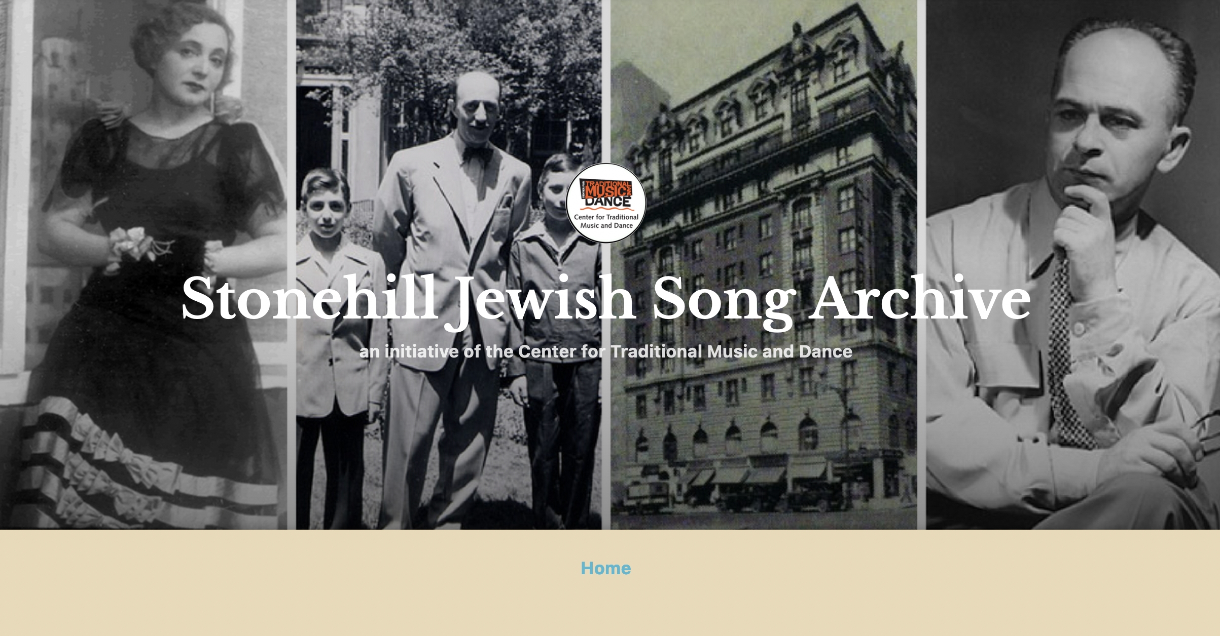
Ben Stonehill Jewish Song Archive
Center of Traditional Music and Dance
Sample:
Ayeder mentsh darf dos farshteyn (Every Person Must Understand This)
https://stonehilljewishsongs.wordpress.com/2018/04/17/0002-ayeder-mentsh-darf-dus-gut-farstheyn-every-person-must-understand-this/

Slide 13
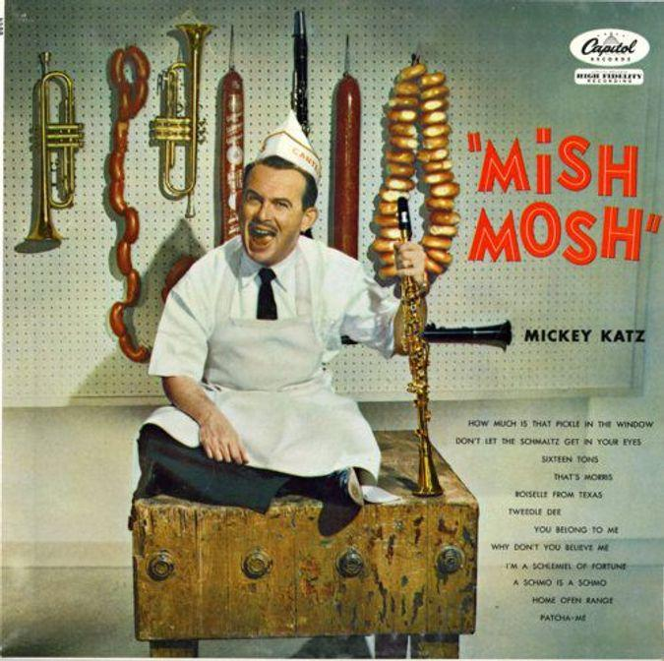
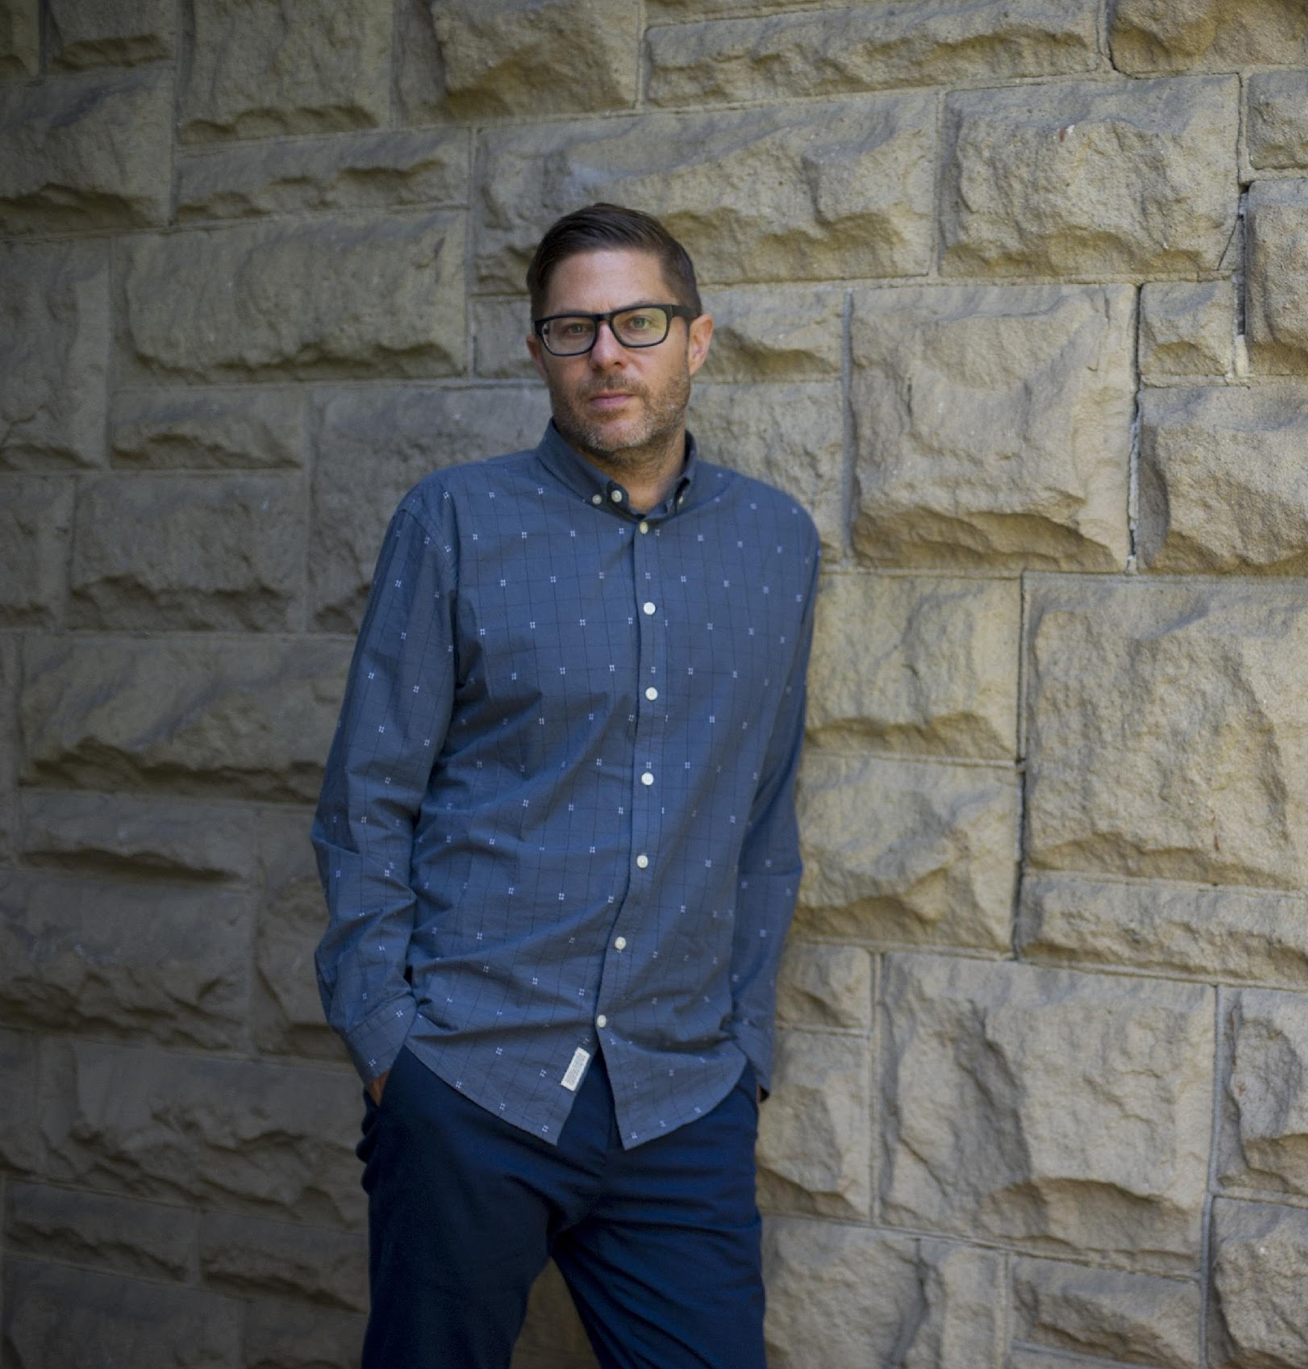
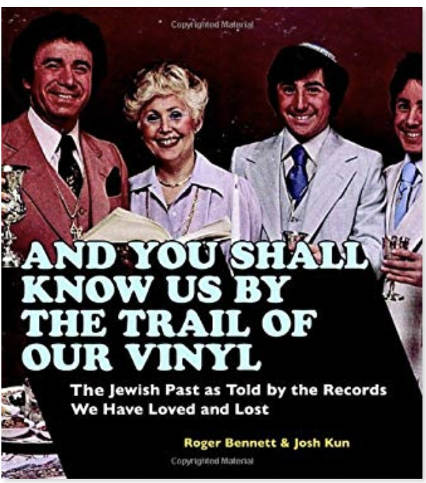
Josh Kun -- LPs only

Slide 14
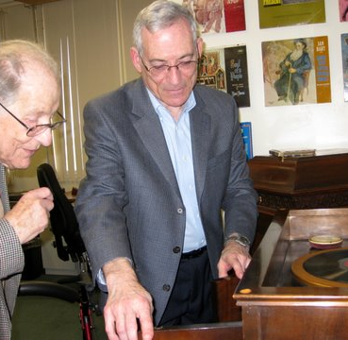
At FAU
Jack Saul (donor collector) and Nat Tinanoff

Slide 15
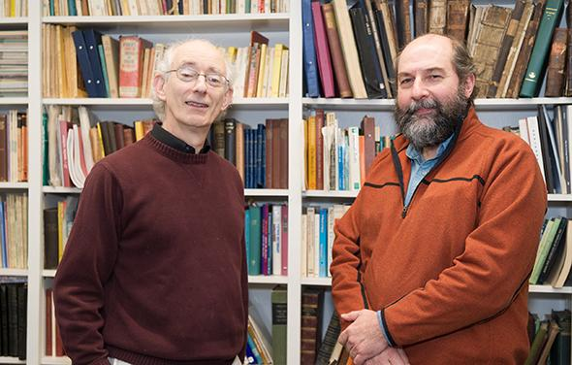
Dartmouth College -- Jewish Sound Archive
https://djsa.dartmouth.edu/TToT
The actual collection of recordings is not owned by the College, only the digital
https://djsa.dartmouth.edu/sound files
To listen to sound files, users must register with the JSA.

Slide 16
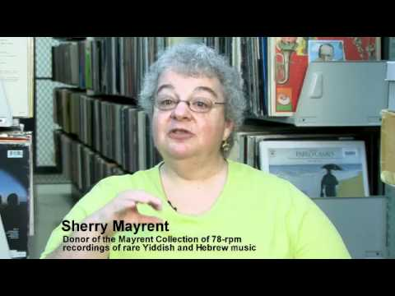
Sherry Mayrent
Collection of
Yiddish Recordings https://search.library.wisc.edu/digital/AMayrentRec
Sample of early Hebrew recording: 1905.
Uv'chaim yitchadesh And life will be renewed
https://digital.library.wisc.edu/1711.dl/6GLNQKFXRW5L48J

Slide 17
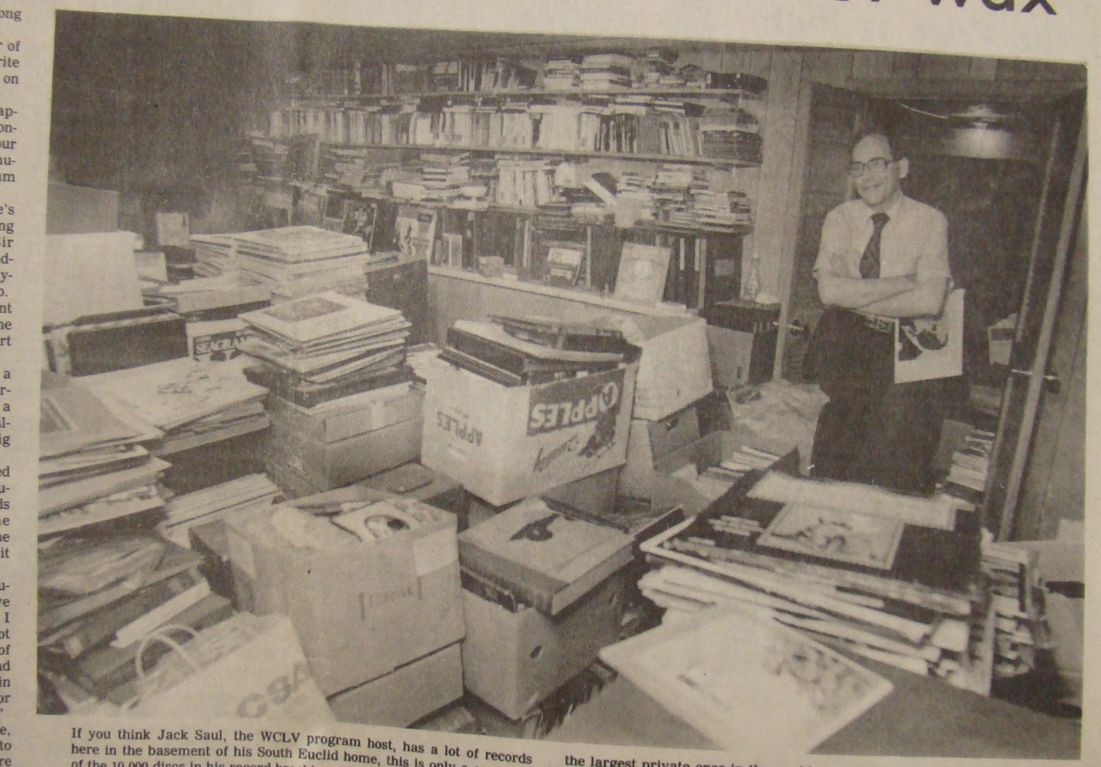
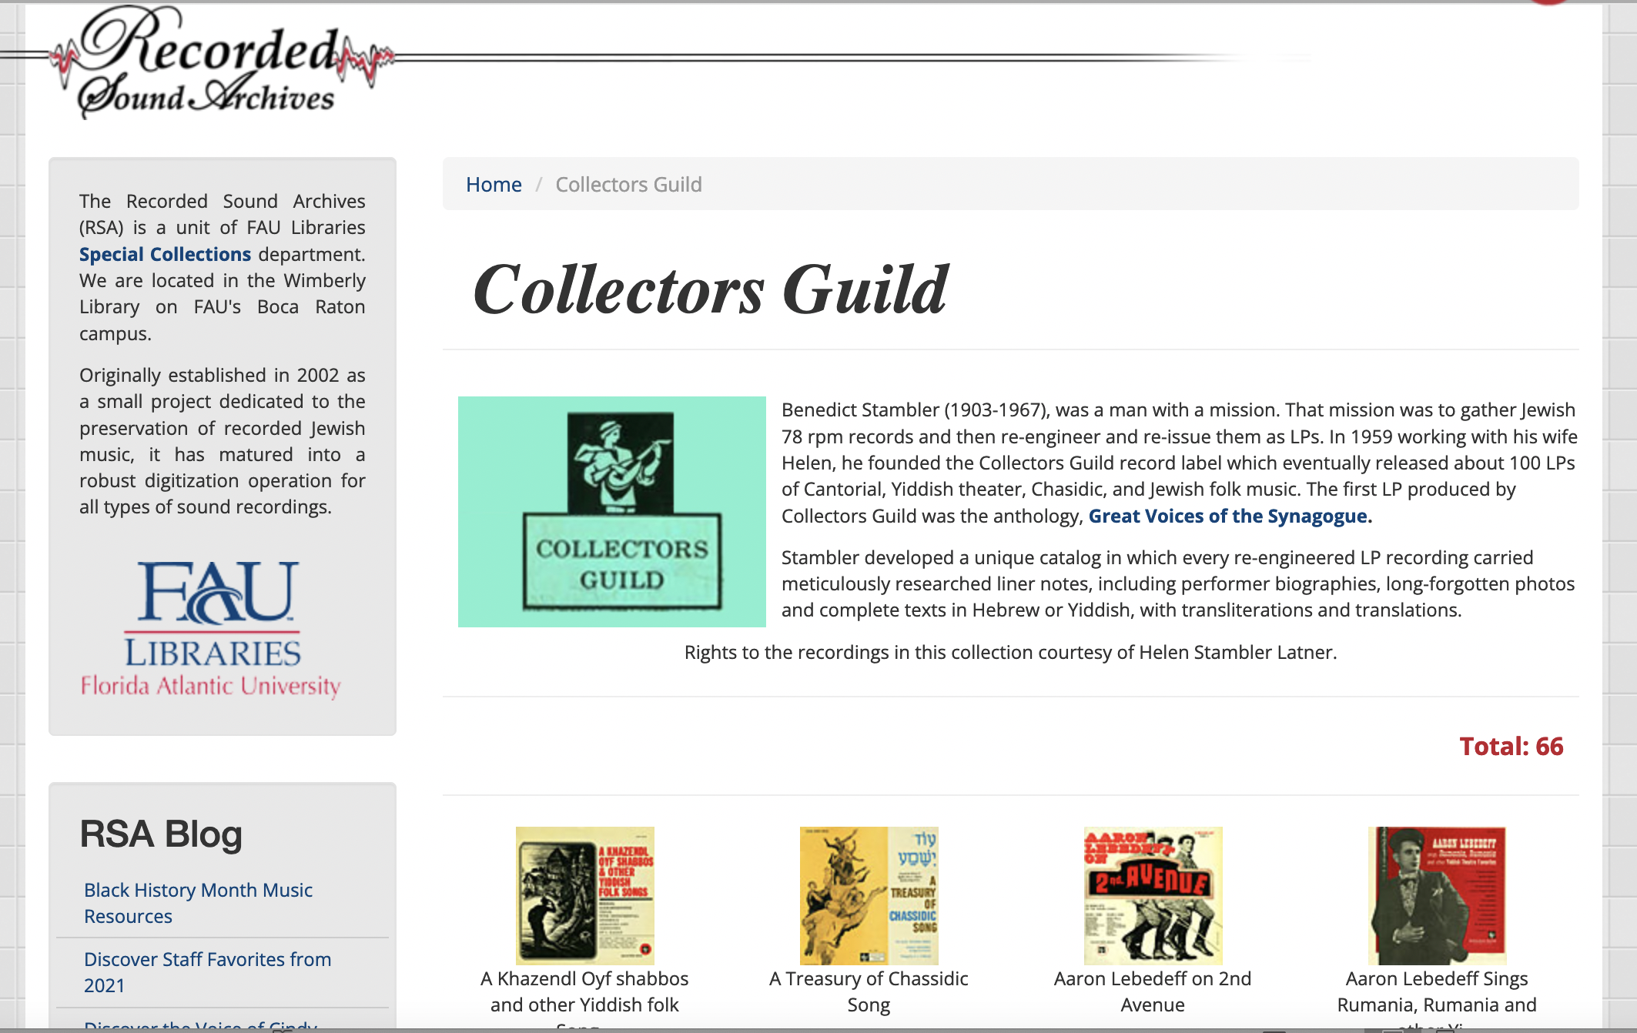
FAU- Collectors Guild
https://rsa.fau.edu/judaic

Slide 18
Difficulties Surrounding Jewish Music Collection in Libraries, Archives and Institutions

Slide 19
Issues in Bibliographic Control
Individual, non-standard cataloging schemes for each collection
Quality of cataloging
Sustainability of cataloging efforts– funding, staff
Use various non-standard orthographies
Different transliterations used (see, Siegel)
Lack of high-level indexing
Lack of name authority files
Variable object level cataloging– album, track, or performance piece

Slide 20
Hidden Collections
  “Hidden” by being uncatalogued
  Lack of funding
  Backlogs
  Few retrospective cataloging projects
  Passionate individual efforts are often haphazard, sporadic
  Lack of cultural understanding
  Collections are decontextualized
  Lack of evaluation of quality of holdings

Slide 21
Format Issues
Transfers to new formats lag behind
Many items never see reformatting
Cultural heritage preservation in multiple formats a necessity
Most cassettes never reformatted**
Estimated that less than 40% percentage of Jewish LPs reformatted
**Cassettes also frequently served as “field recordings” and are extremely fragile.

Slide 22
Cataloging Issues
LC Subject headings are lacking in specificity for Jewish music
  No standard vocabularies
  Lack of proper genres
  Lack of floating subject headings
  As with many folk cultures, categorization doesn’t fit neatly in LC
Generic terms (such as “klezmer”) are descriptors that no longer contain their original meanings

Slide 23
Preservation Issues
In addition to format transfer, there are issues of:
Copyright
Digital formats are not inherently safe harbors of preservation
Digital formats are at particular risk
Specialized equipment necessary for playback– increasingly rare

Slide 24
Rarity of
Jewish sound recordings
Heritage Health Index– 46.4 million recordings in US institutions
Possibly between 150,000-to-250.000 Jewish items
Or, approximately < .5% of the country’s estimated holdings
Issues in Knowing WHAT EXISTS:
No uniform method of enumeration between Jewish collections
No way yet to assess duplication
--An aggegated database may be one solution

Slide 25
Issues for Scholarship: Needs Source Criticism
Authenticity-- Aesthetic needs outweighed normative authenticity
Authenticity of performance practice
Many performing musicians use commercial recordings as the “historical record” that encapsulates an “authentic” Jewish sound (yet, …does it?)
False impression of style and performance practice
Use of contrafacta not indicated
Origins of songs (including composer) and other information, often not indicated or mislabeled (erroneous genre/names also common)
Homogenized/Westernized musical elements
Lush stylizations; variable speeds of early recordings; changes for in-recording studios
Early recordings limited/caused alteration for styles, playing techniques, instrumentation, tempi, length of sections.
Pseudonymns of performers
Sound restoration applied differently across collections
Sound engineering changes from old 78s to digital copy?(78s may have been at 72 or 76 or 80 or 82 when recorded, for example, affecting apparent tempi)

Slide 26
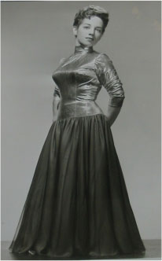

Stylized Renditions by Bas Sheva
Sheyibone Beys Hamikdosh
Capitol Records
1954
Music by Schorr
In the best
20th Century
Hollywood
Tradition….

Slide 27
Using Commercial Recordings for Scholarship
Complementary to field recordings
Commercial recordings outnumber and often predate field recordings of Jewish music in US
Provide Historical performance techniques and styles
Give wider and richer view of musical practice
Provide information not available through conventional written sources
Can provide tracing of evolution of performance practice; comparison between communities; transmission of culture; transformation of culture
Discover musical relationships between “heritage informants”* and performers
* a term I’m using to indicate people who transmit cultural/folk information
Sound Sample:
Harry Kandel's Orchestra 1926, Der mizinikel
(The Youngest Son)
https://digital.library.wisc.edu/1711.dl/SKCN2ZTDYWEOO87

Slide 28
Static vs Digital Collections
Static nature of current sound recording collections
Digital collections going forward– how are they being collected?
  Digitally-licensed music
  Online-only copyrighted music
Distribution through Jewish music apps
Capturing Web-based/born digital.
Composers/ band
Youtube channels, etc.
Practically nothing of much of the culture on sites like Spotify
Sound Sample
𝑀𝑖’𝑚𝑎’𝑎𝑚𝑎𝑘𝑖𝑚 𝑘𝑒’𝑟𝑎𝑡𝑖𝑘ℎ𝑎 𝐻𝑎𝑠ℎ𝑒𝑚 𝐴𝑑𝑜𝑛𝑎𝑖 𝑠ℎ𝑖𝑚𝑎ℎ 𝑣’𝑘𝑜𝑙𝑖
From the depths I cry out to You O Lord, listen to my voice
From Psalm 130.
Joey Weissenberg and Hadar Ensemble, 2021.
https://www.youtube.com/watch?v=Pmy_vIA4XYU

Slide 29
Thanks for Listening!
Contact:
Judy Pinnolis jpinnolis@berklee.edu

