Slide 1

A New Process for Getting Involved in MLA’s Committees and Subcommittees
NEMLA Annual Meeting, October 2024
Sonia Archer-Capuzzo
smarcherdma@gmail.com
The Committee Management Team (CMT)
cmt@musiclibraryassoc.org

Slide 2
Why would I want to get involved in MLA?

Slide 3
What is the Committee Management Team?
Charged with coordinating an annual recruitment and selection process for MLA committee and subcommittee members and chairs
Process meant to be transparent, easy, and inclusive
Tasks:
Identify vacancies
Advertise and recruit
Monitor data submitted via the interest form and share with chairs
Assist chairs as needed
Evaluate the process regularly

Slide 4
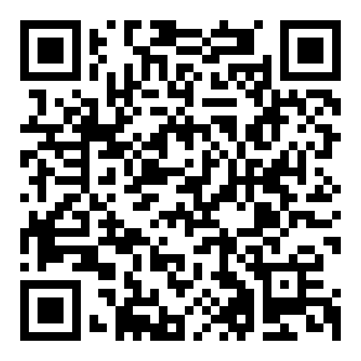
The Process
You express interest in joining and/or chairing one or more MLA committees/subcommittees
Committee Interest Form (QR code to left)
Your form is shared with the CMT
The CMT shares your interest form with the chair(s) of the committee(s)/subcommittee(s) you expressed interest in joining/chairing
The committee/subcommittee chair(s) select new members

Slide 5
What if I have limited or no service experience?
No problem!
Any MLA member in good standing can serve on a committee/subcommittee
Fresh perspectives are valuable
This is where you can gain experience
Some positions may be out of reach, but others are great for early career, student, and newly-involved members.

Slide 6
How do I join a committee / subcommittee?
Express your interest in joining one or more committees/subcommittees using the new Committee Interest Form
Deadline for interest forms is the business day after the end of all MLA annual meeting activities (March 31, 2025)
Submit a new interest form each year you want to join a new committee/subcommittee

Slide 7
How do I express interest in chairing a committee / subcommittee?
Express your interest in chairing a committee/subcommittee using the new Committee Interest Form
Deadline for interest forms will be around the beginning of November (November 1, 2024)
*Deadline for interest forms for the Nominating Committee is the same as that for chairs (November 1, 2024)
Submit a new interest form each year you want to chair a new committee/subcommittee, even if you are being directly recruited for that position

Slide 8
Am I guaranteed a place on a committee / subcommittee?
No, but…
Some committees/subcommittees will have limited or no vacancies
You can be considered for multiple committees/subcommittees by filling out one form
There are other ways to get involved with MLA that CMT doesn’t cover
  Interest groups
  Editors
  Special Officers
  Board
  And more…

Slide 9
What if I change my mind?
It happens. Just let us know.
cmt@musiclibraryassoc.org

Slide 10
Important links and dates
Interest Form: https://wp.musiclibraryassoc.org/committee-interest-form/
CMT webpage: https://www.musiclibraryassoc.org/page/ServeMLA
FAQs: https://docs.google.com/document/d/1IQ5k2uIn7KQWxmFqJ1F_4WlcUxrgjnMdPvmyttb_CH4/edit?usp=sharing
Deadline for chair interest forms: November 1, 2024
Deadline for Nominating Committee interest forms: November 1, 2024
Deadline for membership interest forms: March 31, 2025

Slide 11
Thanks!
Questions?
Sonia Archer-Capuzzo
smarcherdma@gmail.com
MLA Committee Management Team
cmt@musiclibraryassoc.org

