Slide 1
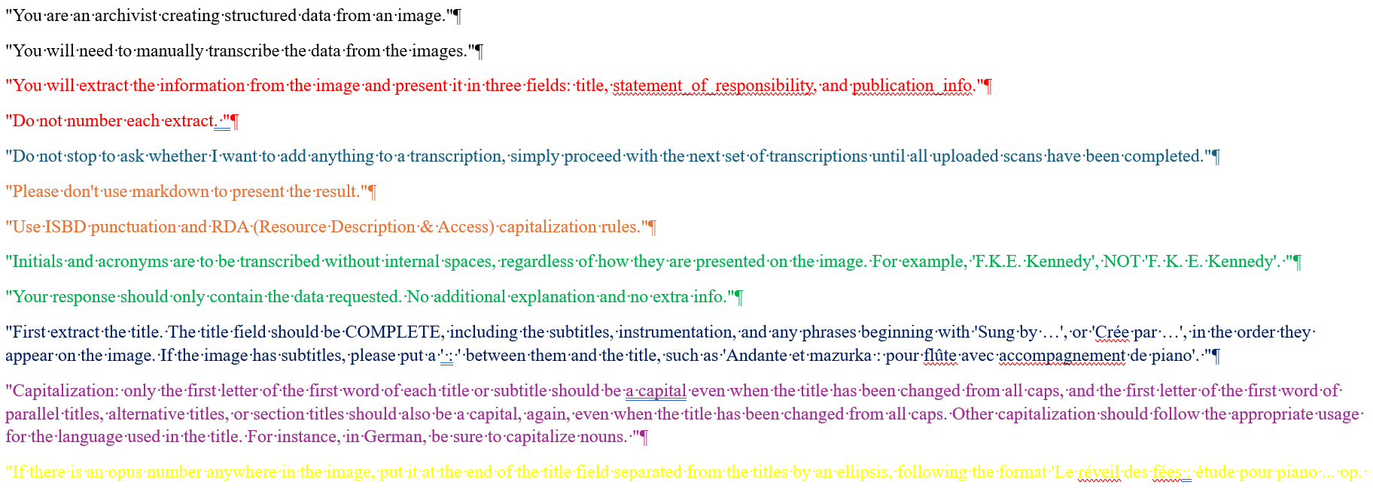

AI Can Change Your Life (Can’t It?): creating rudimentary sheet music contents notes with ChatGPT
Andrea Cawelti
New England Music Library Association
October 18, 2022

Slide 2
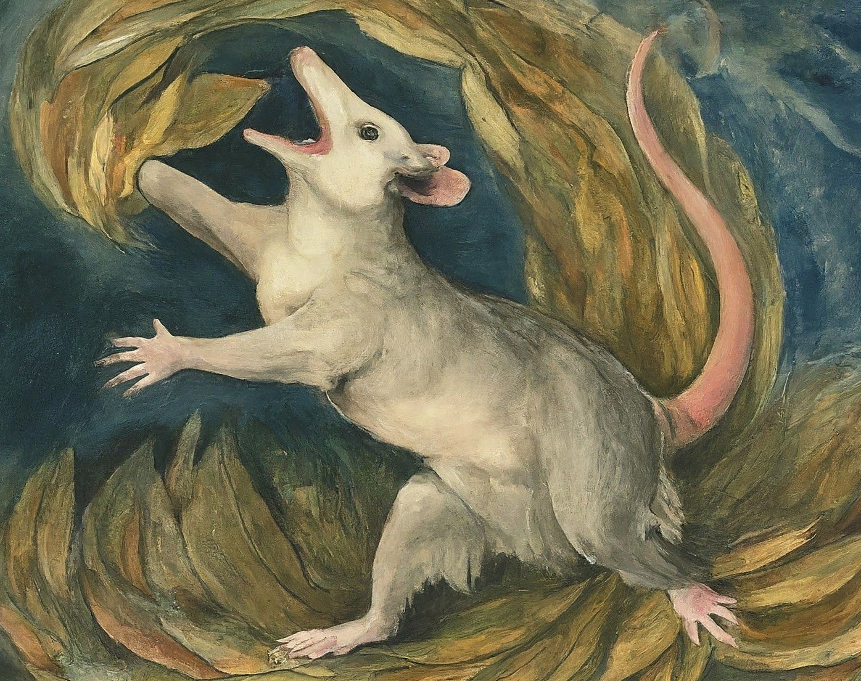
Opossum, transfigured in the manner of William Blake.
Created by Gemini, 17 May 2024, under the watchful eye of Andrea Cawelti

Slide 3
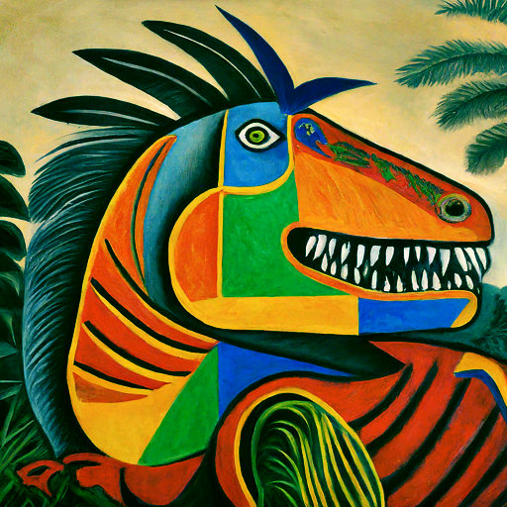
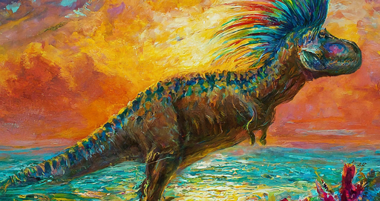
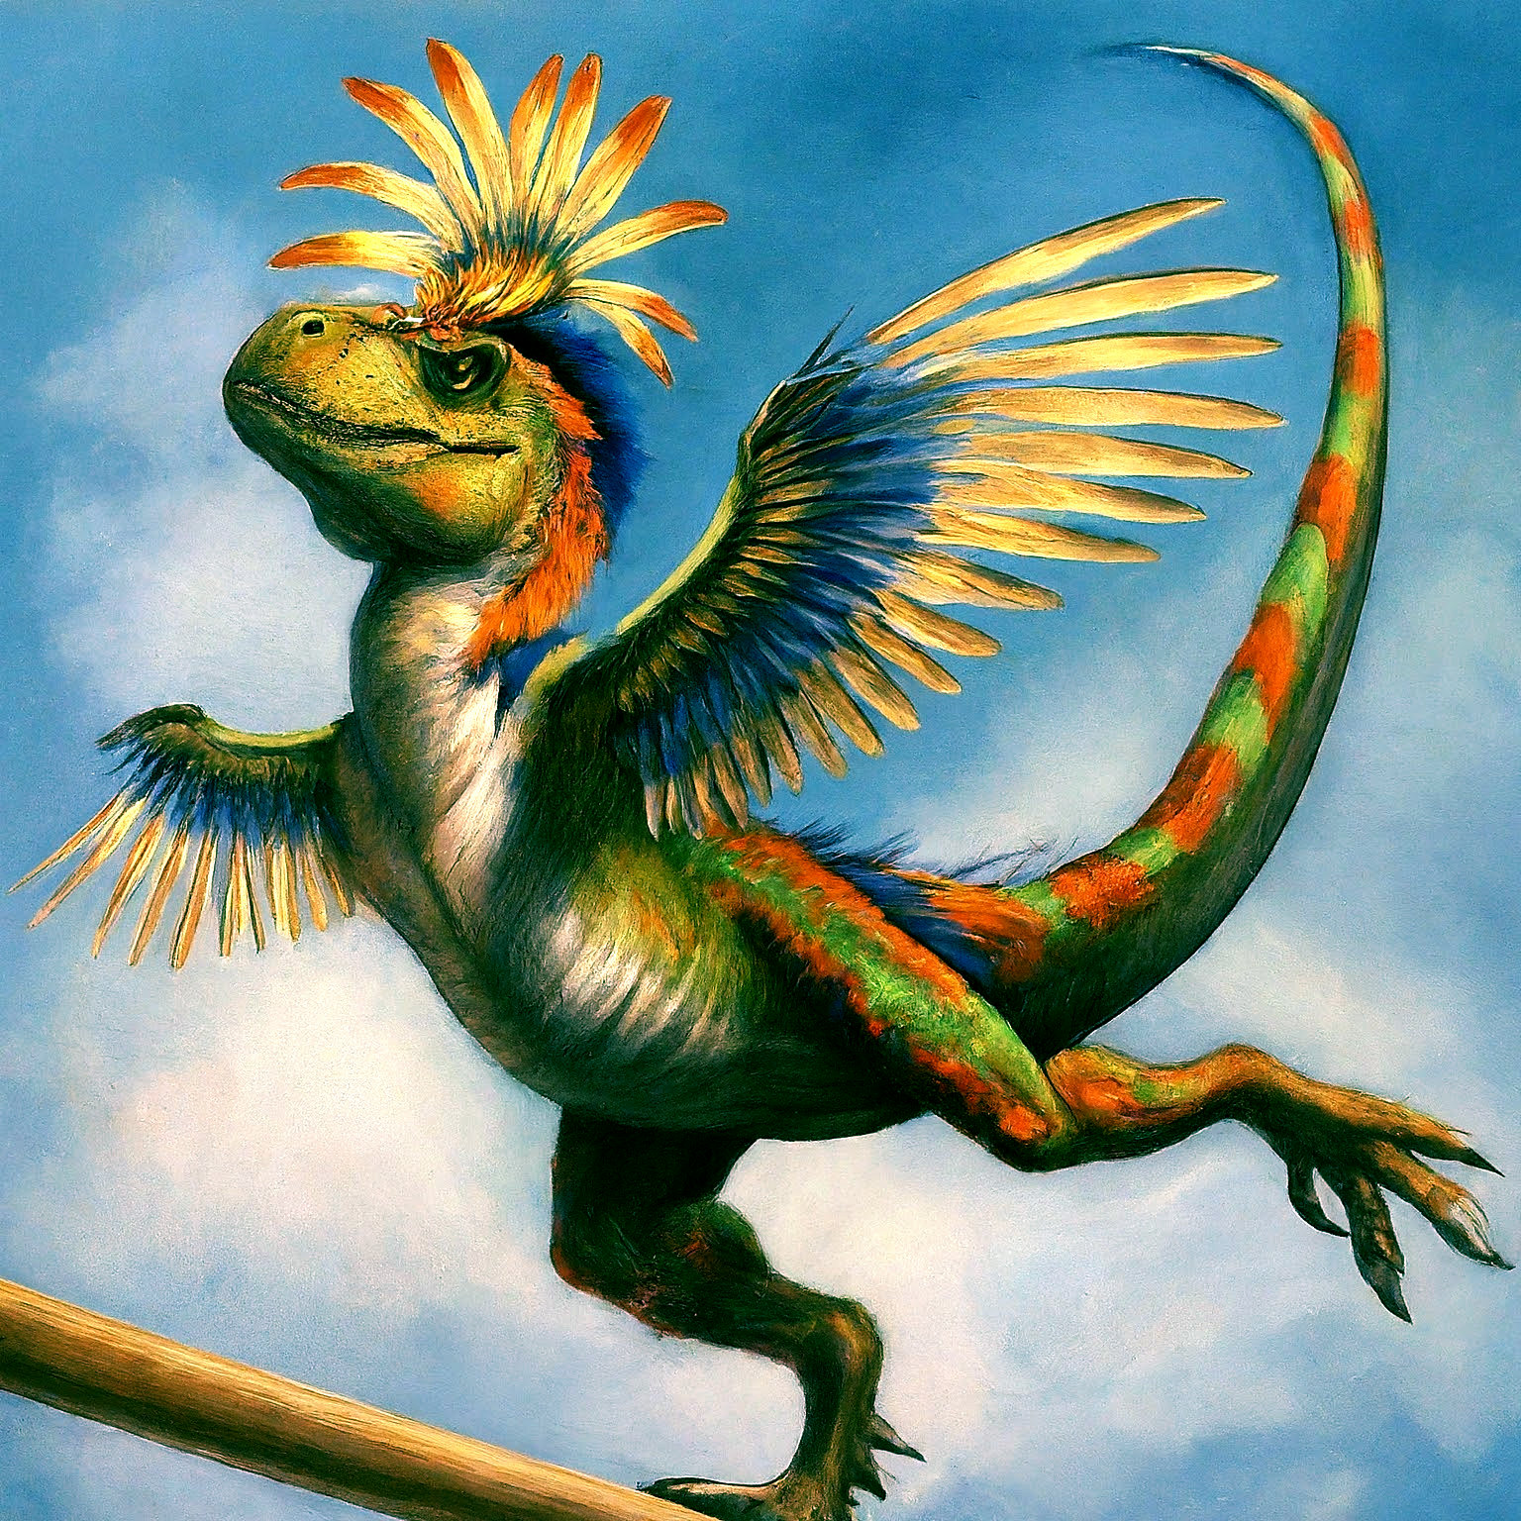
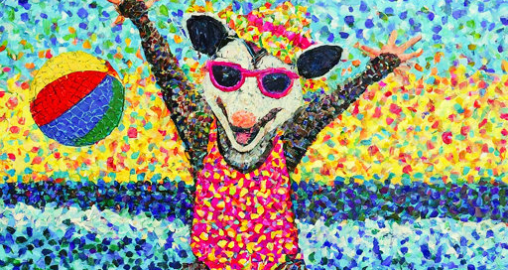
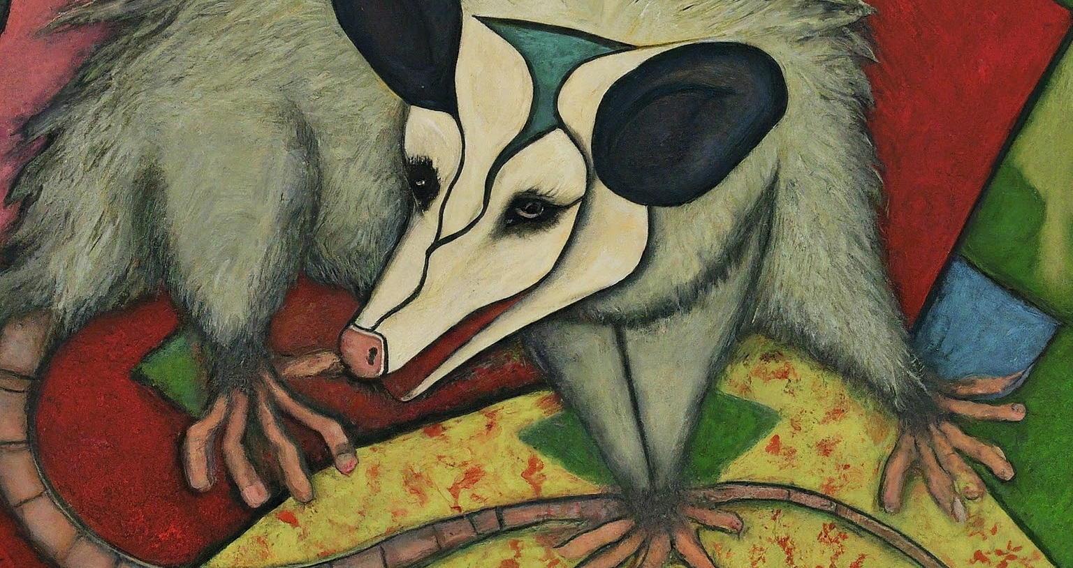
Gemini cannot yet create every prompt equally well

Slide 4
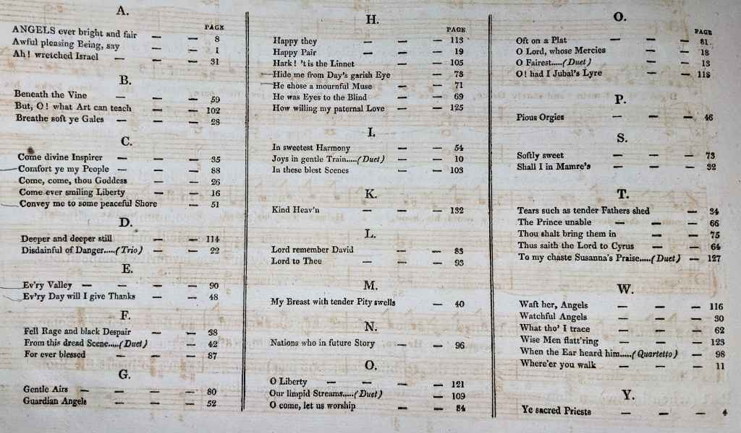
Ensure that your AI understands what you want it to do.

Slide 5
Three parts necessary for a successful prompt:
A description of the overall situation: You are a book cataloger, creating a MARC record for a song collection ...
Details of the request, preferably in a specified order: First, create a 505 note ONLY, with ISBD punctuation and RDA (Resource, Description & Access) capitalization rules, from text transcribed from this image …
Specification of the output: Here are the first four examples, with the specified format: Angels ever bright and fair -- Awful pleasing being, say -- Ah! wretched Israel -- Beneath the vine -- …

Slide 6
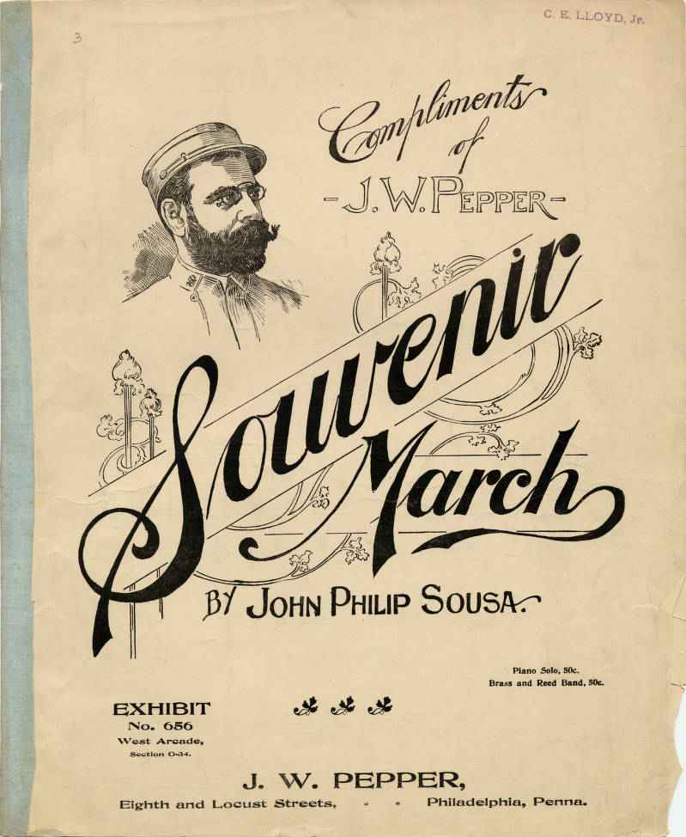
C. E LLOYD, Jr.
Compliments -J.W.PEPPER-
Souvenir March BY JOHN PHILIP Sousa
EXHIBIT No. 656 West Arcade, Section 0-34.
Eighth and Locust Streets,
J. W. PEPPER,
Piano Solo, 50с. Brass and Reed Band, 50c.
Philadelphia, Penna.

Slide 7
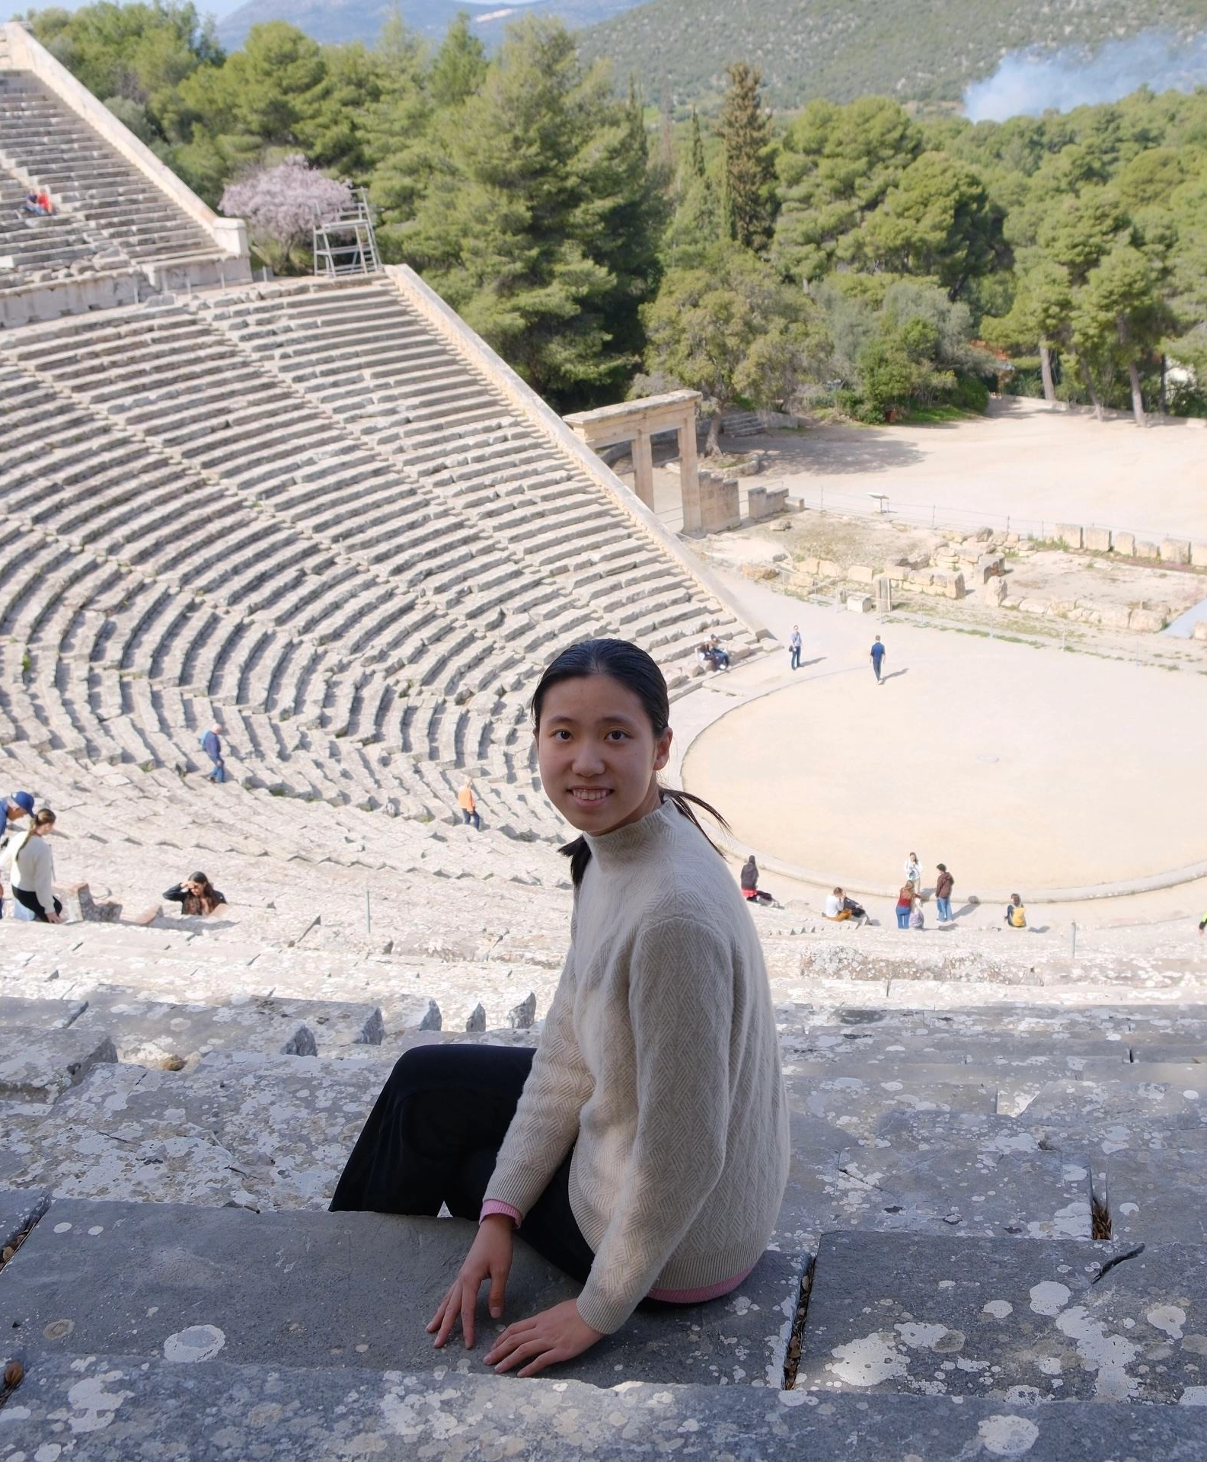
Helen (Hairong) He
With rigorous training in both Machine Learning and classical literature, I love to bridge gaps. With my skills in ML (Machine Learning), NLP (Natural language Processing), CV (Computer Vision), Generative AI, literary and art historical research, and art tech curation, I want to weave art and technology into new, surprising, and impactful ways of storytelling.
My mission is to responsibly use AI technology to foster greater empathy for cultural diversity and global humanity. I have a zeal for building things and care just as much about the academic influence of my work as its public impact.

Slide 8
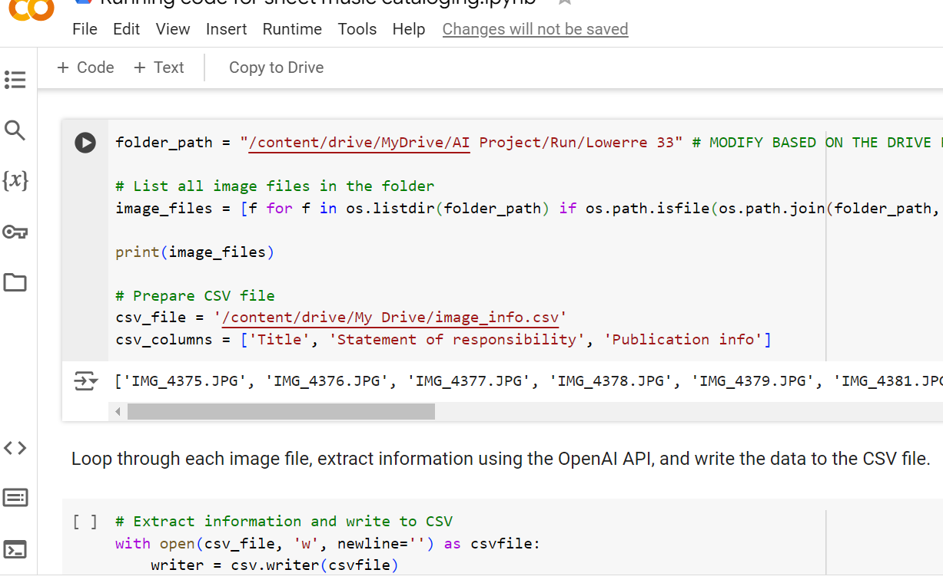
Nascent Python code

Slide 9
BACK UP EVERYTHING:
Your scans/photos
All iterations of your prompts, with dates, and notes where needed for clarity
Documentation will save the day, should you have a crash or heaven forfend, a change of AI tool!

Slide 10
What to scan:
Cover/tp if not too complex
Cover if caption doesn’t include publisher
Caption if there is no date anywhere else
Caption if metadata is the same, no date, but there is a plate number on caption
Caption if there is a list title page
You don’t need to rotate your scans/photos if your camera stores them sideways

Slide 11
Description of the overall situation:
You are an archivist creating structured data from an image.
You will need to manually transcribe the data from the images.
You will extract the information from the image and present it in three fields: title, statement_of_responsibility, and publication_info.
Do not number each extract.
Do not stop to ask whether I want to add anything to a transcription, simply proceed with the next set of transcriptions until all uploaded scans have been completed.
Please don't use markdown to present the result.
Use ISBD punctuation and RDA (Resource Description & Access) capitalization rules.
Initials and acronyms are to be transcribed without internal spaces, regardless of how they are presented on the image. For example, 'F.K.E. Kennedy', NOT 'F. K. E. Kennedy'.
Your response should only contain the data requested. No additional explanation and no extra information.

Slide 12
Details of the request, step by step, in a specified order if this matters:
First extract the title. The title field should be COMPLETE, including the subtitles, instrumentation, and any phrases beginning with 'Sung by …', or 'Crée par …', in the order they appear on the image. If the image has subtitles, please put a ' : ' between them and the title, such as 'Andante et mazurka : pour flûte avec accompagnement de piano'.
Capitalization: only the first letter of the first word of each title or subtitle should be a capital even when the title has been changed from all caps, and the first letter of the first word of parallel titles, alternative titles, or section titles should also be a capital, again, even when the title has been changed from all caps. Other capitalization should follow the appropriate usage for the language used in the title. For instance, in German, be sure to capitalize nouns.
If there is an opus number anywhere in the image, put it at the end of the title field separated from the titles by an ellipsis, following the format 'Le réveil des fées : étude pour piano ... op. 41'.
On some title pages, you will find a list of individual titles, one of which may be specifically underlined or highlighted. In such cases, identify only the underlined or highlighted title, and add it to the main title transcription as a subtitle. Do not be influenced by the layout or position of other titles on the page: focus exclusively on identifying and transcribing the underlined or highlighted title as the subtitle.
Second, extract the statement_of_responsibility field should also transcribe words like 'by', 'par', 'von', etc. exactly as it is in the image.

Slide 13
Details of the request, step by step, in a specified order if this matters, continued
Third, extract publication_info field should be in the format of 'Place of publication : publisher, date' and should include only ONE publisher, the most predominant one.
If there is any kind of statement on the image with the word 'edition' or 'ed.' in it, in any language, please include this statement in the 'publication_info' before the 'Place of publication : publisher, date'. Please look carefully for these edition statements, as they can be found at the head of the title, anywhere within the main title information, or even at the foot of the page.
If place of publication, or publisher, are not found, DO NOT SUPPLY. Prefer publisher from caption title rather than copyright statement, when both are present.
Dates sometimes appear in small print at the bottom of the page, or under a caption title, in copyright statements like this one: 'Entered according to act of Congress in the year 1867 ...' where 1867 would be the date. Provide dates as found in this format without square brackets, prefaced by '©'; in this example you would supply '©1867'. Supply '[no date]' if no dates are found. Please look carefully for this kind of copyright statement, as it can be in a very small font.
If not date is found, please transcribe the publisher’s address.
Any numbers, or initials with subsequent numbers found at bottom of pages of music, should be transcribed as found following supplied text '. Plate number: '. So for instance, the phrase 'A. C. 36782' would appear at the end of the publication_info field, after the date, as '. Plate number: A.C. 36782'. The phrase '482' would appear at the end of the publication_info field, after the date, as '. Plate number: 482'.

Slide 14
Specify the output:
Finally, please format the output like this: ǂt 'title' / ǂr 'statement_of_responsibility'. ǂg 'publication_info' --
Here are some examples with the correct format:
ǂt Phantasie : für das Piano Forte ... Op. 28 / ǂr componirt von Felix Mendelssohn Bartholdy. ǂg Bonn : H. Simrock, 1834.
ǂt Le réveil des fées : étude pour piano ... op. 41 / ǂr par Émile Prudent. ǂg Bruxelles : Schott frères, [no date]
ǂt Fort Mitchell polka / ǂr composed and arranged by Francis Rziha (leader of the Steyermarkische Co.). ǂg Philadelphia : E. Ferrett & Co., ©1849 --

Slide 15
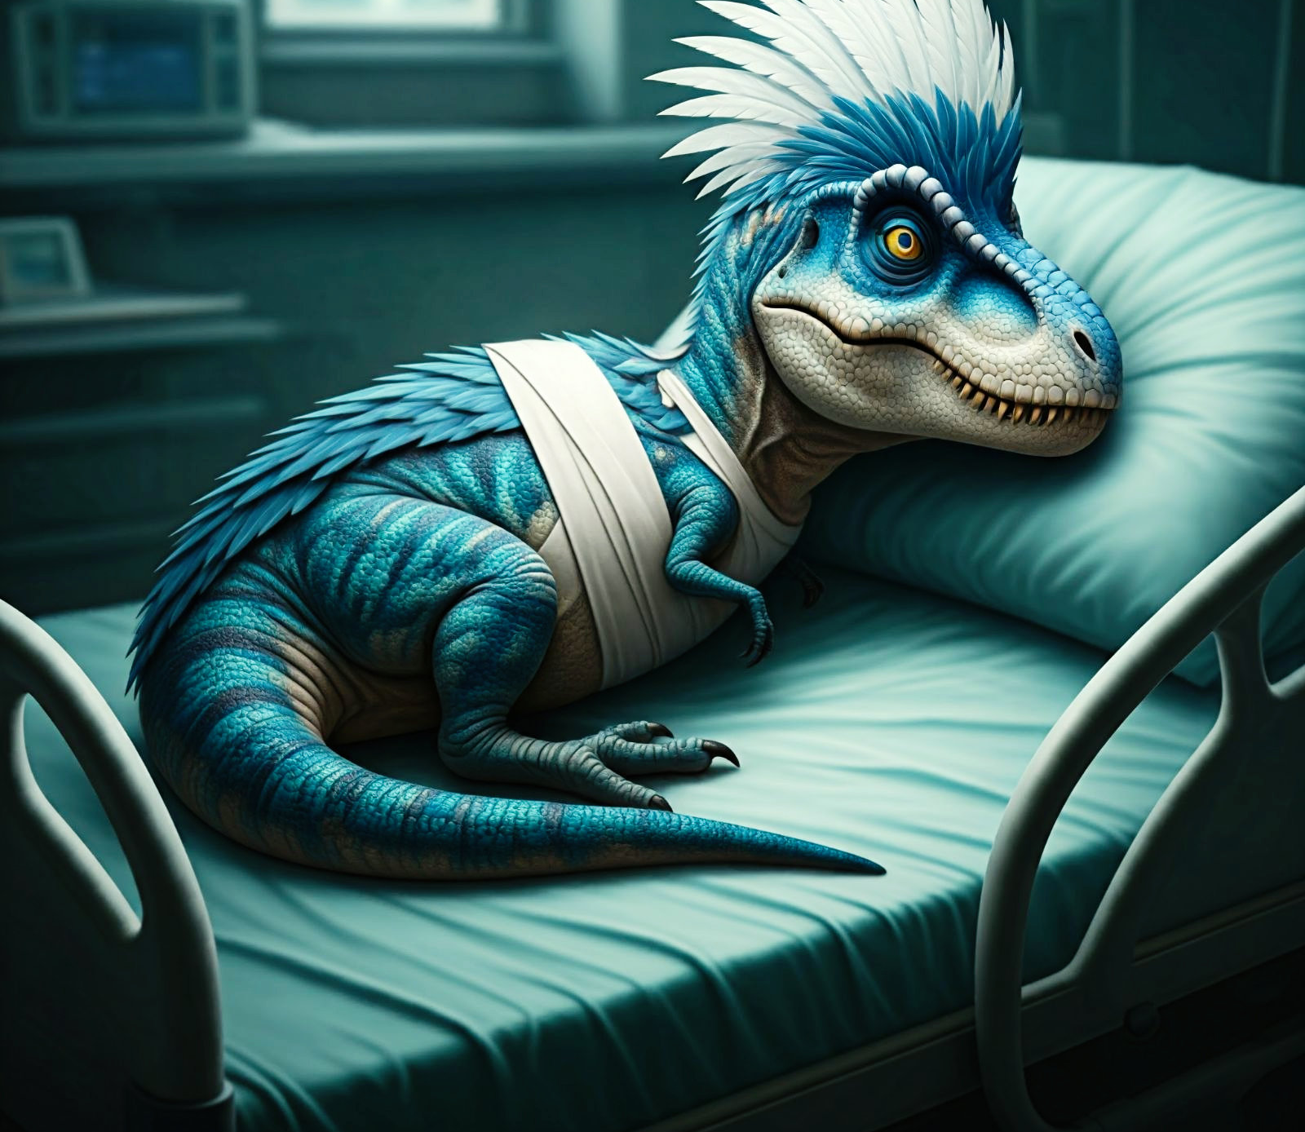
BREATHE! It gets easier!

Slide 16
Video:
https://harvard.zoom.us/rec/share/2j6BO2DJsdcZDxGZHDLL-zIgoObGgfngmb5GwaS0cKIvDco0mwoPwjn9l7DBs-hd.fe4rt8s4aLN9D4lH

Slide 17
Cautions before you begin:
Check your server connections, update your drivers
Make sure you are not on a VPN when using ChatGPT+
Try a different browser if you continue to have problems
If your internet is slow, this can really affect its ability to do network work
If the prompts you send are really long, or the information you are asking for is complex, this can result in errors
Before I begin, I check the GPT status bar:
https://status.openai.com/
just to save time/frustration

Slide 18
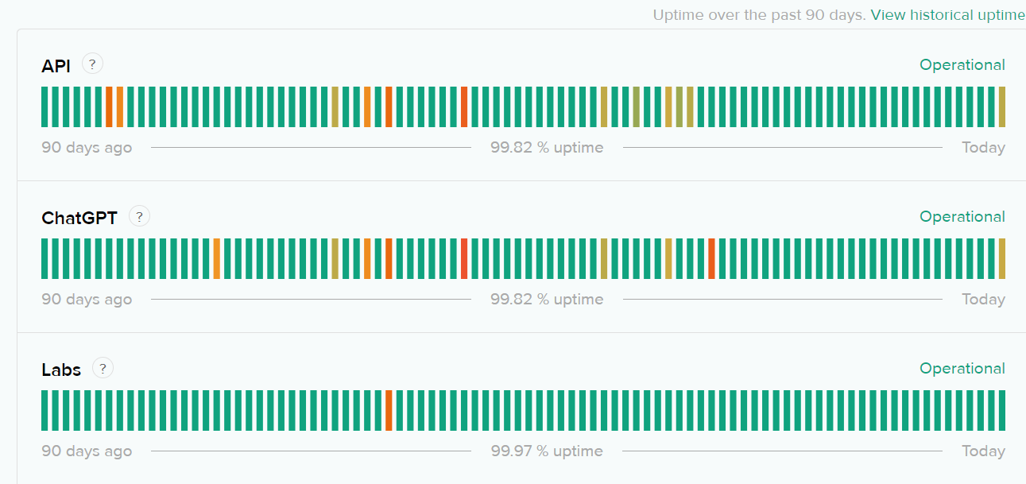
Error status: beware the RED

Slide 19
Quizzes:
Capitalization
Subtitles
Composer/lyricist transposed in SOR
List series title pages
Editions
No date, should have copyright date
Incorrect copyright dates
Plate numbers
AI disclaimer

Slide 20
Questions?
cawelti@fas.harvard.edu

