Slide 1

Not Just a PDF on a Website:
Copyright and Self-Publishing for Composers
Marci Cohen
Head, Music Library (retired)
BU Libraries
April 8, 2025
Adapted from a slide deck by Kathleen DeLaurenti
Director, Arthur Friedheim Library
Peabody Institute, Johns Hopkins University
Notes:
I am not a composer
I’m not a lawyer. This is not legal advice.
I am a librarian
I’m focusing on U.S. copyright law, not other countries.
In olden times (maybe 2 decades ago)
You hoped to get a publishing deal, maybe with Boosey or Theodore Presser (or a publisher who represents someone in your organization)
They would take care of:
typesetting
printing
distribution
registering copyright
licensing/synching
maybe collecting royalties
Libraries might:
Buy copies of scores and/or parts
Catalog them
Put them on the shelf for patrons to borrow
Maybe have the works performed by campus ensembles
Today: to quote one of the most successful composers of the past two decades, Taylor Swift, "You're on your own, kid."

Slide 2
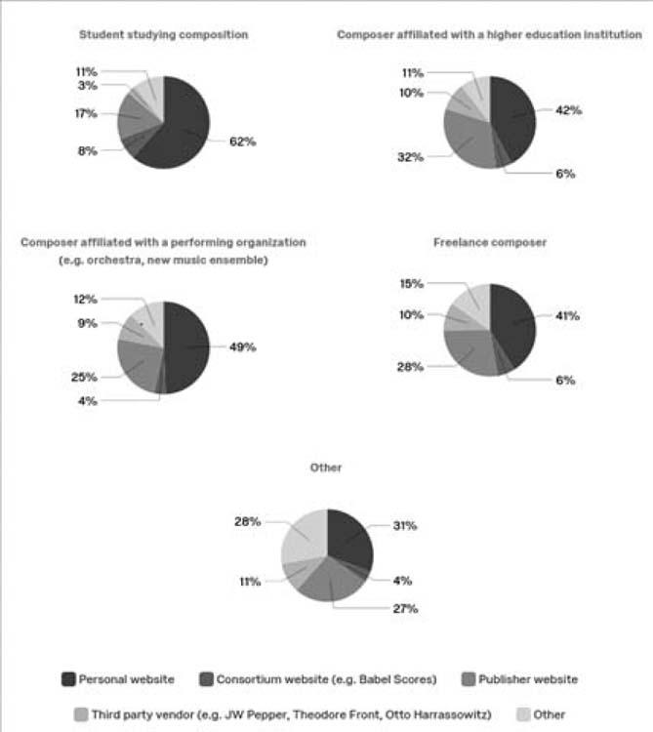
Berndt-Morris, Elizabeth, and Sandi-Jo Malmon. “Surveying Composers: Methods of Distribution, Discoverability, and Accessibility of Their Works and the Corresponding Impact on Library Collections.” Fontes Artis Musicae, vol. 67, no. 2, 2020, pp. 81–98, https://doi.org/10.1353/fam.2020.0007.
Notes:
To quote some music librarians “Personal Web sites are the most frequently used distribution method by all composer groups.”
That's why I'm here to discuss copyright and self-publishing in a talk I'm calling "Not Just a PDF on a Website"
My purpose in talking to you today is to help you navigate making money in this DIY economy.

Slide 3
Copyright
Notes:
Ask “Who owns a copyright?”
Ask “Who has registered a copyright?”
explain that owning is automatic, but you get more rights if you register
financial damages in copyright infringement cases
181 countries have signed onto the Berne Convention or joined WIPO which involves acknowledging copyrights from other countries. (Only Solomon Islands, South Sudan, Timor-Leste and Tuvalu are not members of either)
Resource list has a link to the Copyright Office website where you can do this yourself.
Copyright Clause: Also known as the “Progress Clause.” The basis for federal intellectual property laws in the United States, found in Article I, Section 8, Clause 8 of the United States Constitution: “[Congress shall have the power] to promote the progress of science and useful arts, by securing for limited times to authors and inventors the exclusive right to their respective writings and discoveries."

Slide 4
What is copyright?
Copyright is a type of intellectual property that protects original works of authorship as soon as an author fixes the work in a tangible form of expression.

Slide 5
What is copyrightable?
Two-factor test in the United States for copyrightability:
  Is the work unique?
  Is it fixed in some format?
Improvising at the farmer’s market may be unique, but if it wasn’t captured in some way, you cannot copyright it.
Notes:
That tangible form could be a score or a recording. Merely humming a melody that’s stuck in your brain isn’t sufficient.

Slide 6
What ISN’T copyrightable?
Facts
Works created by the U.S. federal government
Ideas:
You can copyright *your* love song, but not the idea of a love songs

Slide 7
Rights
Reproduce
Prepare derivative works
Distribute copies
Perform the work publicly
Display the work publicly
Digital audio transmission
Notes:
Copyright provides a bundle of rights:
Reproduce the work in copies or phonorecords.
Prepare derivative works based upon the work.
Something to consider if you want to create a work based on someone else’s, such as a new arrangement or an opera based on a book or movie.
Distribute copies or phonorecords of the work to the public by sale or other transfer of ownership or by rental, lease, or lending.
Perform the work publicly if it is a literary, musical, dramatic, or choreographic work; a pantomime; or a motion picture or other audiovisual work.
Display the work publicly if it is a literary, musical, dramatic, or choreographic work; a pantomime; or a pictorial, graphic, or sculptural work. This right also applies to the individual images of a motion picture or other audiovisual work.
Perform the work publicly by means of a digital audio transmission if the work is a sound recording.

Slide 8
Length
Short answer: For works created on or after January 1, 1978, life of the author plus 70 years.
Long answer: There are lots of exceptions, including different rules for works created earlier.
Notes:
Short answer: Useful for knowing how long your own copyright will last.
Long answer:
Useful if you want to make a derivative work.
Cornell has a useful chart: https://guides.library.cornell.edu/copyright/publicdomain/
This is why Disney made so many movies from fairy tales in the public domain: they didn’t have to pay anyone for making derivative works.
Copyright laws are seen as balancing the rights of creators vs. consumers. But it often plays out as creators, i.e. composers and authors vs. content sellers (record companies, Spotify) with consumers having little voice. Librarians are often advocates for consumers.

Slide 9
Music Copyright
Notes:
two kinds
ask if anyone can explain the difference in the Grammys between last year’s Song of the Year and Record of the Year. (This year, both awards went to Kendrick Lamar for “Not Like Us.”
Song: Billie Eilish: What Was I Made For (won by songwriters Billie Eilish O'Connell & Finneas O'Connell): an award for the composition
Record: Miley Cyrus: Flowers (won with producers; and engineers): an award for the recording

Slide 10
Music = Many Copyrights
Musical work itself
expressed as notation (musical or text) OR in a sound recording
Sound recording
Sound recordings have their own copyright that is different from the musical work, even if the musical work was created digitally with software
Text
Any lyrics or text that are part of the musical work can be copyrighted separately
Notes:
on the composition (owned by the composer and lyricist or publishing co.) (as a score or recording)
on the sound recording (usually owned by the record label) aka "masters" (Mechanical rights—the exclusive right to fix a musical work in the form of a sound recording (or mechanical reproduction)—were first added to U.S. law in the Copyright Act of 1909 in the player piano era.)
(discuss Taylor Swift's re-recordings, most recent: 1989, she still hasn’t redone Reputation or her debut). She had a dispute with the record company, the owner of the copyrigh on the original recordings. As the composer, she already held the copyright for the compositions. By rerecording, she also owned the rights to the sound recordings.
Text/lyrics can be copyrighted separately, i.e. musical settings of poems by Edna St. Vincent Millay

Slide 11
Getting your work made
Clarify roles in collaborations
Potential collaborators:
  Musicians
  Writers of poetry or prose
  Recording engineers
  Financial sponsors (?)
Things are always friendly until they are not.
Notes:
Clearly document who is doing what.
Is this a work for hire done within the scope of employment?
Financial sponsors may own the copyright via assignment of rights. It is typical for record companies to own the master recordings.

Slide 12
Contract vs. Joint Ownership?
Joint copyright ownership
  Lasts for the duration of the copyright
  Every owner owns 100% of the copyright
Contracts
  Outline who copyright owners are
  May determine royalty rates, length of contract, transfers of copyright, and other terms
Notes:
Producers typically earn points, a percentage of royalties for sales and streams of recordings.

Slide 13
Register your work
There are important places you should be registering your work NOW to ensure you are collecting royalties:
U.S. Copyright Office
US Collection Societies:
  Public performance of musical works: ASCAP, BMI, SESAC
  Public performance of non-interactive sound recordings: Soundexchange
  Mechanical licenses for digital downloads and streams: Mechanical Licensing Collective
Notes:
you can register your own copyright
U.S. Copyright Office – link in resource guide
performing rights organizations
Who is familiar with them?
Can you explain what they do?
Who they are?
ASCAP
BMI
SESAC (invitation only)
Do you need to join one? Ask faculty for their opinions.
ASCAP and BMI have awards/grants for young composers that provide money, publicity, and prestige
Most campuses has blanket licenses from PROs for all campus music which covers activities such as:
concerts by school of music ensembles
marching band playing at football games
KPop dance nights in the student union
You can negotiate public performance rights and royalties on an individual basis, especially as part of selling your own scores.
SoundExchange and Music Licensing Collective take care of other kinds of royalties.
As a record company rep said at a Berklee College of Music panel on music industry ethics, she wants to pay earned royalties but can’t if she doesn’t know how to reach you. Registering means that those who collect royalties know where to send the money.

Slide 14
Selling Scores
Print sales
Can be shared under First Sale
Lent in libraries
Subject to fair use
Overhead: binding, postage, and inventorying
PDF Sales
Require licenses to clarify lending & sharing activities
Do not require physical inventory/postage/binding
Overhead: online storefront, licensing terms

Slide 15






Selling via a Publisher
Generally requires transfer of copyright
Services to manage rights
May limit where and how work is sold
Receives 50% of all public performance royalties
Additional percentages for rights management and legal support
Provides editorial services
Notes:
Via a publisher. Short version: you give up rights and money to benefit from their services.

Slide 16





Self-Publishing
Self-Publishing
Requires establishing a business
Requires running a business
More work typesetting/preparation publication
More work managing rights
Many platforms to choose from
Retain control over where and how work is licensed
Notes:
Self-publishing: you retain control and don’t have to pay others to do the work for you, but you have to do the work yourself.

Slide 17
Self-Publishing
Registration and Publishing
Things to consider:
Are you self-publishing? You will likely need to set up a business to register to collect your publishing royalties
Where will you be registering copyrights and what reciprocal agreements are in place?
Do you want to assign rights to a publisher or contract a rights administrator to manage your copyrights?
Notes:
registration and publishing: if you do self-publish, you can outsource some of the tasks
You can choose a Creative Commons license if you are not interested in collecting royalties

Slide 18
Editing & Typesetting
Notes:
Don’t just assume that a Sibelius of Finale file exported as a PDF is sufficient
include covers
include margins for binding, especially because not everyone is performing from iPads
avoid awkward page turns, i.e. at a rest rather than in the middle of a phrase. Not everyone is using Bluetooth page-turn foot pedals
Look at Elaine Gould: Behind Bars "is a practical guide to present-day users who need to communicate their music accurately and effectively." Gould recently retired after 4 decades as an editor at Faber Music.
from the Paul Lombardi's College Music Symposium review: Every composer, music theorist, and music editor would benefit from a cover-to-cover reading of it.
Sections:
General Conventions
Idiomatic Notation
Layout and Presentation: all the things you may not have considered when you were merely composing
Rehearsal marks
Cues
Combined instrument parts
Shorter style guide is the Music Preparation Guide for composers on the website for the Music Orchestra Librarians’ Association.
Those are librarians who focus on providing performance materials.

Slide 19
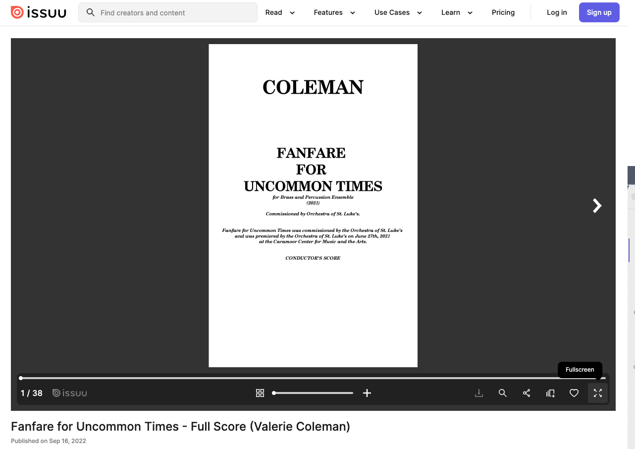
Notes:
Issuu as an option if setting up your own website.
enable perusal without download on your website to display a score
varying pricing levels
default, even the free version, prevents downloads. You have to pay more to allow downloads.
It can also make you more discoverable beyond your own website
See from the Coleman example that the score itself should also have all the publication information
Copyright holder
Year and place of publication
Catalog and/or opus number
Commission information
dedication

Slide 20
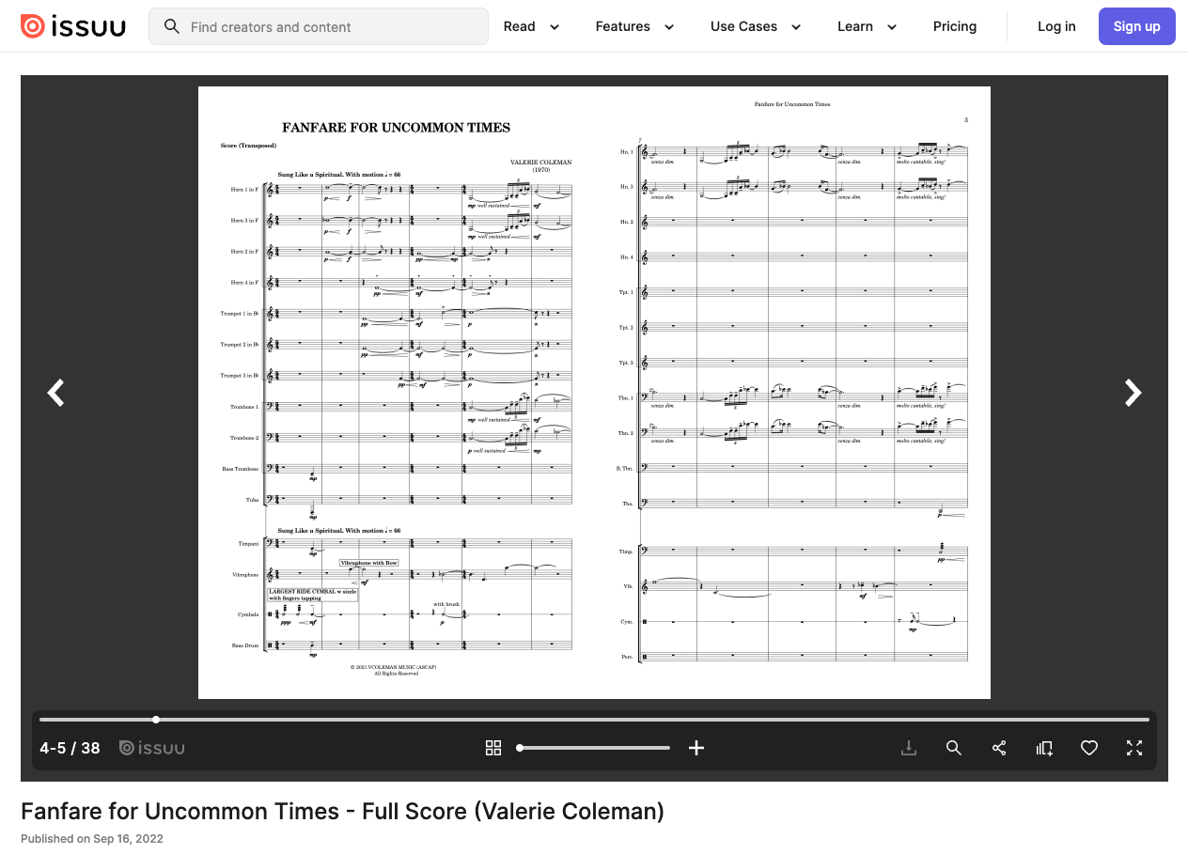

Slide 21
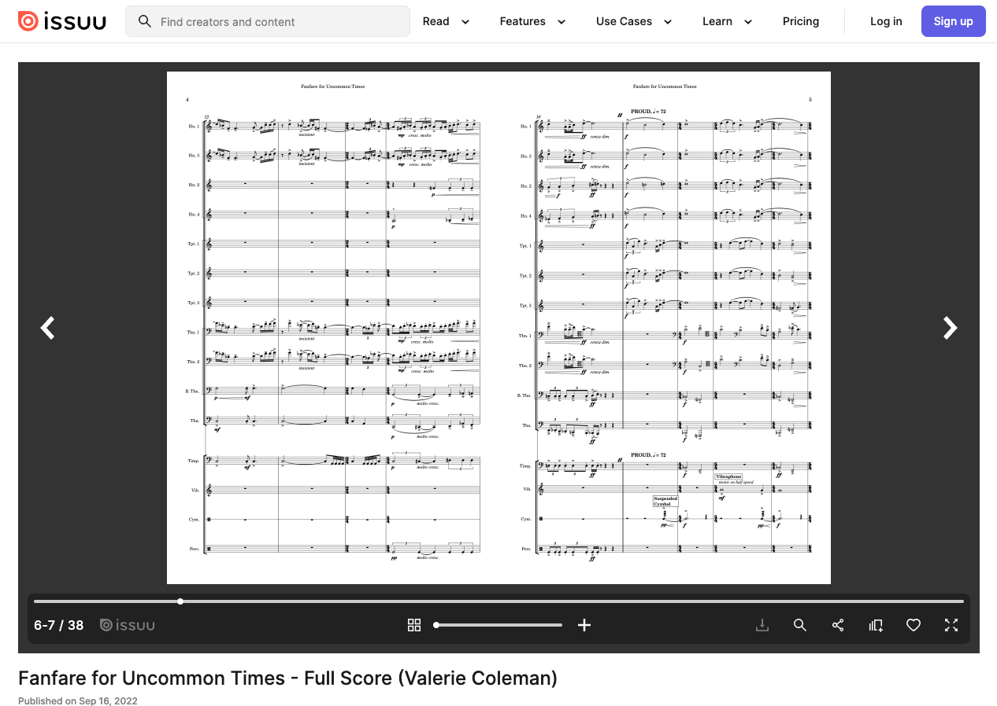
Notes:
When presenting your scores on your website, make your metadata clear especially by thinking of the needs of potential customers in programming a performance
Instrumentation
Duration
As you build up a repertoire, genre classifications such
Solo instrumental, maybe subdivided by instrument
Vocal works
Chamber music
Orchestral music

Slide 22



Libraries as Markets
Libraries can be a good market to have your work accessible! To ensure libraries can collect your work.
Ensure your publisher or distributor does not limit potential library purchase (check digital score terms!)
Have a license available for libraries and/or individuals on your webstore
Notes:
Selling to/licensing for libraries, not just end users
Berdt-Morris and Malmon also reported “(51 percent of surveyed composers) were unaware that libraries may have special requirements.” That’s why I’m here talking to you.
Libraries want to collect your scores (you hope)
Your college may be particularly eager to collect scores by alumni
Selling prints vs. PDFs
Physical item
is covered by the doctrine of first sale: "Under this principle, the rights holder’s exclusive right to distribution of any given copy of a work ends with the first authorized distribution of that copy. This means that rights holders are not able to control secondary markets for their work such as secondhand sales or library lending."
Think about binding. Comb binding is terrible for performing: page turns are cumbersome and distractingly noisy
PDF
Strictly speaking, you are licensing a copy, not selling a file.
Doctrine of first sale doesn’t apply.
Libraries are not end users.

Slide 23
Evaluate the score terms:
Are any buyers excluded based on these terms?
What restrictions are put on these digital scores?
How are these restrictions being enforced?
Notes:
Helps to think in advance what rights you are and are not granting. Make them explicit and include them on your website so that potential customers don’t need to ask for every purchase. Reminder about the bundle of rights
Public performance
Make and distribute copies
Can they make PDFs available to their community?
Can libraries lend prints?
Can they reprint multiple copies
If lost or damaged
Doubling of parts
Music Library Association has a model license that you can use.
Theodore Front website has a library-friendly license that you can use

Slide 24
Publicizing to Libraries
Notes:
Notes Music Received column is thematic rather than exhaustive, but it worth sending.
Can send a print score or email a file or link, but make sure to include a full citation.
Submit to Notes review editor consideration
Consider Open Access publishing. For example UCLA has a large collection (https://www.library.ucla.edu/collections/explore/contemporary-music-score-collection). People can see your scores, and you can decide if you want to sell or license the performance parts separately.
We want to buy your scores. By posting your licensing terms on your website, you make it easy for libraries to do so.

Slide 25
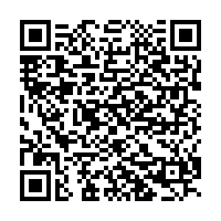
Questions?
Marci Cohen
rockhackcohen
@yahoo.com
Resource Guide
Notes:
Recap:
You own copyright merely by putting the music you create in fixed form.
You get more rights by registering.
Make sure you have systems in place to collect royalties
Especially if you self-publish, think about your audience
Performers
And libraries
Formatting your score PDFs
Your licensing terms
Take questions from the audience. It’s okay if you don’t know the all the answers

