Slide 1
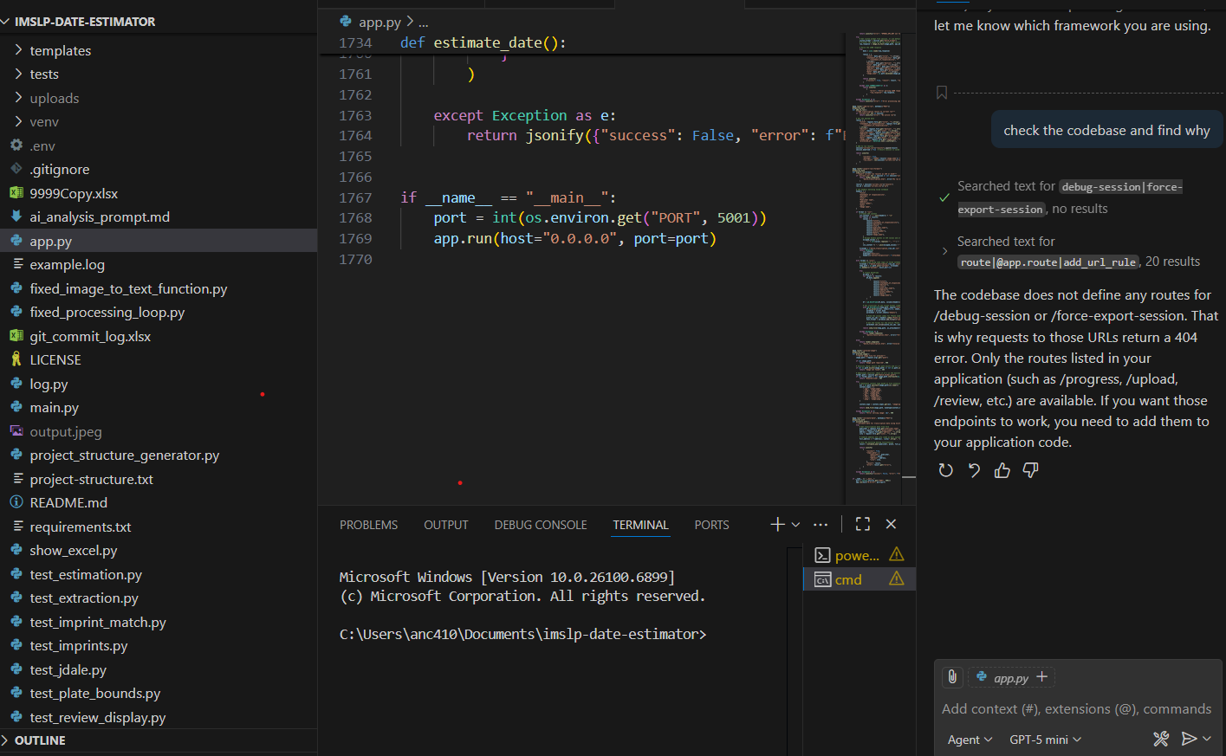

Dating the Undated:
New Dating Resources for 18-19th Century Music
Andrea Cawelti and Femi Ositade
New England Music Library Association
November 14, 2025

Slide 2
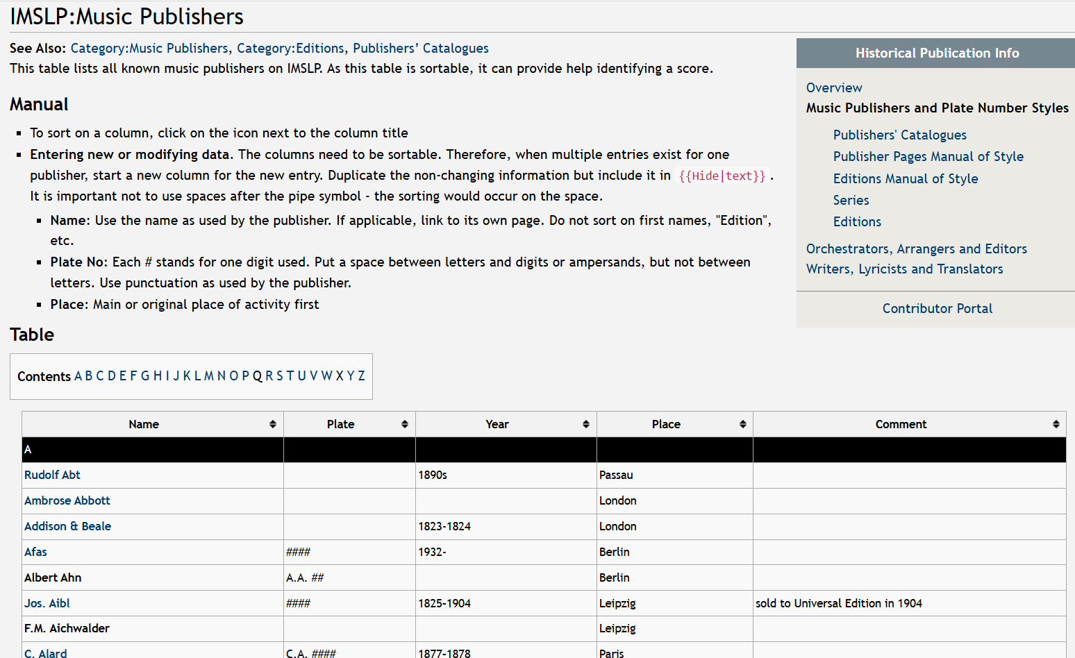
What’s this all about then?
Andrea will provide a brief overview of traditional music dating, and background about the current sheet music AI grant:
The Advancing Open Knowledge Grant and how Femi became involved;
How he transformed the AI cataloging project;
How he solved the music dating obstacle;
How this all works from a user’s perspective.
Femi will introduce you to the back end:
His perspective on the sheet music grant;
Why he created the Music Dating Program;
How he built it into its current functionality;
A look into the back end.
Where do we go from here?

Slide 3
Traditional music dating resources
Music provides several clues to narrow dates to a single year, or a range of years:
Publishers’ names, their addresses, and sometimes their printers (“manufacturers”), can provide clues to a range of dates at least.
Plate numbers, those little numbers often found down at the bottom of pages (depending on the publisher) are often chronological!
Internal advertisements can have chronological imprint numbers, or be dated.
Music printed in England between about 1795 and 1825 has watermark dates on the paper. They can be difficult to find, but when you do, you know your score can have been printed no earlier than the watermark date.
Internal evidence can lock in a date: publishers’ catalogs often list works whose publication date IS known.
Newspaper advertisements can be excellent sources for release dates.

Slide 4

Printed resources:
Overview with more details: Krummel, Donald William. Guide for dating early published music : a manual of bibliographical practices (1974)
Dictionnaire des éditeurs de musique français (1988)
Deutsch, O.E. Musikverlags Nummern (1961)
Antolini, B.M. Dizionario degli editori musicali italiani (also available via RILM Music Encyclopedias)
Fog, D. Musikhandel og nodetryk i Danmark efter 1750
Humphries & Smith. Music publishing in the British Isles
English music publishers' plate numbers in the first half of the nineteenth century
Dichter & Shapiro. Handbook of early American sheet music, 1768-1889:
a dictionary of American Music Publishers, list of lithographers/illustrators

Slide 5
Online resources:
The National Authority File has a lot of publisher headings, many of which include addresses with date ranges: https://authorities.loc.gov/
VIAF includes national authority records from other countries for publishers, and Wikidata links:
https://viaf.org/en
IMSLP Publishers’ Wiki is far from complete, but it includes a lot of valuable information: https://imslp.org/wiki/IMSLP:Music_Publishers
Hofmeister XIX includes the first date that many 19th century imprints were released:
https://hofmeister.rhul.ac.uk/2008/content/database/search/advanced.html
As does the Internet Archive version of the Pazdirek online:
https://archive.org/search?query=creator%3A%22Pazd%C3%ADrek%2C%20Franz%22
The CERL Thesaurus has a ton of publisher and printer records, providing addresses and tenure info:
https://data.cerl.org/thesaurus
The British Book Trade Index has struggled in the wake of the British Library cyberattack, but there are several access options listed on its site: https://bbti.bodleian.ox.ac.uk/
The Scottish Book Trade Index includes information impossible to find elsewhere:
https://data.cerl.org/sbti/_search
The Dublin Music Trade Index is equally useful, as well as listing many London publishers’ Irish partners: https://www.dublinmusictrade.ie/simple-search
Library Hub Discover (JISC, was COPAC) includes many dated Stationers’ Hall registry scores:
https://discover.libraryhub.jisc.ac.uk/

Slide 6
Stationers’ Hall legacy: Early British Legal Deposit Music:
The British Library has always received legal deposit materials, has the most complete collection, and all are cataloged. The collection began as the Royal Collection, then formed the basis of the British Museum collection, from which the British Library evolved.
For the remainder of the legal deposit libraries, historically, some form of library committee decided which music to keep. This varied widely:
Bodleian Library, University of Oxford – has always received legal deposit materials, from the start right up to the present. Mostly cataloged, though historical entries aren’t all full records, having been digitized from older card records.
Cambridge University Library – has always received legal deposit materials, from the start right up to the present. Not all historical materials are cataloged.
Aberdeen University Library – was a legal deposit library up to 1836. An incomplete collection, but what survives is cataloged – but not all online.
St Andrews University Library – again, a legal deposit library up to 1836. A more comprehensive collection, but only items post 1800 are cataloged online, and the paper catalog records for the earlier items appear to be missing. Interestingly, the historical music collection was very much a working one, frequently used by professors and students.
Edinburgh University Library – a legal deposit library up to 1836. A patchy collection, but items that ended up in the Reid Music Library (established in the 19th century) are at least now listed on a spreadsheet.
Glasgow University Library – a legal deposit library up to 1836. A more comprehensive collection, and cataloged online.
National Library of Scotland – evolved from the Advocates Library in Edinburgh, and is a legal deposit library to this day. Historical music is cataloged in the Victorian paper catalog; probably not as complete as the British Library, for various reasons. More modern materials are cataloged online.
Trinity College Dublin. Although a legal deposit library since 1801, there is little historical music copyright material to speak of, because it wasn’t collected. Still a legal deposit library.
Sion College, London, was historically a theological institution, with a legal deposit library prior to 1836. All holdings have more recently been transferred to Lambeth Palace Library, London, and little music survives. Not cataloged.
King’s Inns, Dublin – another historical legal deposit library 1801-1836, but music appears not to have been cataloged to any extent, except very popular publications which must have been added individually as they made their way to the library.
National Library of Wales. Was not a legal deposit library until the 20th century. Unlike the National Library of Scotland, it was a new establishment in 1907, not growing out of an earlier institution.
https://karenmcaulaymusicologist.blog/2018/03/15/tracing-early-legal-deposit-music/

Slide 7
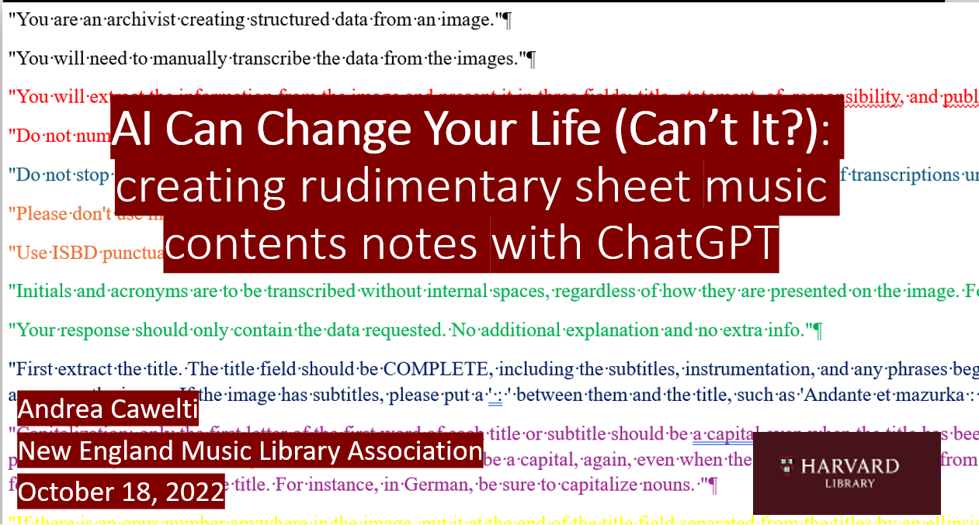
BUT THIS IS THE AGE OF AI!

Slide 8
Then along came FEMI OSITADE!
Harvard Library's Advancing Open Knowledge (AOK) Grants Program seeks to advance open knowledge and foster innovation using artificial intelligence (AI). The 2025 program awarded up to $10,000 for projects that started March 3, 2025 for completion by October 31, 2025, funded by the Arcadia Foundation.
Proposed a grant to catalog sheet music, “The AI Way,” which was fully funded in March 2025;
Interviewed Femi April 9, just as Harvard’s hiring freeze began: he was clearly the one for the job, but we had to wait until the end of April to clear the grant funds;
Femi worked almost full time through the summer semester, and we finished the grant $$ at the end of August;
He transformed our AI sheet music cataloging program from producing simple spreadsheets into an interactive tool enabling real-time proofreading during scanning;
Created the dating program with a user-facing website with broad functionality.

Slide 9
Looking up individual dates: IMSLP Publishers’ Wiki

Slide 10
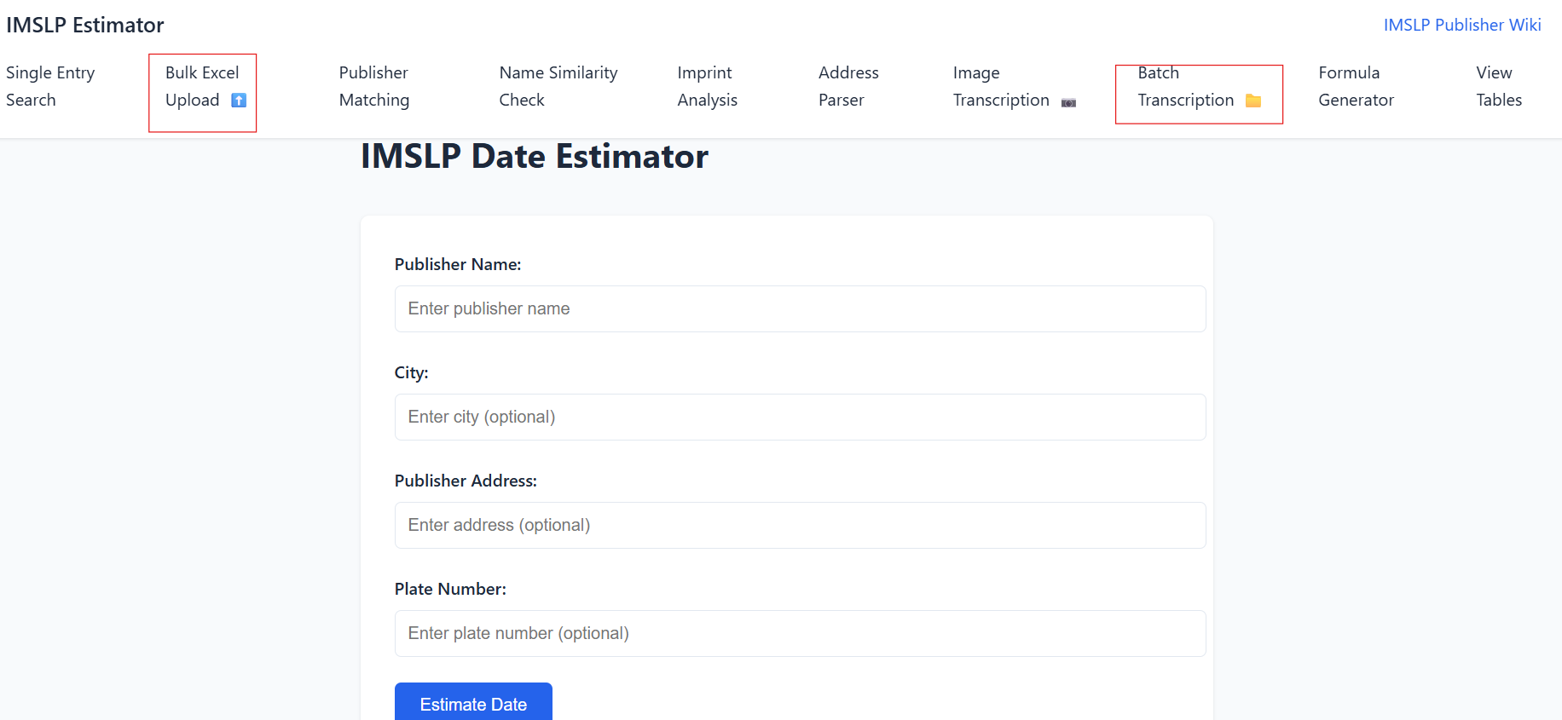
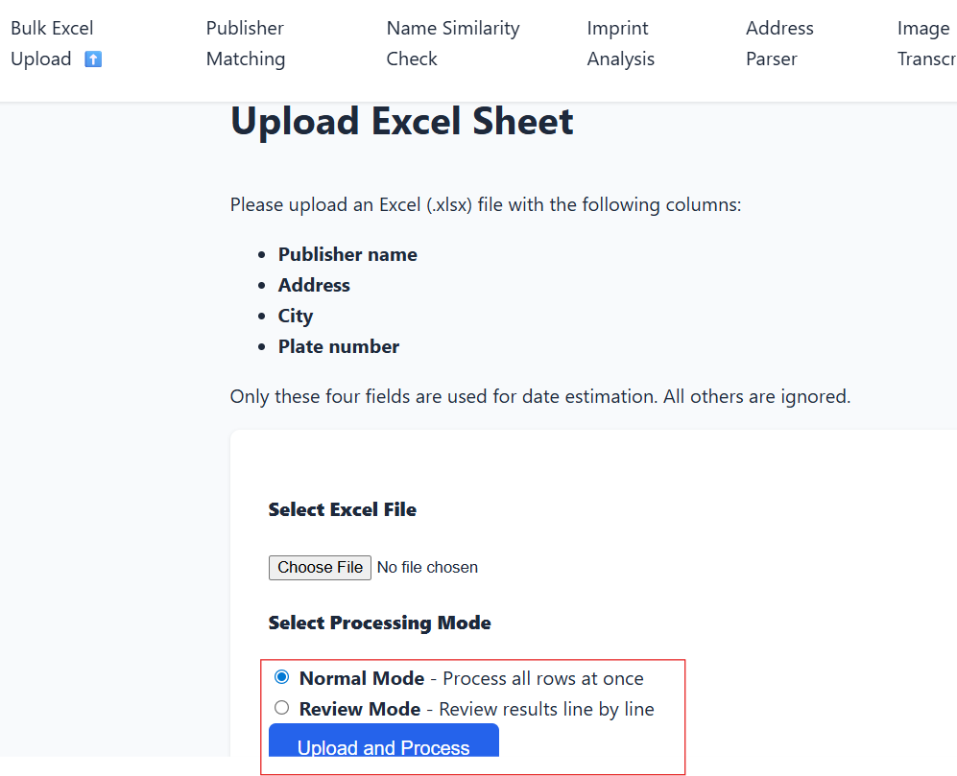
Batch transcription we'll look at later
BULK EXCEL UPLOAD:
Upload an Excel sheet with specified columns
Choose normal mode:
Results will be returned on your Excel sheet
Choose review mode:
You can review results row by row

Slide 11
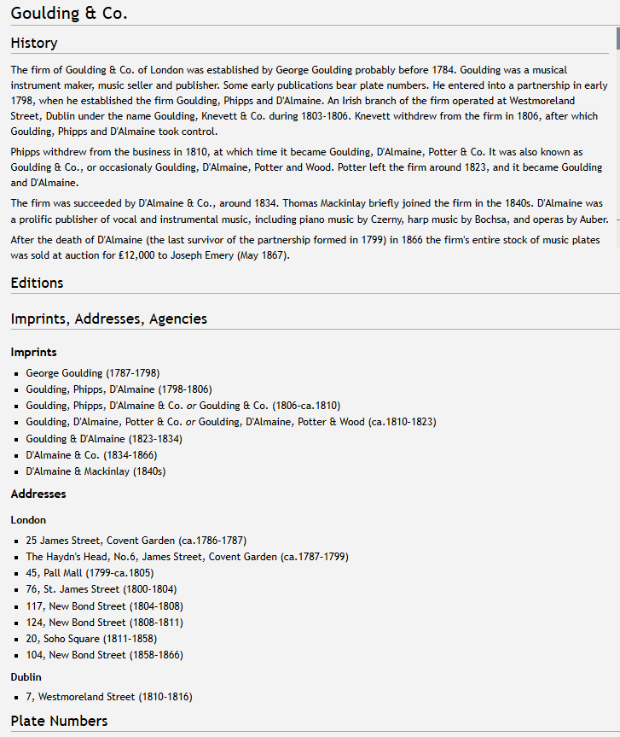
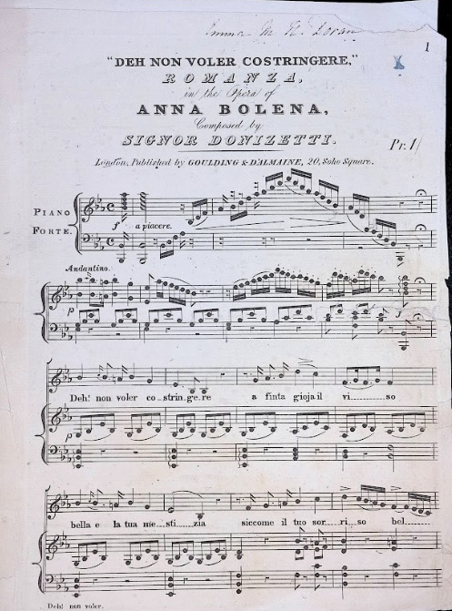
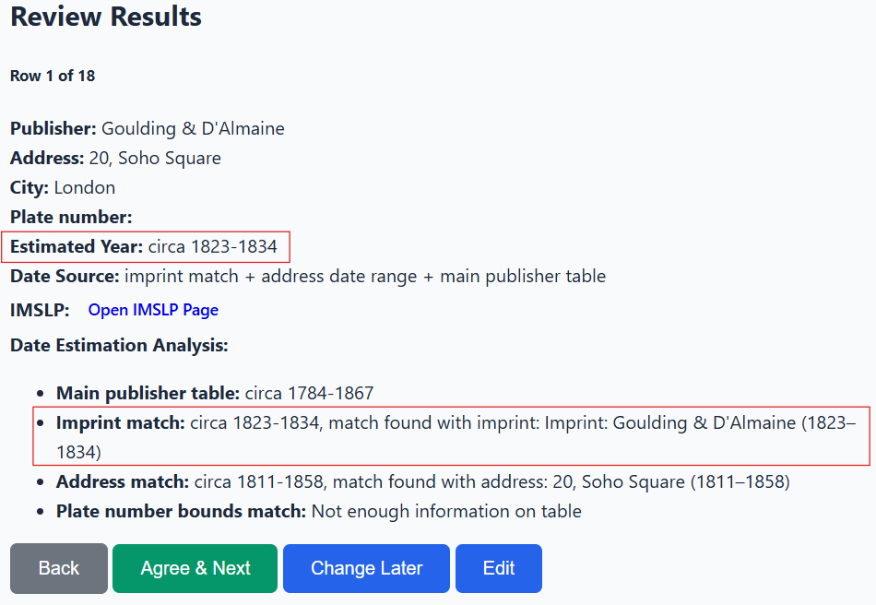
Publisher address to IMSLP PublisherWiki to “Review mode” results
2015T-184. Houghton Library

Slide 12
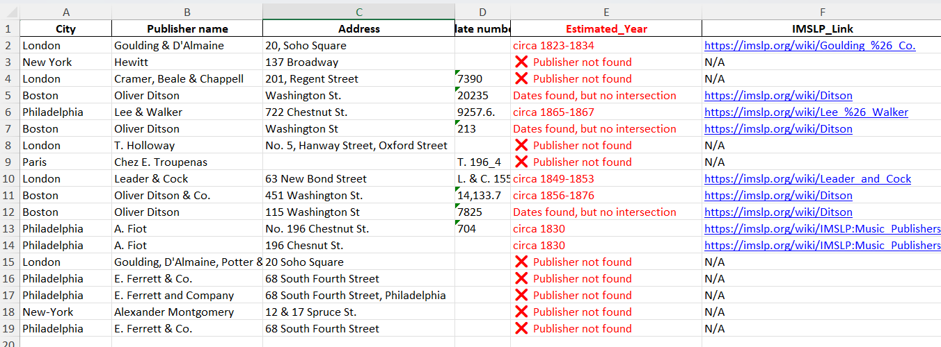
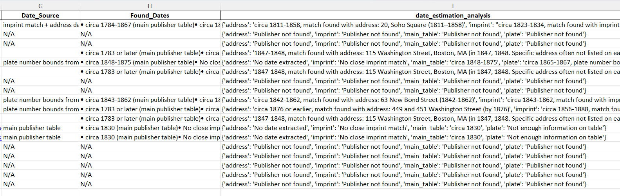
Output from the BULK EXCEL UPLOAD

Slide 13
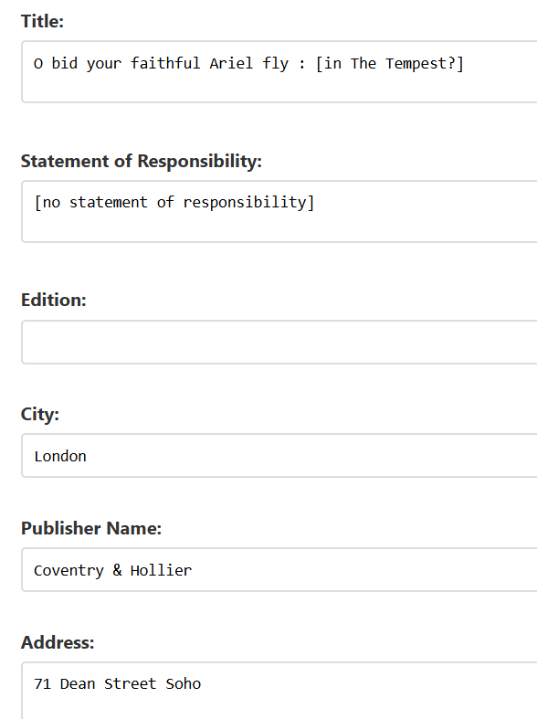
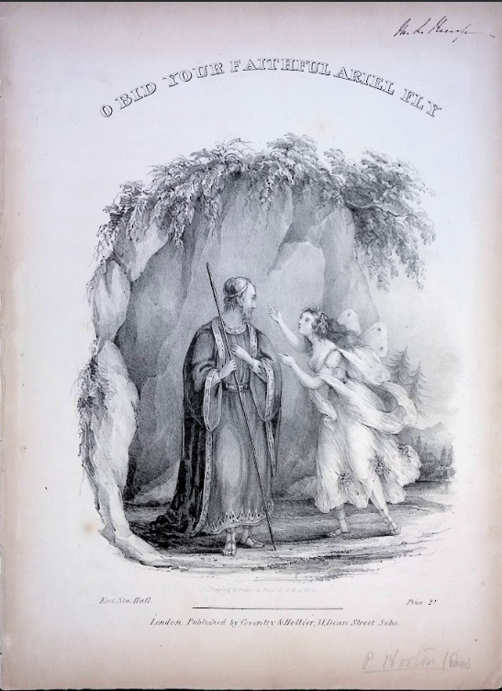
Batch transcription interactive tool, used during scanning
2015T-290, Houghton Library

Slide 14
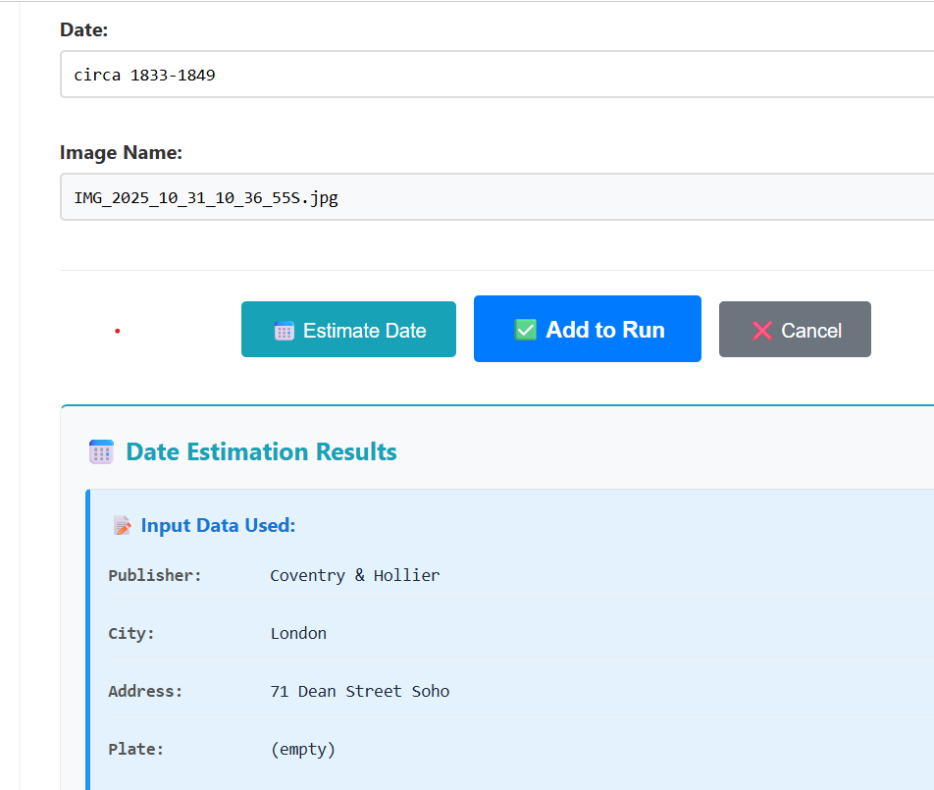
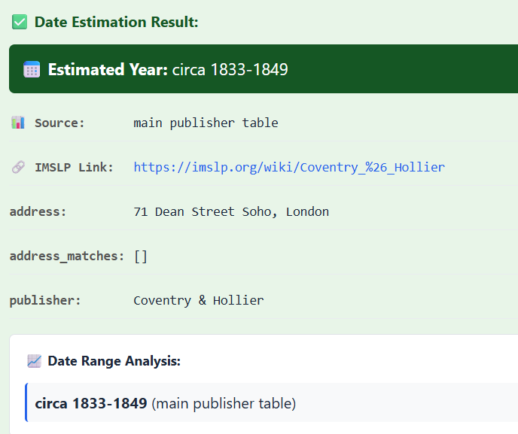
Date estimation based on publisher’s address

Slide 15
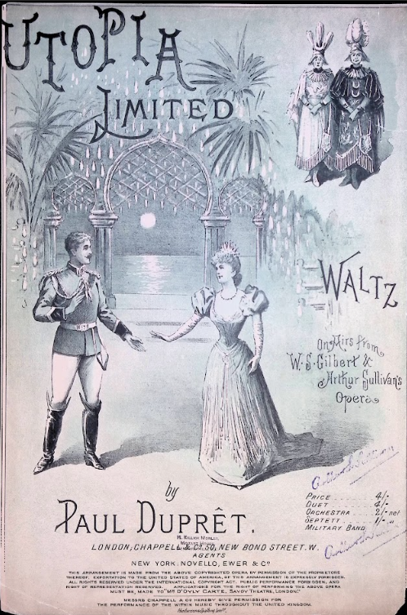
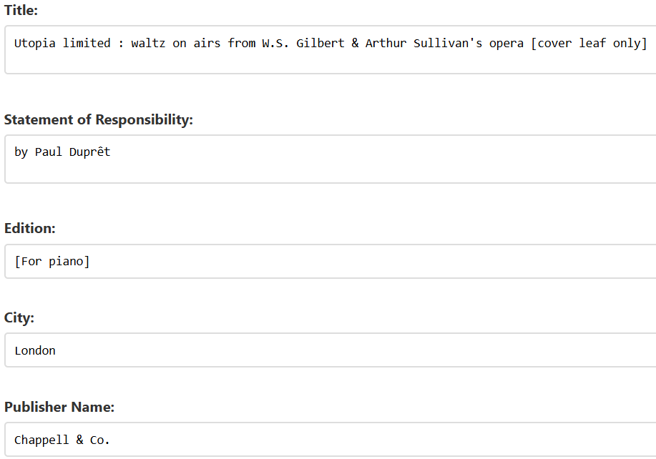
Batch transcription with plate number

Slide 16
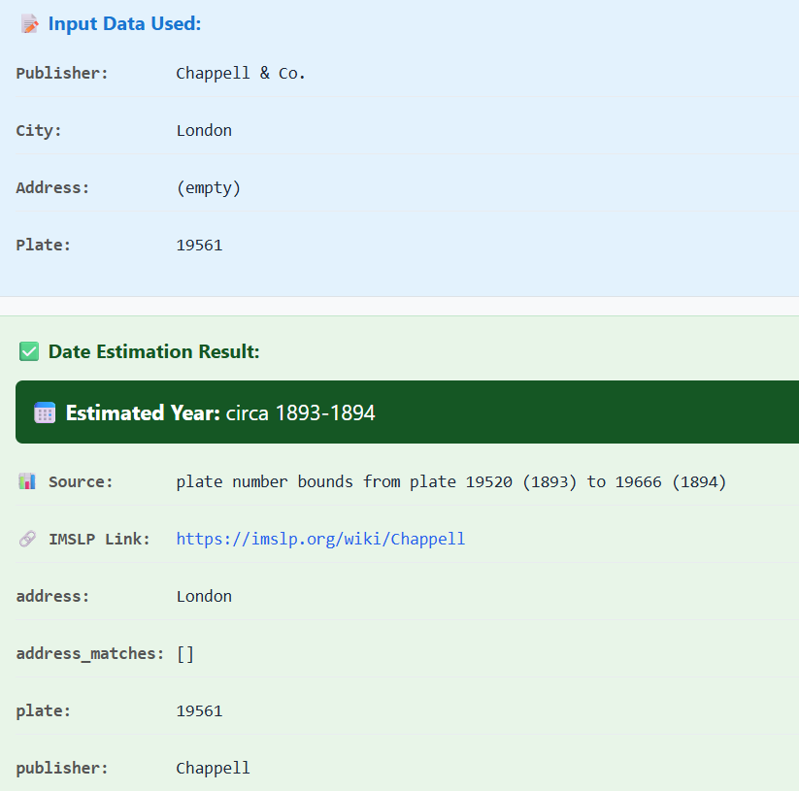
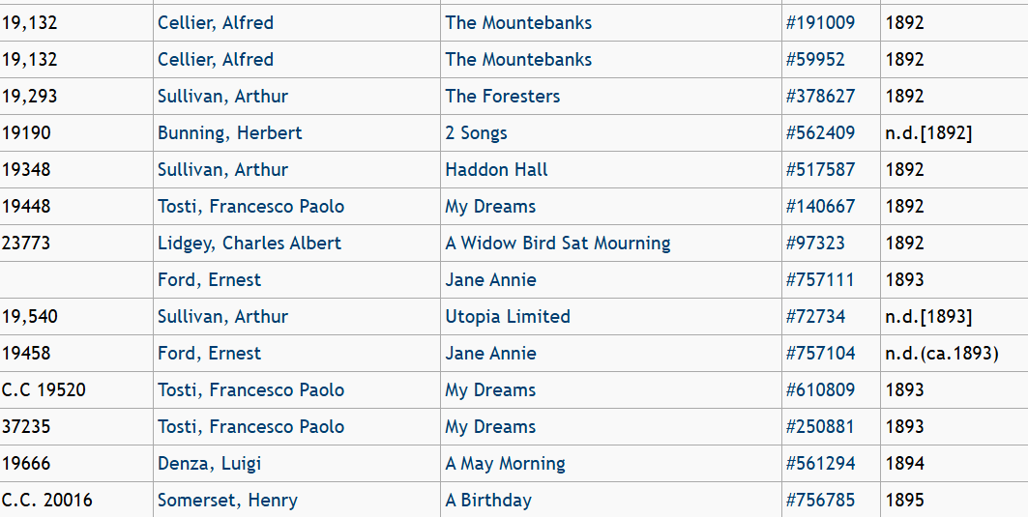
Date estimation based on plate number grid in IMSLP Publishers’ Wiki

Slide 17
Over to Femi!

Slide 18
Questions? cawelti@fas.harvard.edu

Slide 19
Video film links
1: entering the batch transcription mode
https://harvard.zoom.us/rec/share/K99HDg_5AmjDVOqRpXjsMvkItS5LdzLgsULvp5QysEk5L-wJqM5lLA7NTlGR5FV9.yDh5mK8g14RwZi1T?startTime=1762959730000
2: AI transcription, proofreading with date estimation
https://harvard.zoom.us/rec/share/K99HDg_5AmjDVOqRpXjsMvkItS5LdzLgsULvp5QysEk5L-wJqM5lLA7NTlGR5FV9.yDh5mK8g14RwZi1T?startTime=1762960972000
3: bulk date estimation uploaded Excel
https://harvard.zoom.us/rec/share/nXVTAsD9_8lW9apjJKJA2EPzCK

