Slide 1
Out of Prague: Jewish Emancipation and the Rise of the Jewish Piano Virtuoso
Tom Moore
Fall 2025

Slide 2
Jews and Judaism in the music-historical literature
Jewish composer/Jewish musician is not a significant category within the standard musical encyclopedias and dictionaries
Even in 2023 major music encylopedias (Grove) consider Jewish identity to be irrelevant/private/personal (in comparison with sexual identity/national identity/racial identity), and is intentionally suppressed
Grove’s approach: “Five of the greatest Jewish-born composers of the Romantic era came from culturally Jewish backgrounds and clearly identified themselves as Jews: Meyerbeer (1791–1864), Halévy (1799–1862), Mendelssohn (1809–47), Offenbach (1819–80) and Mahler (1860–1911). But were there any traits in their works that could be described as distinctly Jewish? Were there any conscious or subconscious reminiscences of traditional elements from childhood?”
Very few books, studies, etc. about Jewish composers in general – one exception is Jewry in Music – Entry to the Profession from the Enlightenment to Wagner (David Conway, 2012)
Conway addresses Western Europe only (Netherlands, England, Austria, Germany, France - but not Czechia, Slovakia, Poland, Ukraine, Russia, etc.)

Slide 3
Prague as a multicultural city
Jews are 30 percent of the population of Prague in the 17th century
Jews make up one-quarter of the population of Prague in the early 18th century
Jews expelled from Prague under Maria Theresa, 1745-1748
Edict of Toleration, Joseph II, 1781
Josefov – Josefstadt (named for Joseph II) (Jewish neighborhood)
Prague – 9500 Jews in 1750 (second in northern Europe after Amsterdam with 20,000)
Most prestigious institutions in Prague ca. 1800 dominated by the German-speaking population
This had been the case since the rule of Bohemia from Vienna by the Hapsburgs after the defeat of the Czechs at the Battle of White Mountain

Slide 4
Prague as a multi-cultural city, II
Most newspapers and magazines published in Prague in the early 19th century were in German (Ost und West, Libussa, etc.)
Theatrical performances generally in German (Czech only at less prestigious times, such as the Sunday afternoon matinee)
Czech-languages magazines start to be published by the second half of the 19th century (Dalibor, 1858-)
Narodni divadlo (planning, 1844, cornerstone, 1868, opening, 1881)
Division between Deutsche Böhmen and Czech Bohemians
Jewish Bohemians do not belong to either of these groups

Slide 5
Jewish musicians as role models – the earliest generation
Ignaz Moscheles (1794-1870)
Studies with Dyonis Weber at Prague Conservatory (1804-1808)
Studies in Vienna with Albrechtsberger and Salieri (1808-)
Traveling virtuoso, 1815-1825

Slide 6
Jewish musicians – the next generation
A list of twenty-two Bohemian musicians published in 1866 is at least one-third Jewish.
Frau Claus-Szarvady in Paris
Frl Wilhelmine Cermak in Prague
Frl Auguste Kolár Composer in Prague
Frau Swoboda Jahn in Pardubic
Frl Mila Zadrobilek in Prague
Franz Bendel Composer in Berlin
J Brava Kapellmeister in Marburg
Franz Cerny Professor of Piano at the Conservatory in Petersburg
Al Dreyschock Composer in Petersburg
Sig Goldschmidt Composer and Banker in Prague
Franz Kavan Composer in Prague

Slide 7
Jewish musicians, II
Wilhelm Kuhe Composer in London
J Lábor Court pianist in Hannover
Leo Lion Professor of Piano in Berlin
Ignaz Moscheles Professor of Piano in Leipzig
Eduard Napravnik Kapellmeister am russischen Theater in Petersburg
Jul Schulhoff Composer in Paris
Friedrich Smetana Composer in Prag
Friedrich Simák Composer in Prague
Bernhard Rie Kapellmeister in Rotterdam
J Todesco Composer Abroad
Charles Wehle Composer in Paris

Slide 8
Heinrich Wilhelm Ernst (1812-1865)
Philipp Broch (1812-1864)
Ernst (from Brno) already becomes well-known during his study in Vienna (1827)
“…so that some Jewish patres familias in Prossnitz, in their initial joy over a career that was to some extent newly open to the Jews, provided their sons, after providing the initial necessary training for entry into that institution partly through domestic instruction, and partly through communal instruction in Prossnitz, with compositional training in Vienna at not insignificant sacrifice. At the same time a musical dilettantism of unusual size and notable success among both sexes developed, so that this community now has several professional musicians, and a number of very good dilettantes, who employ their talents not only for diversion and pleasure, but not rarely for philanthropic purposes, and one can only praise the fact that respectable families sacrifice the prejudice that prevails in small communities to a good cause, and also allow their daughters to appear publicly, and certainly no less if it is done primarily for the benefit of Christian persons or institutions”. [reported in Der Orient Leipzig, 1841]

Slide 9
Broch, II
Philipp Broch and Bernhard Schreiber are two Jewish boys from Prostejov who are specifically mentioned as a examples of the effects of Jewish success in the arts, which enables Jewish parents to support careers in the arts for their talented children. Neither remains in provincial Bohemia, but both make international careers. Broch works first in Lemberg (Lviv) and finally settles permanently in Vienna, where he is orchestra director at the Theater an der Wien. The entire orchestra and chorus attends his funeral service.
See: Philipp Broch, 1812-1864, notable Jewish violinist and composer, ViolinMagazine.online, August 17, 2022, https://violinmagazine.online/en/philipp-broch-1812-1864-notable-jewish-violinist-and-composer/

Slide 10
Sigmund Goldschmidt (1815-1877) born in Prague.
Parents: Jakob Goldschmid (1784-1866), Judith Moises Jerusalem (b. ca. 1787)
“precocious” study with Dyonis Weber (first director of Prague Conservatory)
Later study of instrumentation and dramatic composition with Triebensee
“released” from a life in accounting ca. 1839, active in music alone
Earliest publications – opp. 1-3 (songs), op. 4 (etudes), op. 5 (Sonata in F minor), concert overtures in E minor and D major
Opp. 8-12 published 1844
Piano concerto (F minor) and overture (Undine), 1845
Last public activities in music, 1849
Leaves Prague for Vienna (date unknown – probably after 1857, when he is mentioned as a “cambist” in Prague)
Active in finance and currency exchange for the rest of his life
Attempted suicide, 1873
Successful suicide, 1877
See: Sigmund Goldschmidt (1815-1877): Piano virtuoso, Composer, and Banker, Journal of Czech and Slovak Music (The Journal of the Dvorak Society), Volume 29 (2020), p. 129-203.
IMSLP: his etudes op. 4 (1842) . His Nachlass in MS is at the Austrian National Library.
Notes:
Paternal line in Prague at least as early as late sixteenth century

Slide 11
Sigmund Goldschmidt – critical reactions in the contemporary press
1839: Overture to Romeo and Juliet “Mr. Goldschmidt’s composition was very well received by the public, and the reviewer can only encourage the young composer to boldly continue his studies.”
Performing Beethoven Concerto no. 1 “Mr. Goldschmidt is a master on the piano, one about whose spiritual performance many pianists who move entire cities to tears in many newspapers with their finger dexterity have no idea whatsoever.”
“Among the younger Prague composers, Siegmund Goldschmidt unquestionably takes the first place. His song, “Der todte Tänzer”, which, sung excellently by Mr. Strakaty in a concert, caused an extraordinary sensation”.
1840:…..The names of Goldschmidt, Kittel, Skraup, and Titl are known by every friend of the musical literature of our fatherland”.
1842: “a new Ouverture in E minor by Professor Sigm. Goldschmidt, who once more in this work demonstrated a beautiful talent”.
1843: “A new concert overture by S. Goldschmidt, “Frühlingsgruß” received quite a warm welcome”
Etc. etc. etc.

Slide 12
Leopold Lion (1840-1871)
Parents: Herschmann and Esther Lion (one of ten children)
Born in Prague
1861 “noteworthy talent, student of A. Dreyschock”
Benefit concert for the Israelite Hospital in Marienbad
By October 1861, moves to Berlin to become a piano teacher
Playing chamber music in Leipzig chez Moscheles with R. Dreyschock and C. Davidoff (his own piano trio)
Success in Berlin, 1861-1866
Reported death “at madhouse in Prague” – summer 1866.
1869: committed to asylum in Vienna.
1871: Death in Vienna lunatic asylum.
None of his documented works survive.
See: Leopold Lion from Prague, Journal of Czech and Slovak Music (The Journal of the Dvorak Society), Volume 31 (2023), about to appear (June 2023)

Slide 13
Leopold Lion – critical reactions
1861: “A concert overture which Mr. Lion presented to the public in this city during the previous season was most positively welcomed by both public and critics.”
1862: “The pianist Mr. Leo Lion played a Nocturne by Chopin and a bravura work of his own composition, “Scène du Bal”, a pleasing salon work moving in dance rhythms. The artist gives a particular interest to his performances through a powerful, imposing attack, which is combined with a clarity of concept.”
1862: a very negative note (anti-semitic?): “The performances by Mr. Lion produced much cheerfulness among the little band of listeners, since in his playing he united all the bad habits of the new virtuosos. His pompous removal of his gloves, his sweating and his incessant drying of his sweat, his neck-breaking tossing his head back, his swaying hands, dusting, and comical stabbing at the keyboard with his stiff index finger, his grinning, laughing coquettishness with the public, and so forth are truly worth seeing..... Finally, Mr. Löw Lion even allowed flowers to be thrown at him, because a laurel-wreath was not available”

Slide 14
Leopold Lion – further hostility in the press
1864: “Mr. Leo Lion was also able to create general excitement; by means of gigantic “preparatory announcements” pasted up at the corner of every street, he gave us dull-minded, provincial Praguers fourteen whole days to reflect upon the great treat which was in store for us, thanks to him. Heavens above! If Richard Wagner thought it was acceptable to inform us in advance of the concerts he was presenting, why should not Mr. Leo Lion do the same? He, only a few years ago, so minor in the Prague Organ School, and now so grand as a Berlin professor of piano.”
1866: “Shall we now go into detail, and prove, that Mr. Leo Lion performed the C-Minor Trio by Beethoven in a virtually schoolboyish way, shall we report how many wrong notes he played in the Capriccio? As a composer he can be listed, with his Trio, as one among the legion of imitators of Mendelssohn; in his salon piece he shows, at the most, a talent for a certain brilliance. The best that Mr. Leo Lion can do, is that he cares not at all for critics and musicians, and only plays piano and gives concerts for himself and his admirers.”

Slide 15
Leopold Lion – positive notes
In a review of a collaboration with violinist Ole Bull (where he is referred to as the Berlin piano virtuoso)
“Mr. Léo Lion then introduced himself as a composer with a really very successful ouverture for orchestra. As a pianist he performed Weber’s Concerto in F minor, the Nocturne in F-sharp major by Chopin, the Gavotte in D major by Sebastian Bach, and a Romanze and Caprice of his own composition. The young artist showed all the solid merits of a capable piano virtuoso…”

Slide 16
Ignaz Wolfgang Amadeus Tedesco
(1817-1882)
Parents: Salomon Tedesco (b. 1769) and Ester Pivany Tedesco (b. 1783) – Salomon was a ”Handelsmann” – manufacturer of oil paints. Born in Prague.
Ignaz eighth of twelve children; only one to have a career in the arts
Study with Triebensee; later Tomaschek
Becomes a Mason (as was Tomaschek)
1830: concerts in Vienna
1835: concerts in Vienna
1836: tour in Germany; severe depression.
1840: dangerous lethargy; decision to give up music.
Tour to Lemberg, Czernowitz, Jassy, Odessa. Establishes his home in Odessa.

Slide 17
Ignaz Tedesco: critical reception
“Fantasy and taste are predominant, the rhythms throughout are new and dignified, and the whole has a character of originality”.
And concerning the method of the artist: “His playing reveals the well-informed master of his terrain, who does not want to astonish the listener with the swarm of difficulties buzzing through each other, the overpopulation of his pieces with trills, arpeggios, and double-stops, forcing them to become excited, but rather gives his performance a conciseness full of artistic clarity; he does not let the musical soul clamber up to the pinnacles, and leap, but rather causes it to rise up, to soar.”
-M.G. Saphir
118 works with opus number, dating from 1839 through 1877.
Listen: Nocturne, op. 88, “Mon Souhait” - https://youtu.be/8FYMqTPKQM0

Slide 18
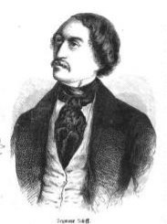
Charles Seymour Schiff, Jewish composer, improviser, touring virtuoso pianist, ca. 1820- d. 1860
Date of Birth and Birthplace unknown: Prussia?
Probably born ca. 1820
Jewish father, English (Jewish?) mother
Student of Hummel, Moscheles, BM/DM,Oxford
Concert repertoire includes works by Herz, Weber,
Thalberg, Chopin, Mendelssohn as well as his own c compositions – fantasies on operas, a Galoppe
Satanique.
Important presence of improvisations, usually on themes chosen from an urn by the audience
Best improviser since Mendelssohn
Colleagues in concert include H.W. Ernst (Jewish),
Servais
Presence of anti-Jewish rhetoric in notices in the press
At least eight compositions documented as having been published in Petersburg, Riga, and Kiev. I have only located one surviving score – a song in Russian.

Slide 19
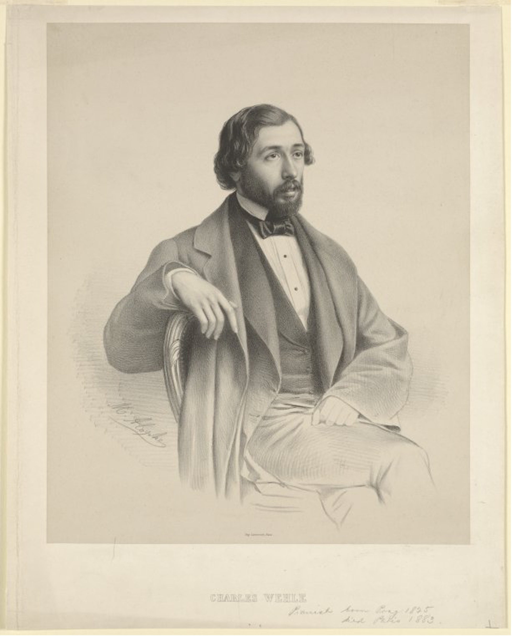
Charles Wehle, 1825-1883
Born to a family active in commerce in Prague; studies music with Proksch.
Starts a business career in London 1848; then study in Leipzig with Richter and Moscheles, in Berlin with Kullak.
Moves to Paris, 1852.
Tours to Portugal, Ireland, Berlin
Königsberg, Poznan, Riga, Estonia
Petersburg, Moscow
Two tours to the far East – 1863-1864,
1870-1871, each of them the subject of extensive travel journals published in Signale
Published compositions through op. 100, including two grand sonatas for piano solo
Listen: https://youtu.be/y3vNKtPPDvY

Slide 20
Bernard Rie (1838-1910)
Parents: David Israel Rie (b. 1805) and Lotti Sobotka. Father in the leather business. Grandfather and great-grandfather, butchers. Brother Isidor: gem merchant.
Studied piano with Joseph Kisch. Later study with Alexander Dreyschock.
Concert tour to Germany: Leipzig, Berlin, Rostock, Hamburg.
Study of composition.
Moves to Paris, 1859. Settles there permanently.

Slide 21
Bernard Rie, critical appraisal
(age twelve) : “the achievements of the small Beny Rie, poor in years, but as it appears, rich in talent, in his performance of the piano concerto of Sterndale Bennet were, for his youth, so excellent, that could only join unanimously with the cheering applause of the enthusiastic public
(age seventeen): “The Rostocker Zeitung praises, with the warmest words, the accomplished and dignified performance of the scarcely-seventeen-year old pianist. About the Mendelssohn Concerto in G minor, which Mr. Rie played, it is said that it has not been since Dreyschock that it has been heard with such virtuosity and tender nuance. ”
(age nineteen): “that which made this young virtuoso win unanimous support were two of his compositions, the Chant de la fileuse and the Aubade. He spoke these two little pieces with a delicacy, an infinite charm, and new and piquant effects.”
Continues to perform and compose in Paris until at least 1894. Published works through op. 46.

