Slide 1
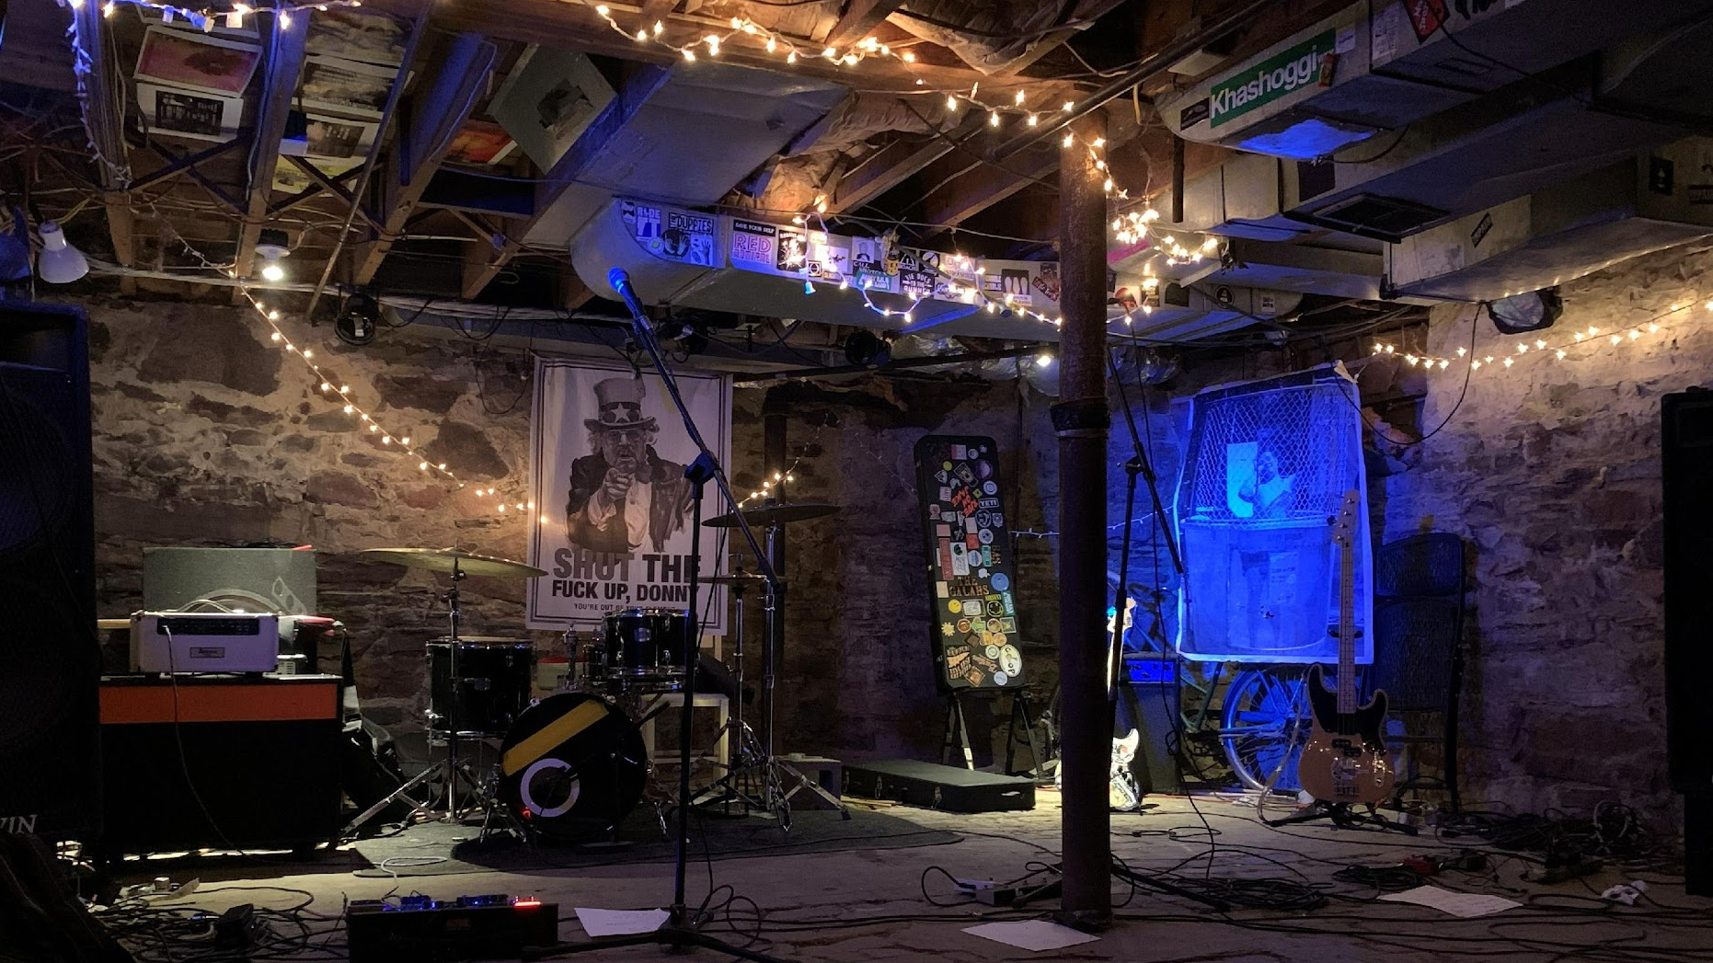



“I’D RATHER STAY FOREVER”
Lauren Posklensky
MLIS, Simmons University
Posklensky@Simmons.edu
On the Intersection of Punk Ethos and Radical Archival Practice in New England

Slide 2
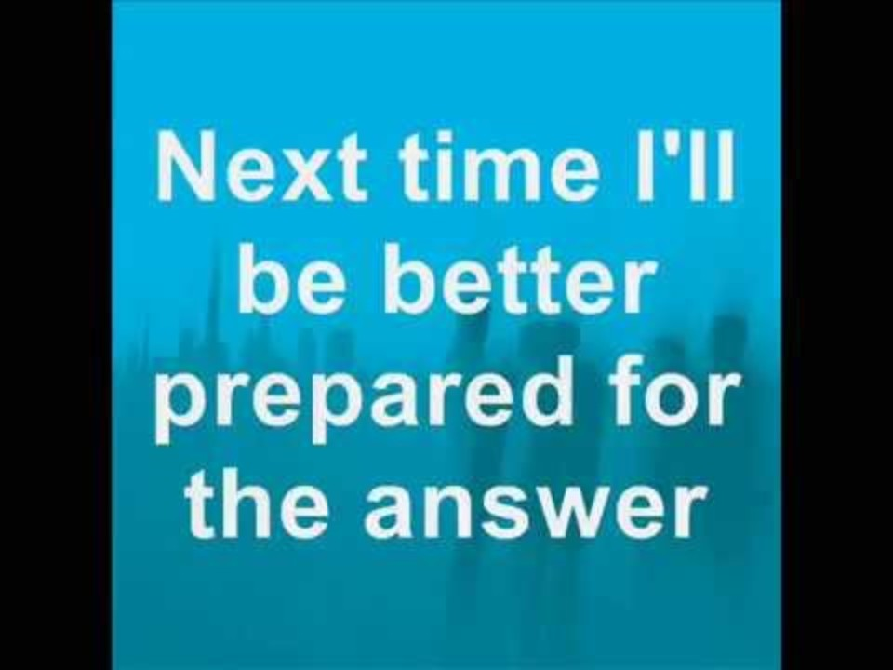
Let’s start with a song!
“Just Exist”
Touché Amoré
Is Survived By
Péter Bodnár. (2015, March 31). Touché Amoré—Just Exist (lyrics).

Slide 3

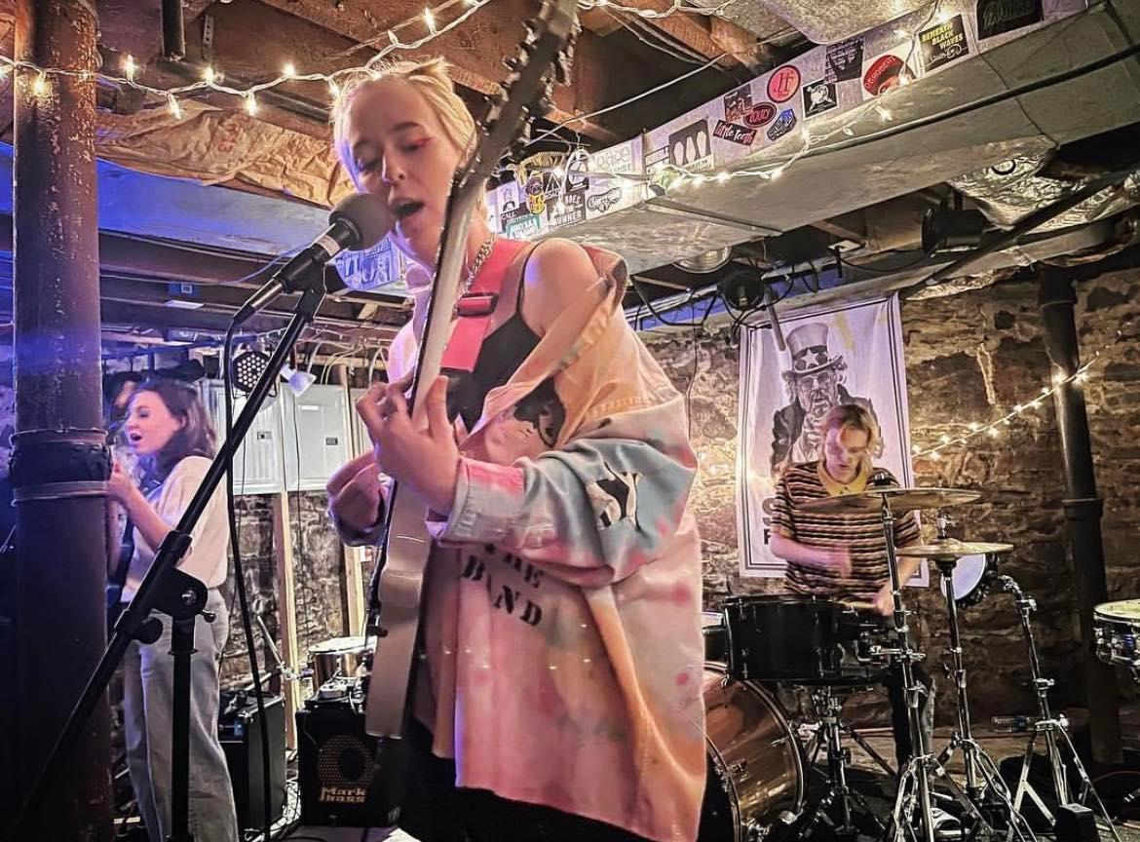
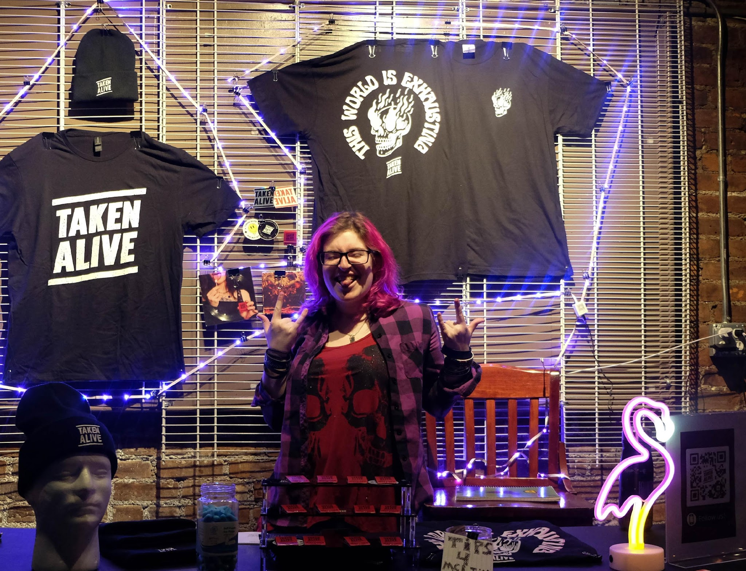
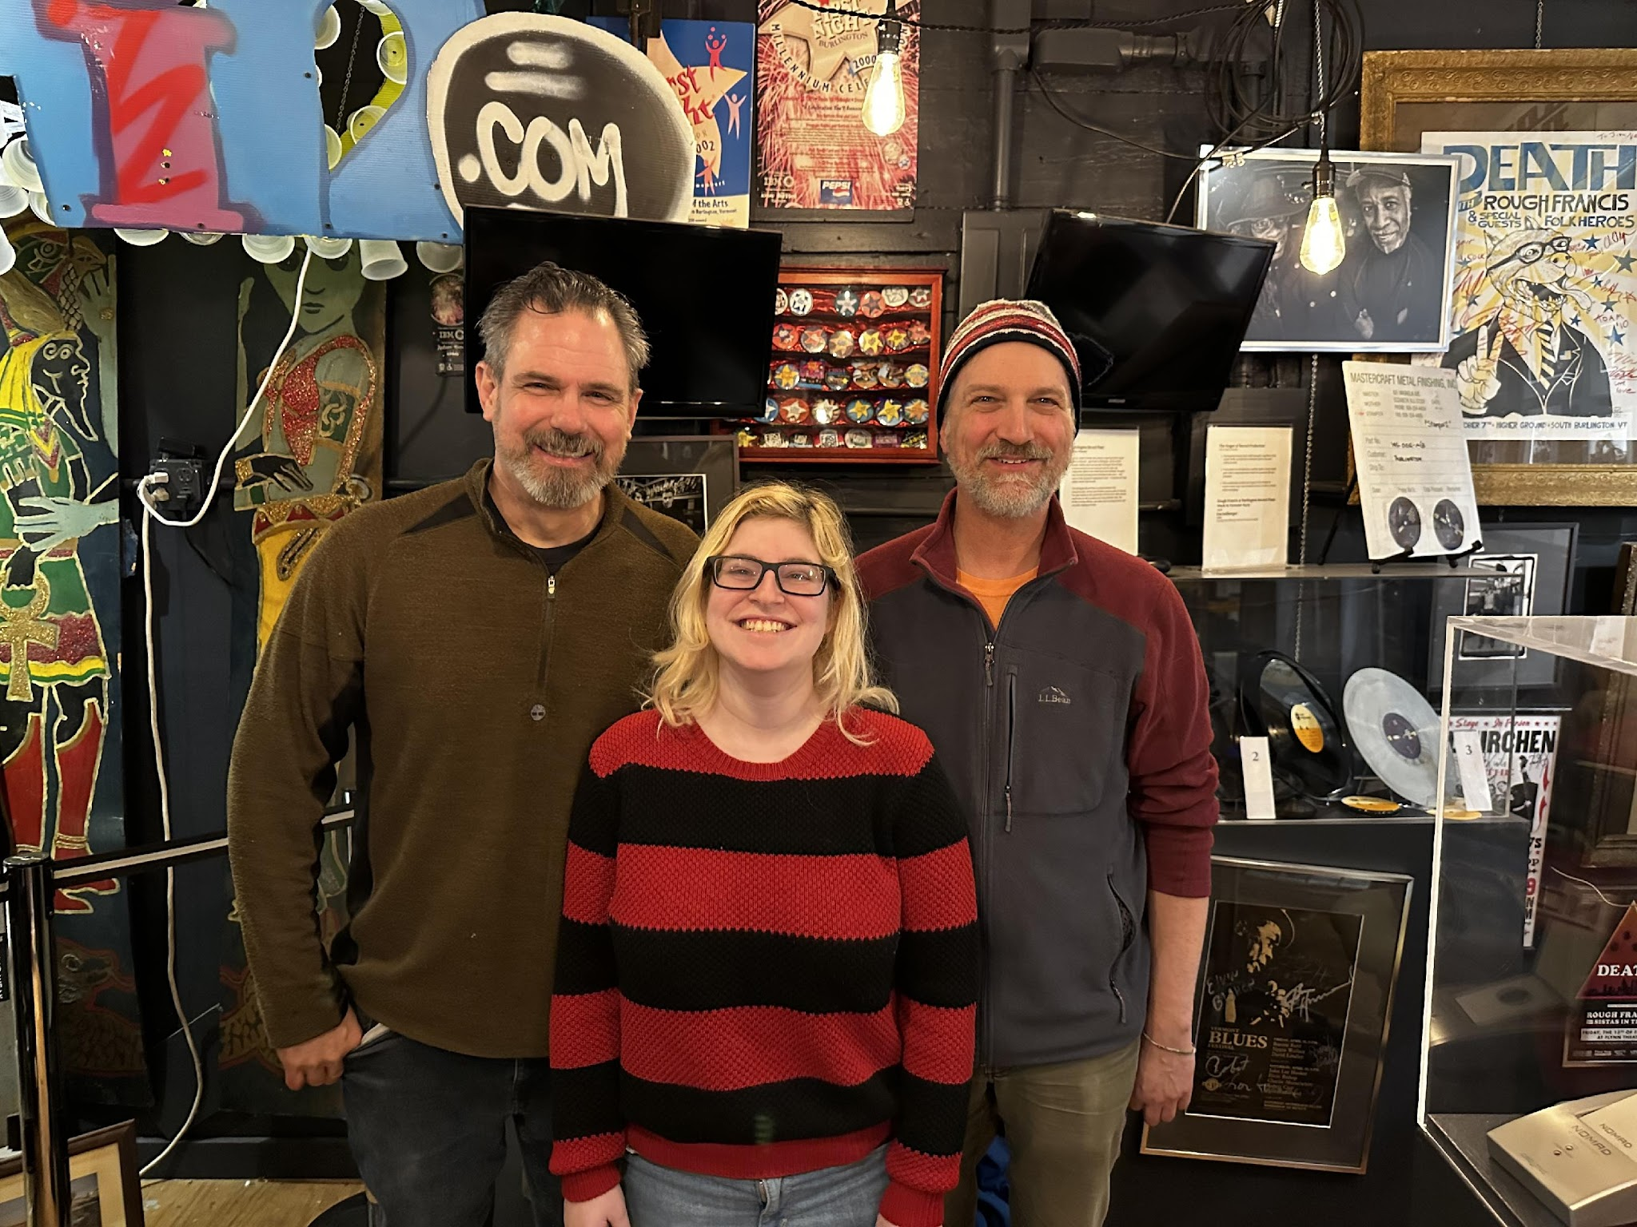

BACKGROUND
VERMONT DIY SCENE AND BIGHEAVYWORLD
The Burly Girls, Jim’s Basement
Taken Alive, Brighton Music Hall
Jim Lockridge, Lauren Posklensky, and Bob Coluquhoun, BigHeavyWorld Museum

Slide 4
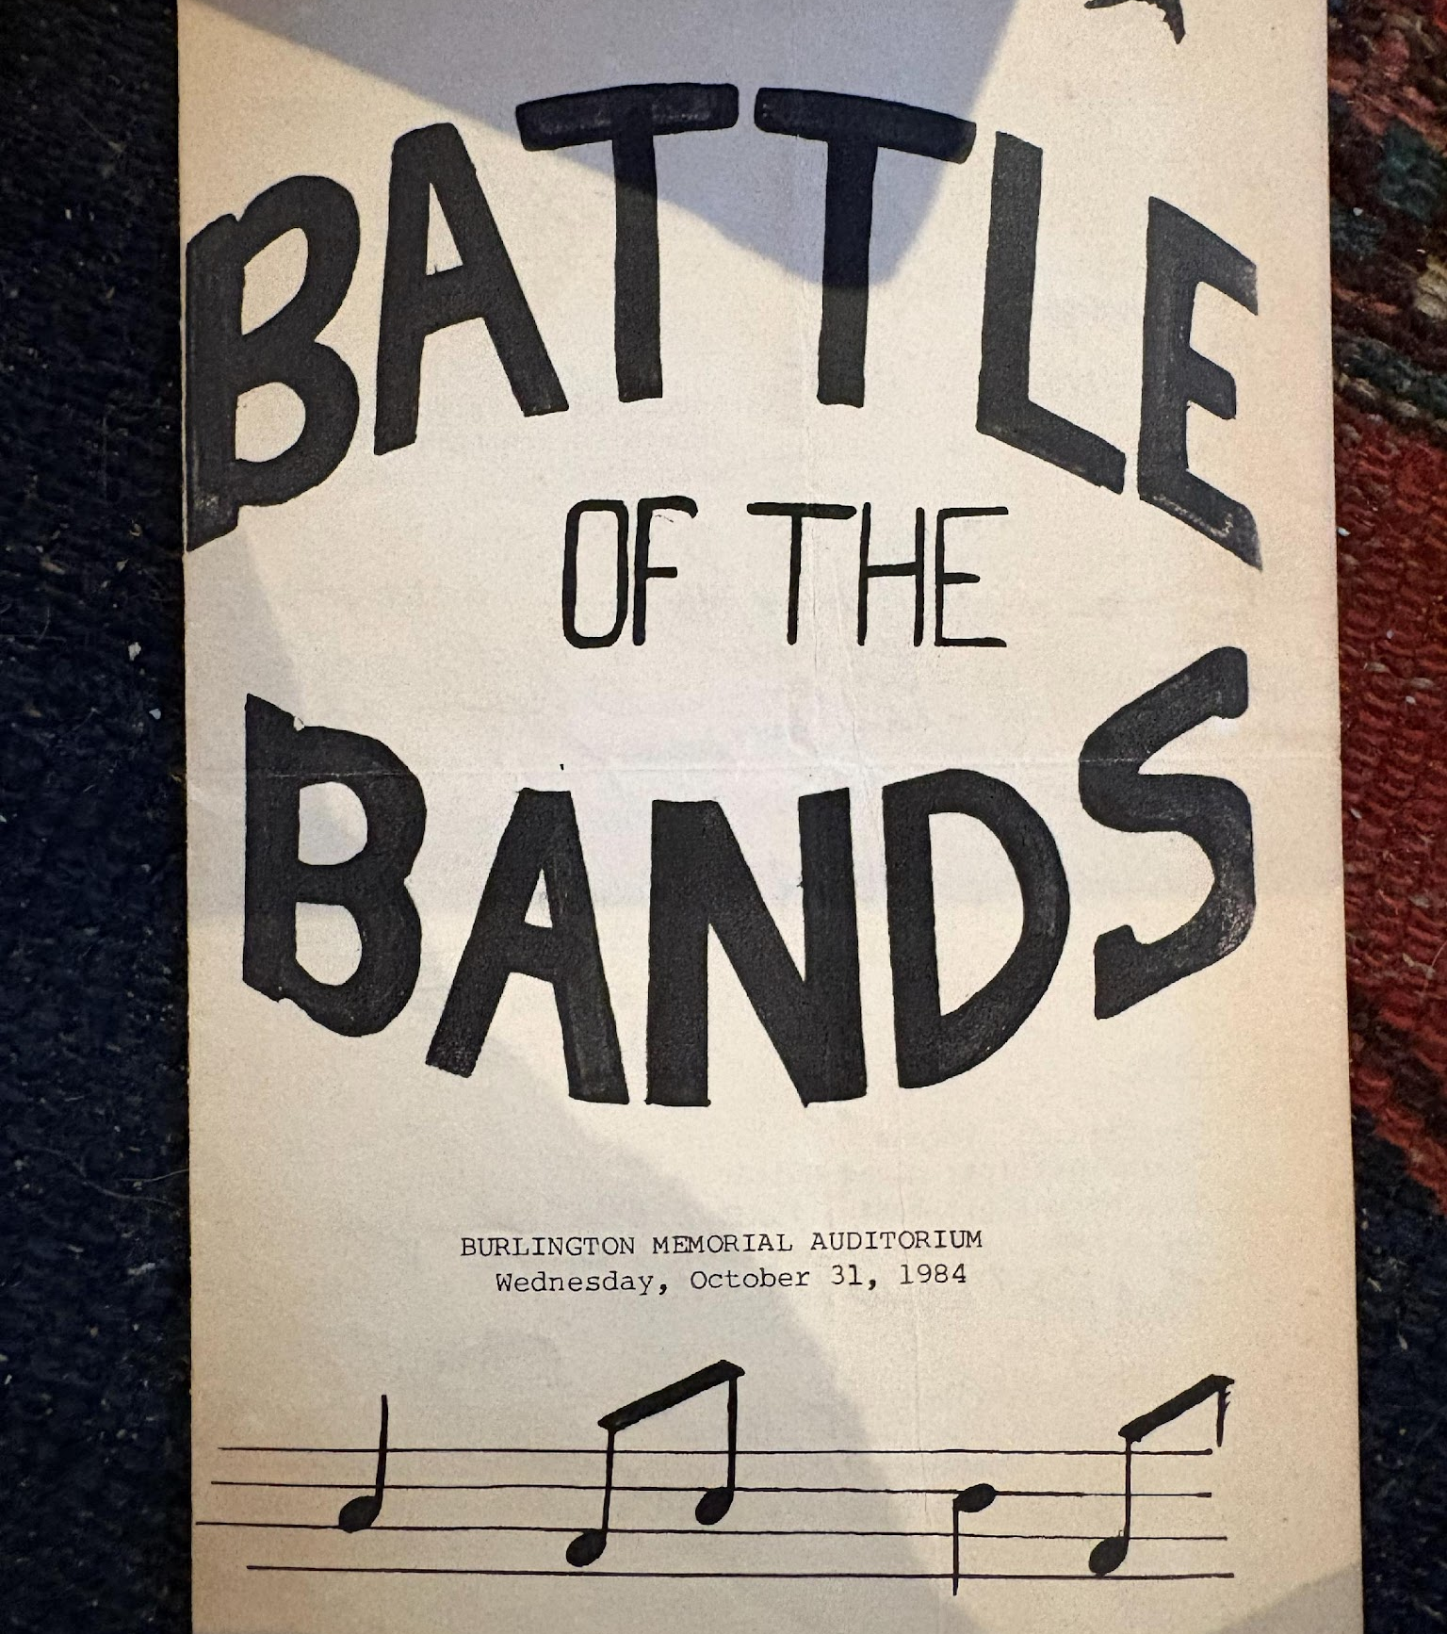
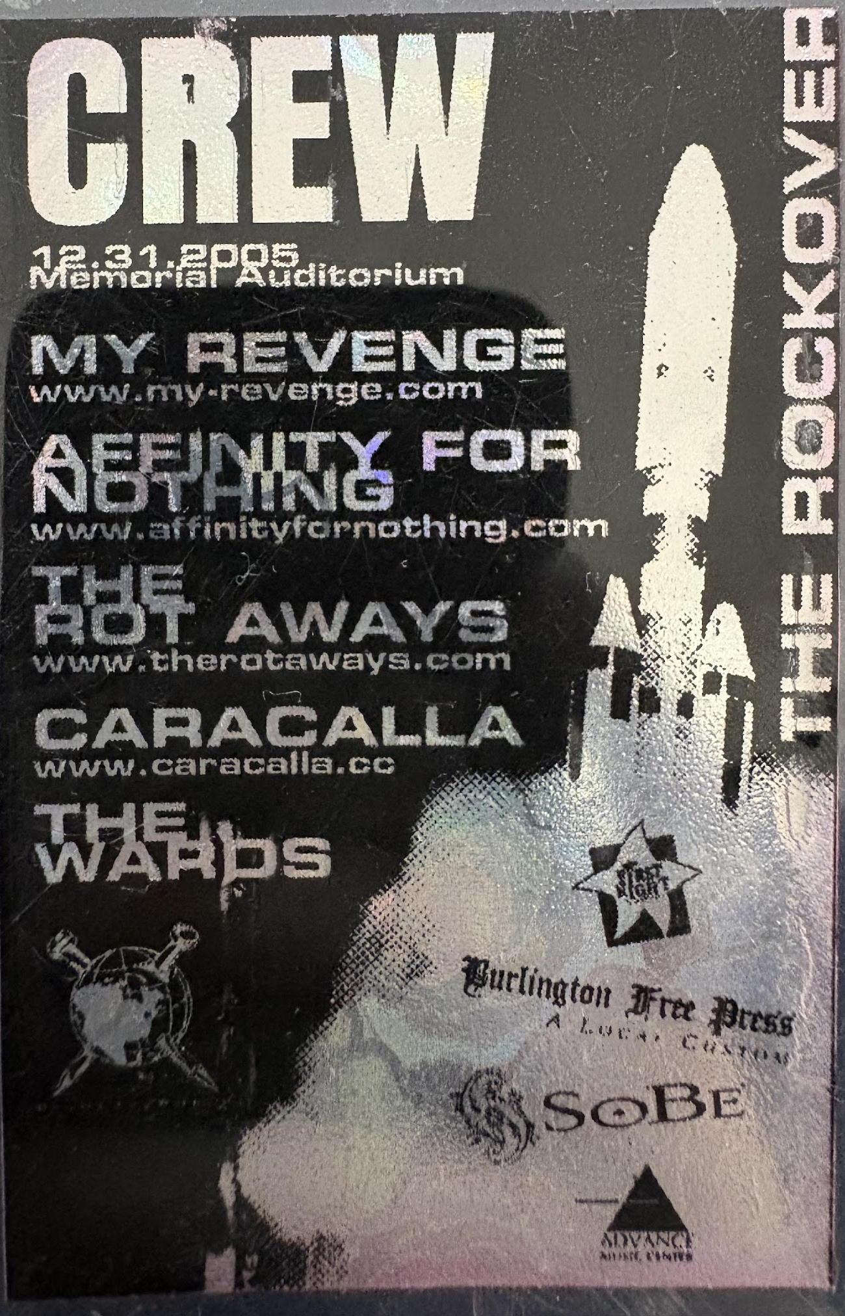
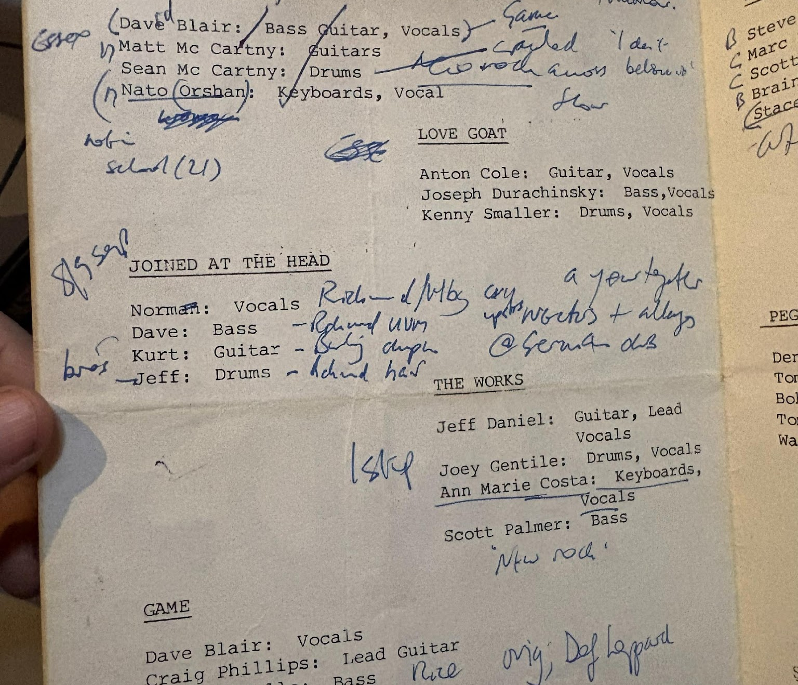
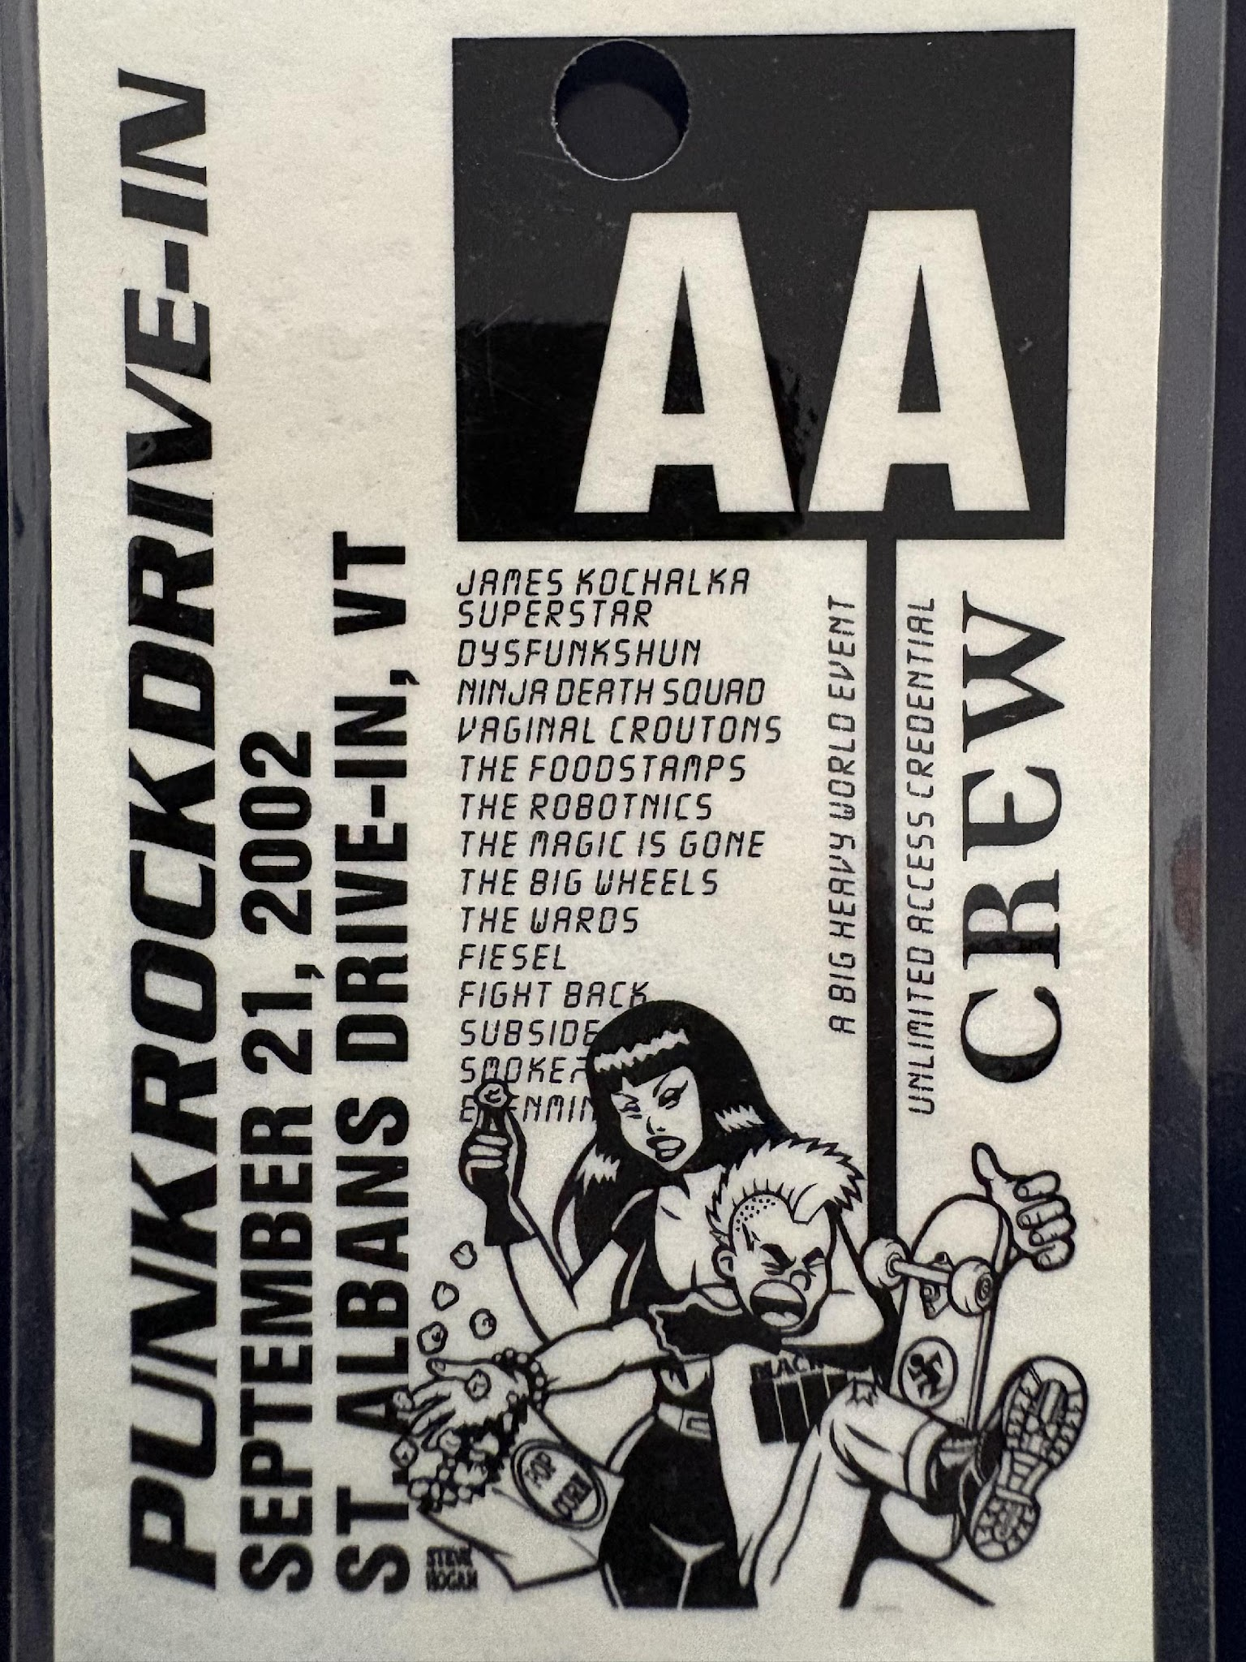
DIY/PUNK EPHEMERA
Booklets, brochures, zines
Backstage passes
Stage plots
Set lists
Monthly schedule postcards
Stickers and pins
Posters and flyers
Letters
Calls to action

Slide 5
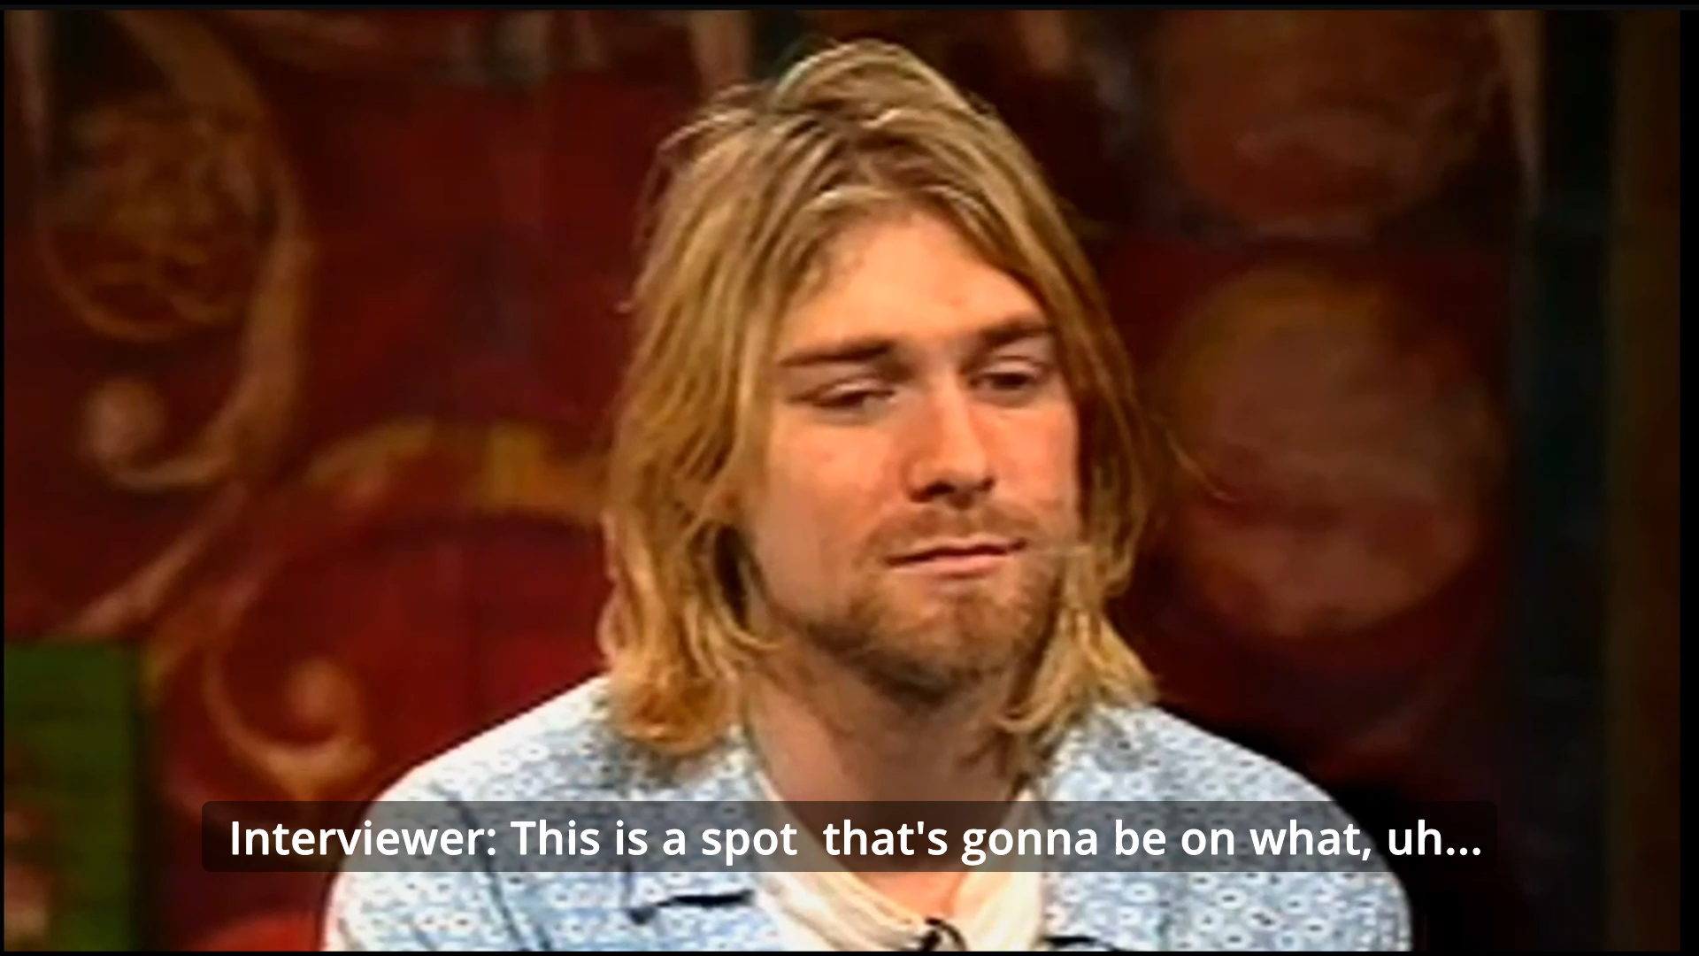
INITIAL RESEARCH “WHERE THERE ONCE WAS A RIOT” LITERATURE REVIEW
MTV Interview with Nirvana, September 24, 1993
JustNirvana. (2021).
Museum of Pop Culture, “Nirvana: Taking Punk to the Masses”:
$30+

Slide 6
DO ARCHIVES HONOR PUNK IDEOLOGY?
Do-It-Yourself Music Archives: A Response and Alternative to Mainstream Exclusivity. (Cuk, 2021)
Queering the Community Music Archive. (Cantillion et al., 2017)
Coming to Terms: Lessons and Challenges for Community Audio Archiving. (Vancour, 2023)
Self-sustainability
Low budget
Maintain authority
Autonomy
Self-determination
Distrust of institutions
Resources
Visibility
Context of collection

Slide 7
COMMUNITY ARCHIVES
“…capturing voices and interests beyond the commercial mainstream.”
Coming to Terms: Lessons and Challenges for Community Audio Archiving. (Vancour, 2023)
“…a community-based approach…characterized by centering the interests, needs and well-being of a community.”
‘A process where we’re all at the table’: community archives challenging dominant modes of archival practice. (Zavala et al., 2017)
“…full autonomy from authorized heritage institutions…made up of collections of artifacts assembled predominantly by members of the community.”
Do-it-yourself institutions of popular music heritage: the preservation of music’s material past in community archives, museums and halls of fame. (Baker, 2016)

Slide 8
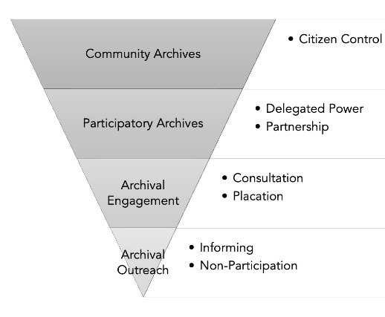
THE CONTINUUM OF COMMUNITY-ENGAGE ARCHIVAL PRAXIS (MATTOCK AND BETTINE, 2023)
“…a multifaceted definition that recognizes the power and authority of the community in the establishment and control of community archives: 1) the archival impulse originates from within the community, 2) the community retains ownership of the archives, and 3) the community maintains control over the preservation, access, and management of the collection”
Situating Community Archives Along the Continuum of Community-Engaged Archival Praxis: Autonomy, Independence, and the Archival Impulse. (Mattock and Bettine, 2023)

Slide 9
PUNKPEDAGOGY.COM AND ZINE ARCHIVES
01 | The scope of “punk”
02 | Zines as a mode of affection and communication
03 | The intention of a zine
04 | Responsibility to community
05 | Punk’s not dead
Archiving Punk Zines (Grinnell et al., 2018). Including contributions from George Grinnell, Francesca Gimson, Britt MacKenzie-Dale, Anne Claret, Lea Rose Sebastianis, K.G., and Stephanie Erickson.

Slide 10
CREATING A PUNK ZINE ARCHIVE
WHO AM I WITHIN THE COMMUNITY?
Resource light
  Digital
  Post-custodial
  Work with institutions
Community-led and defined
  Participatory
  Encourage individual meaning
  Transparency
Flexible scope
  What is “punk”?
  What is “the scene”?
  What is a “zine”?
Regional
  Focus on communities and relationships
Format
  Opt-in rather than opt out
  Emphasize Wiki or directory format
Responsibility to Community
  Access to non-professionals
  Link to creators and community
  Mutual aid and shows

Slide 11
STRUCTURAL PARAMETERS
Metadata | xZINECOREx (DublinCore based system created by the Queer Zine Archive Project)
Subject Analysis | Zine Thesaurus (Created by the Anchor Archive Thesaurus Management Collective)
Search/Browse | Survey priorities of users—region, subject, time period, access, random, favorites, RSS/social media feed
Centralized Objects | No account needed to view; multiple users able to add information, with edits attributed to them (inspired by ConcertArchives.org)
Resources | Collections Policy, Zotero/Libguide, planning documents Links to Punk Pedagogy, Anchor Archive Zine Library, MassFlyerArchive, DoDIY

Slide 12
KEY CASE STUDIES
DC Hardcore Archive
Punk Rock Museum
DoDIY.org
People’s Archive, DCPL
Participatory
Regular shows and workshops
Open submissions
Regular contributions by people involved
Generally single person effort
Resources and mutual aid
Regular outreach
Queer Zine Archive Project
University of Maryland Zine Collections
Flexible framework
Zine-specific resources
Blog
Similar “in-between” position
Rethink standard archival practices to establish trust and connections

Slide 13

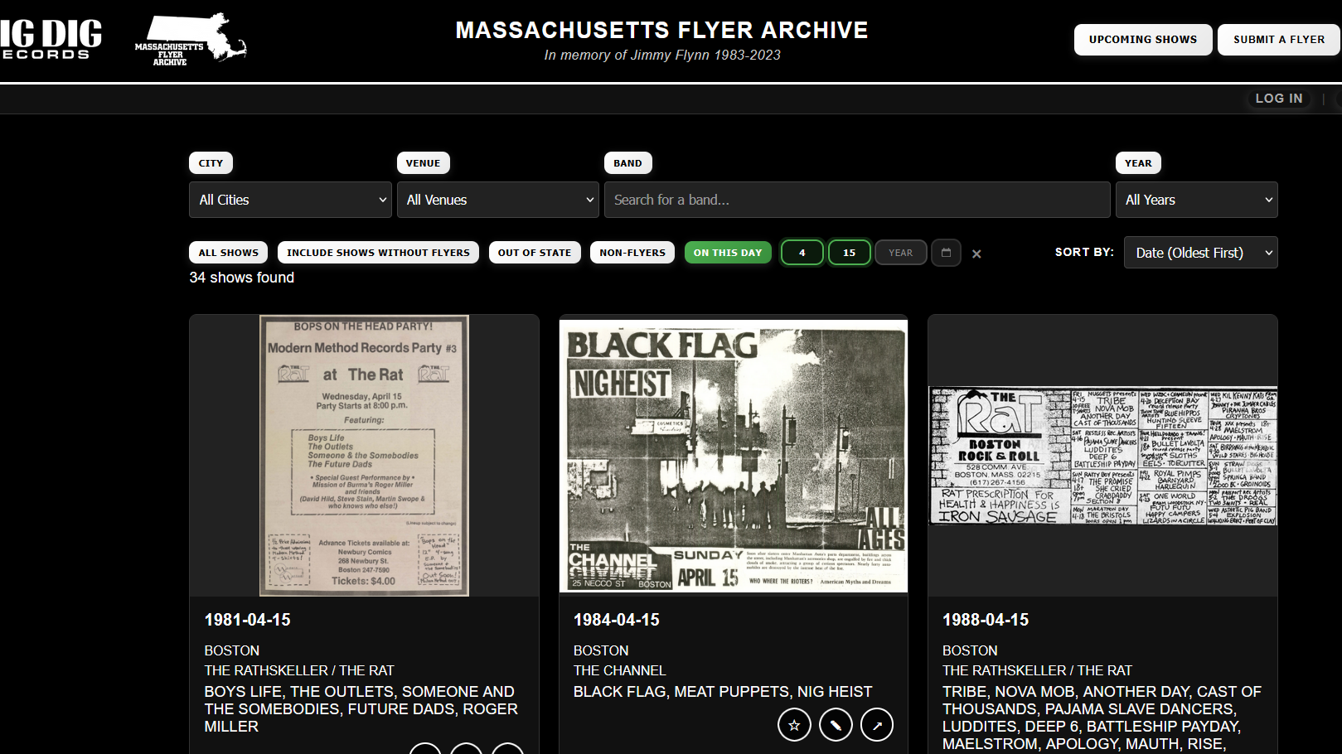
MASSACHUSETTS FLYER ARCHIVE

Slide 14
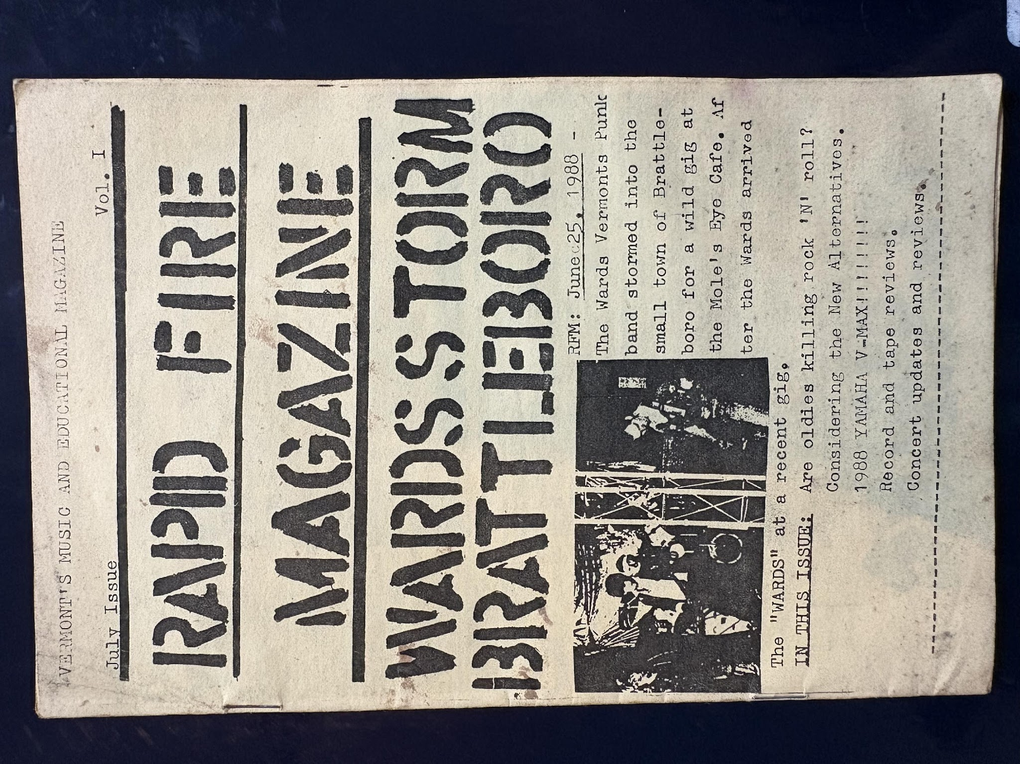
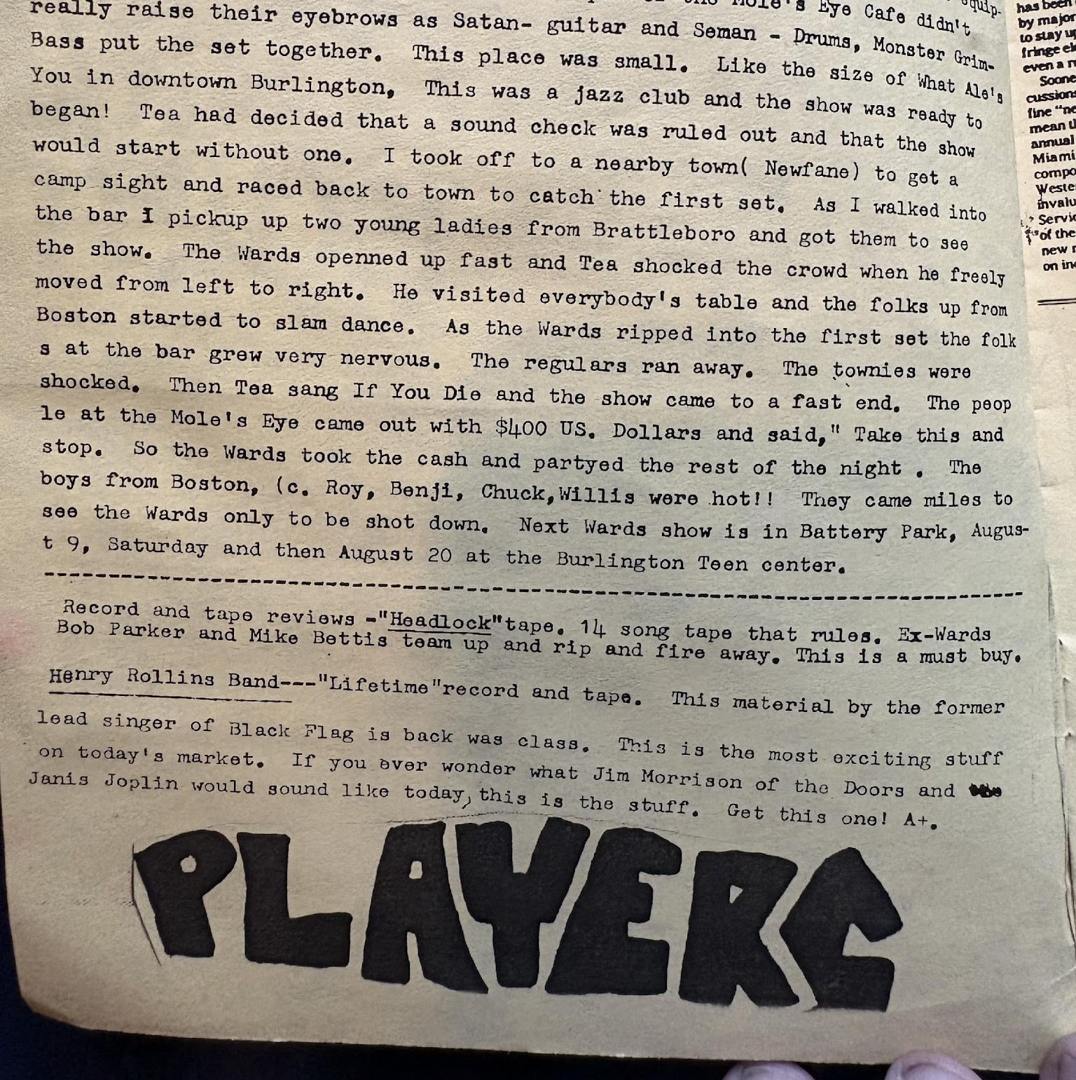
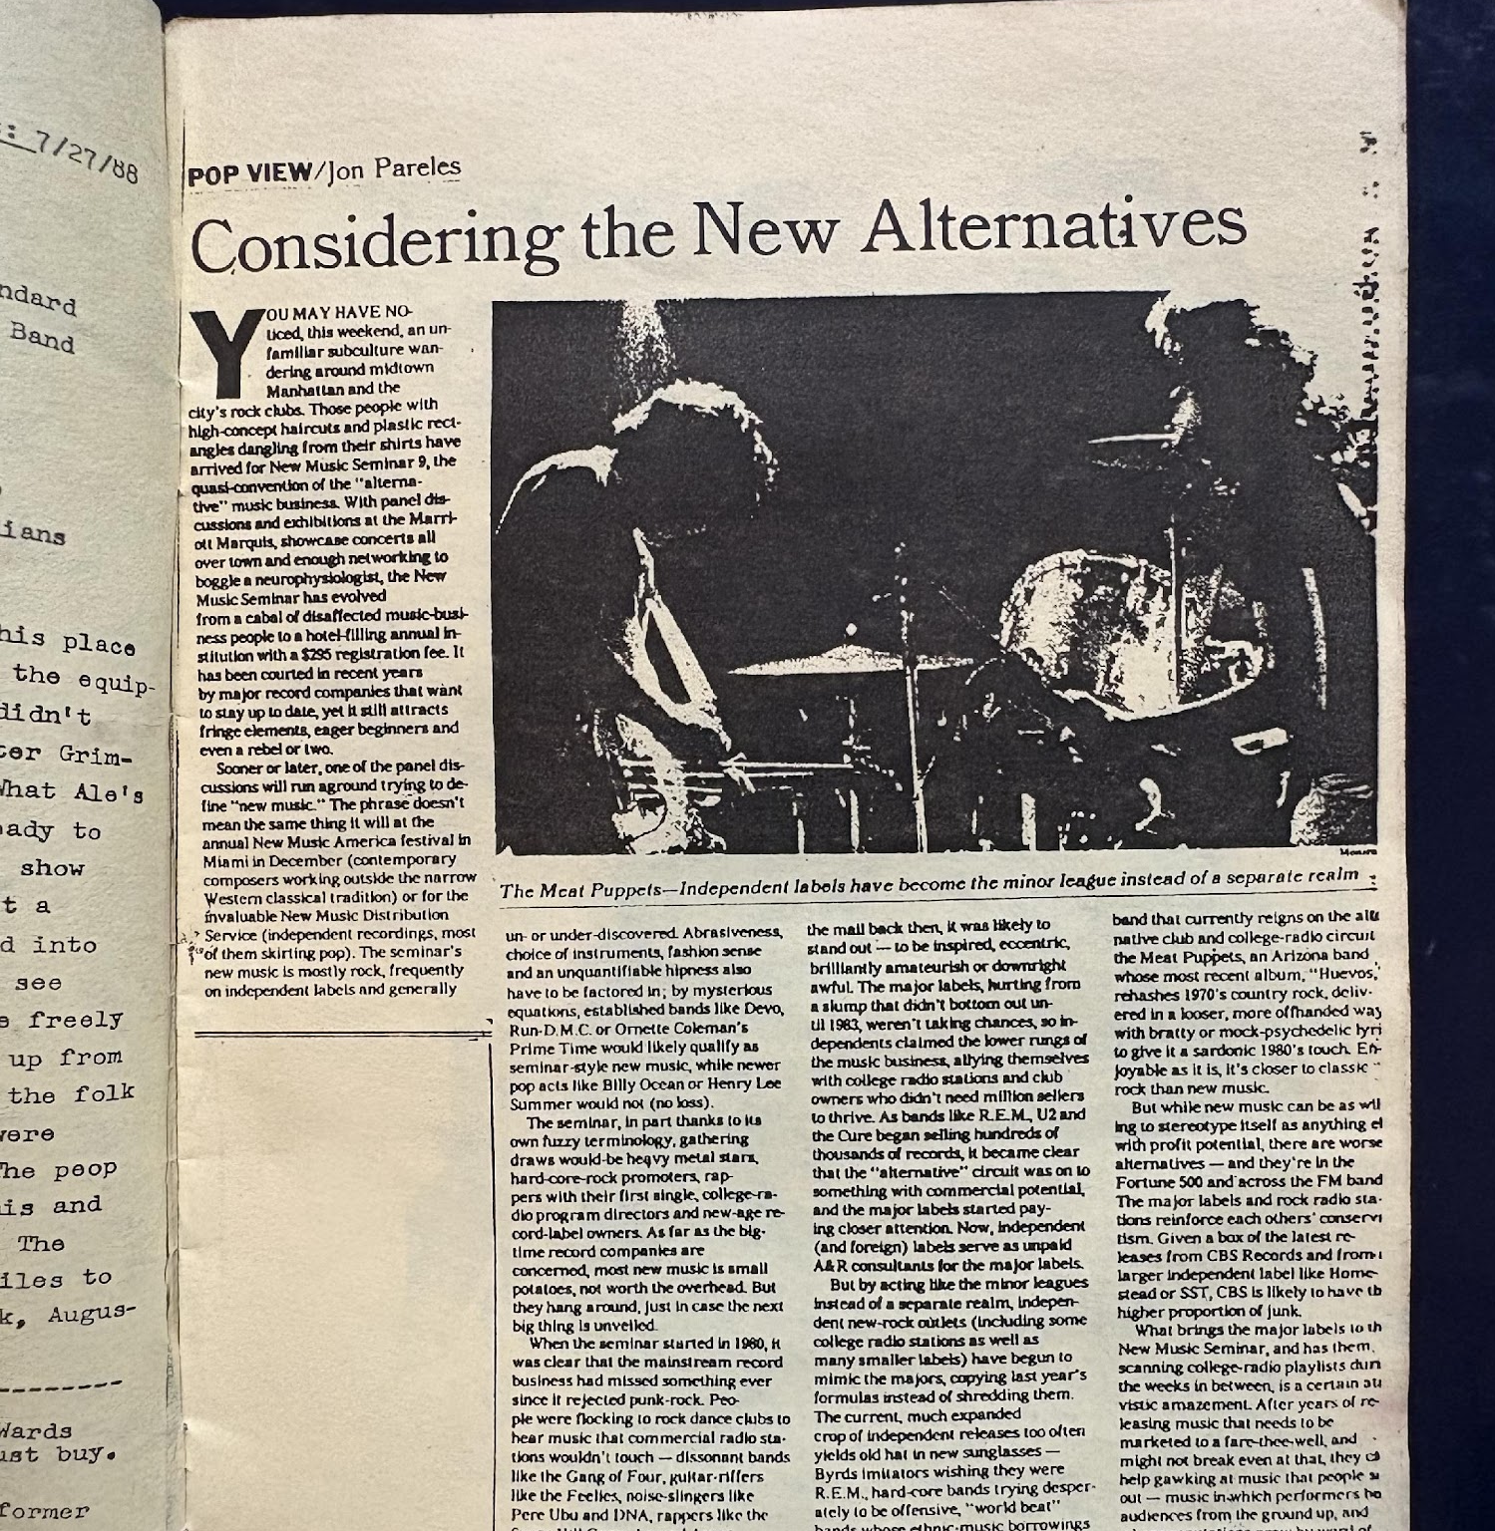
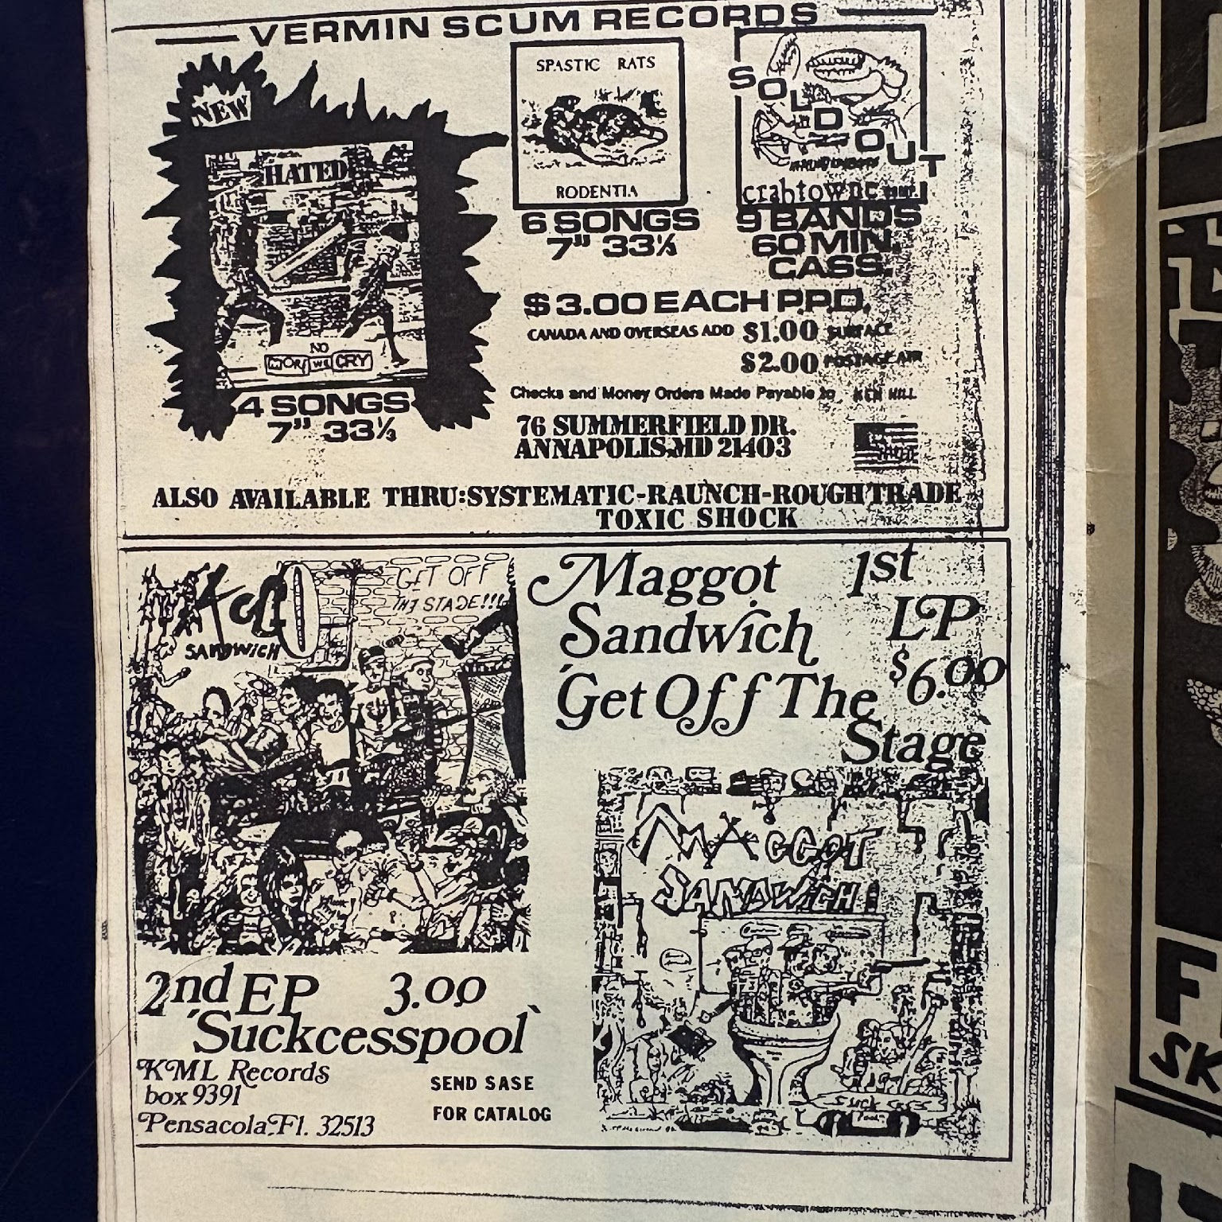
RAPID FIRE MAGAZINE, 1988

Slide 15
WHAT COMES NEXT?
Lauren Posklensky
MLIS, Simmons University
Posklensky@Simmons.edu
Lots of coding and web design!
Contact and consult community members, case studies
Find partners

Slide 16
WORKS CITED
A, P. (1988, July). Rapid Fire Magazine. 1(1).
admin. (n.d.). About Us. The Music Museum of New England. Retrieved December 13, 2025, from https://www.mmone.org/about-us/
APPLE, H. (2021). “I Can’t Wait for You to Die”: A Community Archives Critique. Archivaria, (92), 110–137.
Baker, S. (2016). Do-it-yourself institutions of popular music heritage: The preservation of music’s material past in community archives, museums and halls of fame. Archives & Records, 37(2), 170–187. https://doi.org/10.1080/23257962.2015.1106933
Baker, S., & Cantillon, Z. (2022). Zines as community archive. Archival Science, 22(4), 539–561. https://doi.org/10.1007/s10502-022-09388-1
Barker, R. (2020). A Community Shapes a Collection: The Punk Archive at the Washington, DC Public Library. ARSC Journal, 51(2), 203–209.
BRILMYER, G., GABIOLA, J., ZAVALA, J., & CASWELL, M. (2019). Reciprocal Archival Imaginaries: The Shifting Boundaries of “Community” in Community Archives. Archivaria, (88), 6–48.
Cantillon, Z., Baker, S., & Buttigieg, B. (2017). Queering the Community Music Archive. Australian Feminist Studies, 32(91/92), 41–57. https://doi.org/10.1080/08164649.2017.1357004
Caswell, M. (2014). Community-Centered Collecting: Finding Out What Communities Want from Community Archives. Proceedings of the Association for Information Science & Technology, 51(1), 111–118. (115302940). https://doi.org/10.1002/meet.2014.14505101027
Caswell, M., Cifor, M., & Ramirez, M. H. (2016). “To Suddenly Discover Yourself Existing”: Uncovering the Impact of Community Archives. American Archivist, 79(1), 56–81. https://doi.org/10.17723/0360-9081.79.1.56
Code of Ethics | zinelibraries.info. (n.d.). Retrieved December 13, 2025, from https://www.zinelibraries.info/code-of-ethics/
Collection: New Jersey Regional Zine Collection | Archives and Special Collections at Rutgers. (n.d.). Retrieved December 13, 2025, from https://archives.libraries.rutgers.edu/repositories/11/resources/401
Concert Archives—The concert database for fans, by fans. (n.d.). Retrieved December 13, 2025, from https://www.concertarchives.org/?lang=en
Cornell University Hip Hop Collection. (n.d.). Retrieved December 13, 2025, from https://rmc.library.cornell.edu/hiphop/
Cuk, S. (2021). Do-It-Yourself Music Archives: A Response and Alternative to Mainstream Exclusivity. Serials Librarian, 81(2), 132–139. https://doi.org/10.1080/0361526X.2021.1910614
Davis, J. R., Grimmer, J. H., & Novara, V. J. (2023). Digitising the Ian MacKaye digital collection of punk fanzines at the University of Maryland. Journal of Digital Media
Management, 12(2), 176–186. (174817258). https://doi.org/10.69554/tzwz9696
DC Punk Archive Zine Library | Dig DC: The People’s Archive Digital Repository at DC Public Library. (n.d.). Retrieved December 13, 2025, from https://digdc.dclibrary.org/do/5a4fb481-be26-44bb-8bc4-077f3b28dfb3
JustNirvana. (2021, April 13). Nirvana discussing ticket prices [Video recording]. https://www.youtube.com/watch?v=X29p13cAT1g
Local / Independent Music Initiative of Texas (LIMIT)—University Libraries—UNT. (n.d.). Retrieved December 13, 2025, from https://library.unt.edu/music/local-independent-music-initiative-texas-limit/
Lutz, C. A., Maharjan, T., & Crawford, S. (2020). Going against the archival grain: Case studies of pop culture archives of a music scene, regional zines, and local beer. Archives & Records, 41(3), 254–273. (148164635). https://doi.org/10.1080/23257962.2020.1810005
Mattock, L. K., & Bettine, A. M. (2023). Situating Community Archives Along the Continuum of Community-Engaged Archival Praxis: Autonomy, Independence, and the Archival Impulse. Archival Issues: Journal of the Midwest Archives Conference, 42(1), 47–70. https://doi.org/10.31274/archivalissues.16294

Slide 17
WORKS CITED (CONTINUED)
Outhier, S. (2024). I’d Do Anything for Love: Engaging Local Music Communities to Preserve Texas Music. Music Reference Services Quarterly, 27(2), 73–90. (176495036). https://doi.org/10.1080/10588167.2024.2306082
Overview of Collections in The People’s Archive | District of Columbia Public Library. (n.d.). Retrieved December 13, 2025, from https://www.dclibrary.org/research-learn/overview-collections-peoples-archive
Péter Bodnár. (2015, March 31). Touché Amoré—Just Exist (lyrics) [Video recording]. https://www.youtube.com/watch?v=-MEq0AI1DhU
Punk Pedagogy. (n.d.). Punk Pedagogy. Retrieved December 4, 2025, from https://punkpedagogy.com/
Show Wrangling Guideline | Archive of Our Own. (n.d.). Retrieved December 13, 2025, from https://archiveofourown.org/wrangling_guidelines/2
THE NORTHWEST MUSIC ARCHIVES | THE NORTHWEST MUSIC ARCHIVES captures and presents data about our regional history of recorded music. Our team documents audio recordings …. (n.d.). Retrieved December 13, 2025, from https://nwmusicarchives.com/
Zavala, J., Migoni, A. A., Caswell, M., Geraci, N., & Cifor, M. (2017). ‘A process where we’re all at the table’: Community archives challenging dominant modes of archival practice. Archives & Manuscripts, 45(3), 202–215. https://doi.org/10.1080/01576895.2017.1377088
Zine Subject Thesaurus | Anchor Archive Zine Library. (n.d.). Retrieved October 28, 2025, from https://anchorarchive.org/index.php/subject-thesaurus
Zinelibraries.info | sharing zine library love and expertise. (n.d.). Retrieved December 4, 2025, from https://www.zinelibraries.info/
Unless otherwise specified photos and BigHeavyWorld collection materials are attributed to Lauren Posklensky

